Slide 1
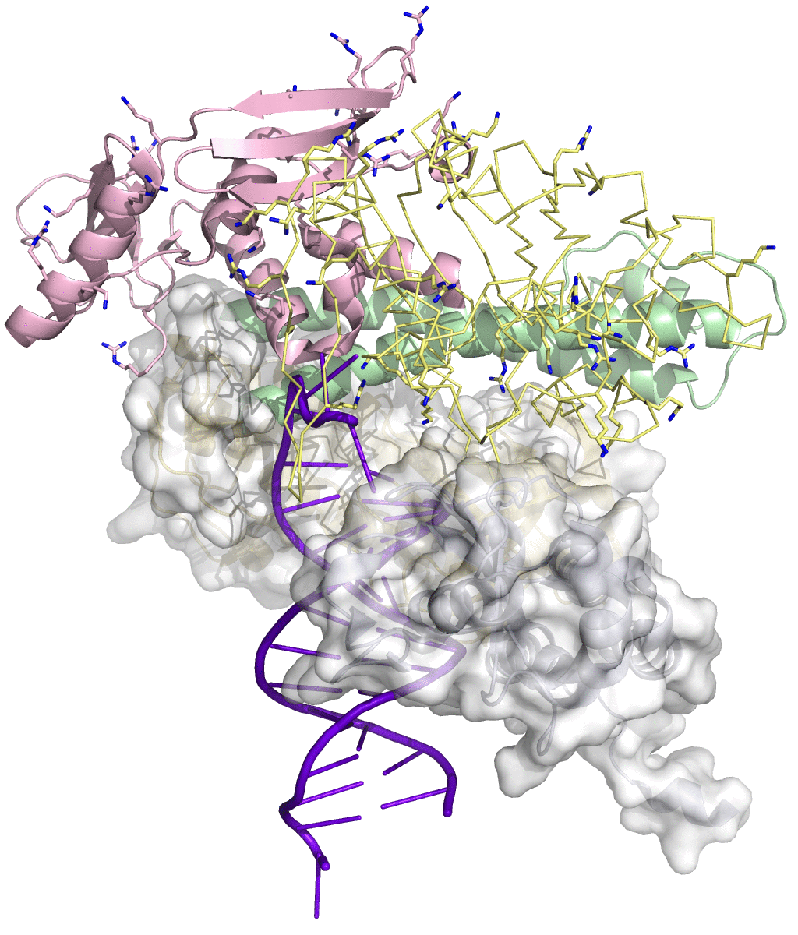

Movie S4. Motions of the N-terminal and exo domains. This movie shows that the motion of the Arg-Lys-rich groove, where the single-stranded template is anticipated to bind, corresponds to the swing of the fingers very well. Driven by this motion, the single-stranded template associated with the Arg-Lys-rich groove would translocate into the polymerase active site. See Fig. 9 for detail.

