Slide 1
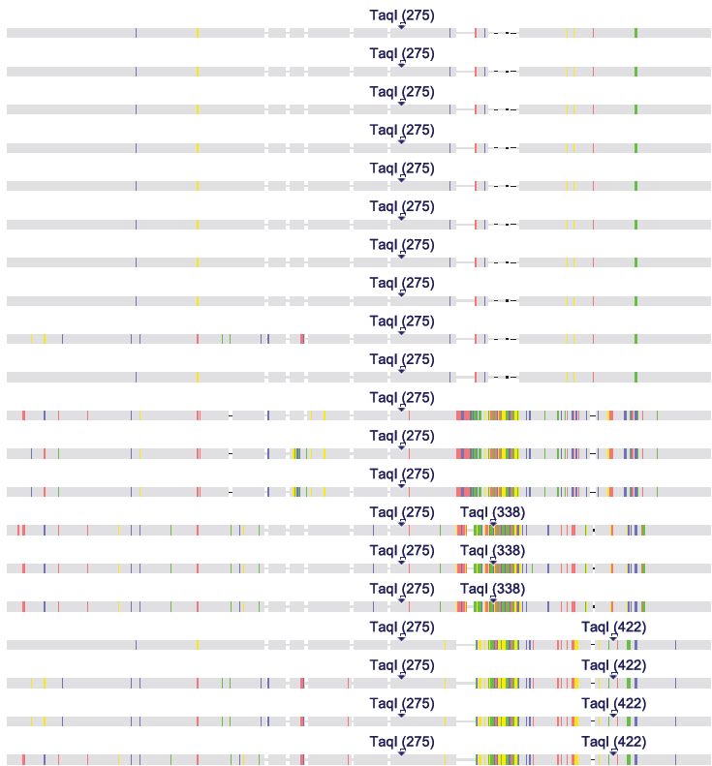
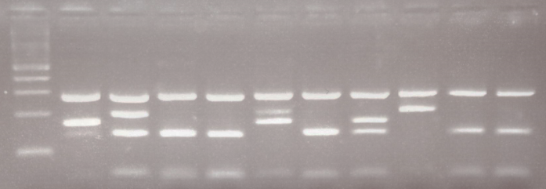
A
B
TaqI(275)
TaqI(275)
TaqI(275)
TaqI(275)
TaqI(275)
TaqI(275)
TaqI(275)
TaqI(275)
TaqI(275)
ALLELE B
TaqI(275)
TaqI(275)
TaqI(275)
TaqI(275)
TaqI(275) TaqI(338)
TaqI(275) TaqI(338)
ALLELE C
TaqI(275) TaqI(338)
TaqI(275) TaqI(422)
TaqI(275) TaqI(422)
ALLELE A
TaqI(275) TaqI(422)
TaqI(275) TaqI(422)
BA CA AA AA CB AA BA CC AA AA

