Slide 1
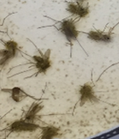
Supplementary Figure 2: Effects of A . nomius on another species of mosquitoes: Culex pipiens.
a- Survival of Culex mosquitoes after spraying the insects with a suspension of A. nomius spores is compared to that of mosquitoes sprayed with the same concentration of B. bassiana spores (red line). A. nomius was able to kill the mosquitoes at a very similar rate compared to B. bassiana.
b- Photo of Culex mosquitoes after they succumbed to A. nomius spore exposure. The dead insects are completely covered by fungal growth.
a
b

