Slide 1
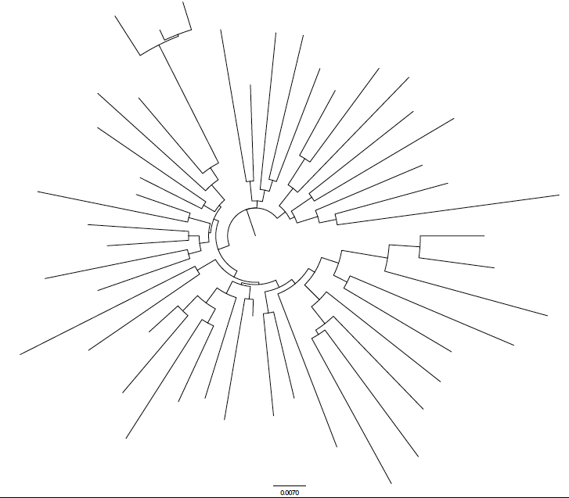
Fig 1
A
B
GM
b 1969
HLA-B*07:02/81:01
D2
b 10/2003
HLA-B*42:01/*81:01
D1
b 04/1987
HLA-B*81:01/81:01
C
GD
D2
GD
b 09/2003
GM
HLA-B*44:03/81:01
1
D
-7
p = 8.2 x 10
q = 0.0008
Consensus C
0.007
amino acid
substitutions / site
(n=192)
(n=1667)

Slide 2
Fig 2
A
NL4-3
B
SK-254
C
SK-254(M)
D
NL4-3
E
SK-254
F
SK-254(M)

Slide 3
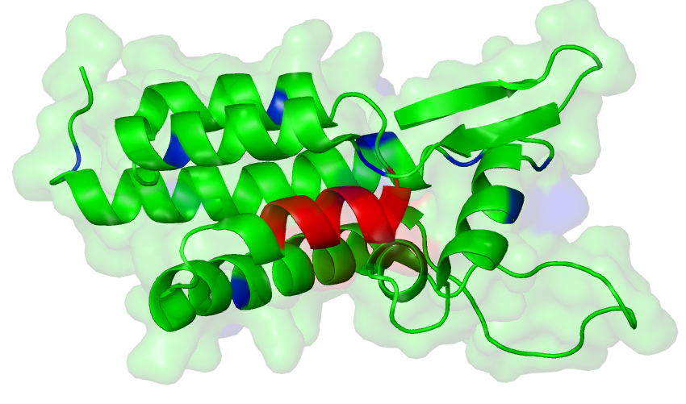
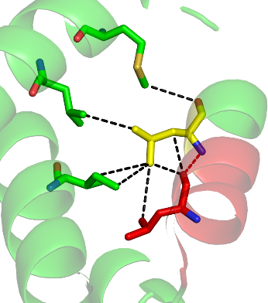
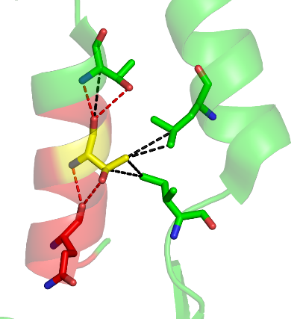
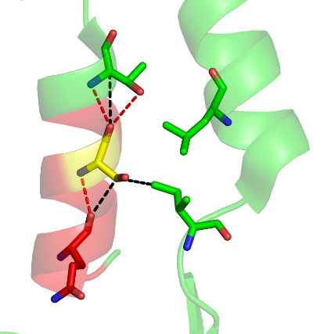
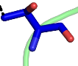
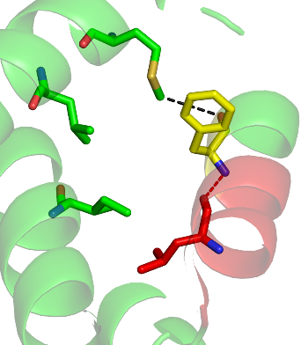
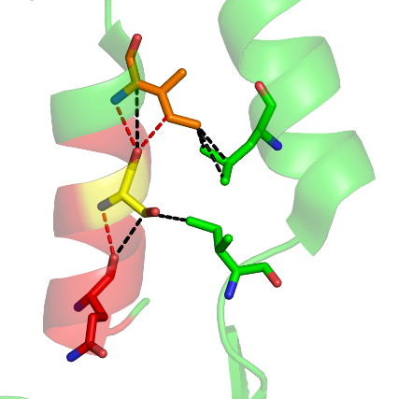
Fig 3
A
N-terminal
hairpin
¹³³ ¹⁴¹ ¹⁵¹
PIVQNLQG QMVHQAISPR TLNAWVKVVE
EKAFSPEVIP MFSALSEGAT PQDLNTMLNT
VGGHQAAMQM LKETINEEAA EWDRLHPVHA
GPIAPGQMRE PRGSDIAGTT STLQEQIGWM
THNPPIPVGE IYKRWIILGL NKIVRMYSPT
Helix 2
N-terminal hairpin
Helix-1
Helix 1
Helix-2
Helix-3
161 171 181
Helix-4
Helix 3
Cyclophilin
binding loop
191 201 211
Helix 7
Helix 6
Helix-5
Helix-6
221 231 241
Helix 4
Helix-7
251 261 271
B
201L
D
E
Helix 4
198M
Helix 1
Helix 1
266I
147I
147I/T
152L
152L
186T
186S
184L
188L
190T
182Q
190T
Helix 3
Helix 3
Helix 3
182Q
C
F
Helix 4
201L
198M
Helix 1
266I
152L
147I/T
188F
190I
184L
186S
182Q
Helix 3
Helix 3

