Slide 1
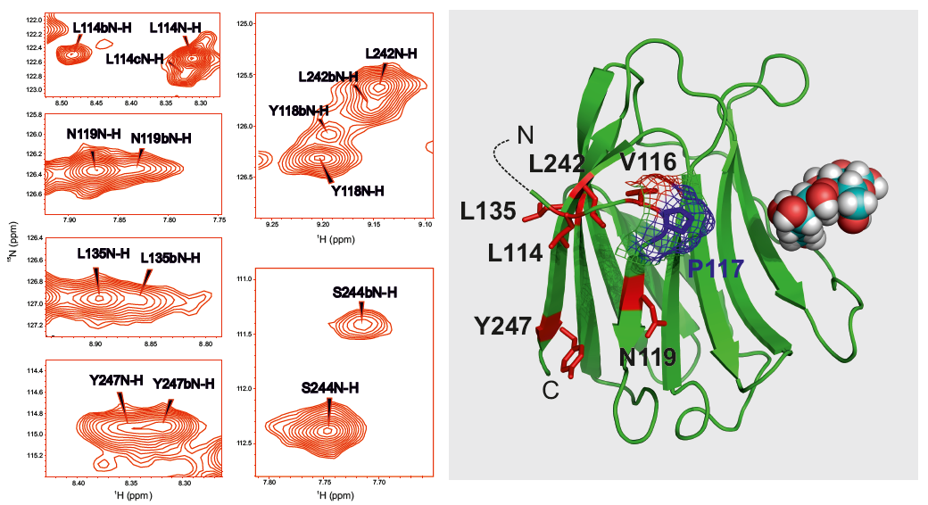
A
B
Supplemental Figure S1

