Slide 1
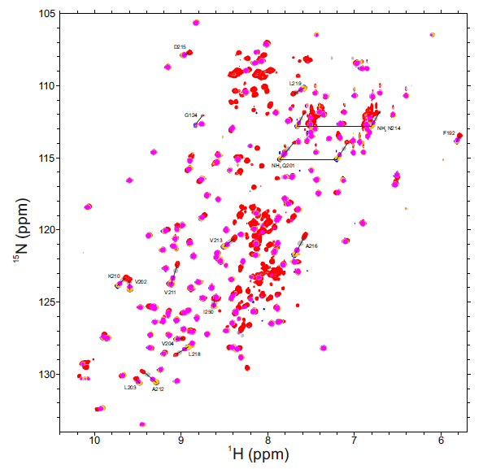
Supplemental Figure S2

