Slide 1
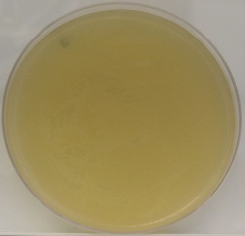
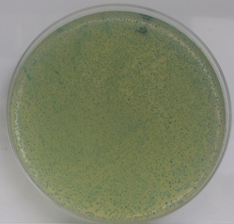
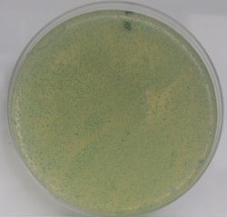
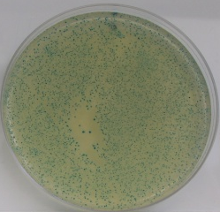
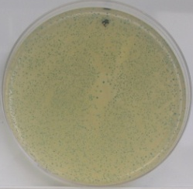
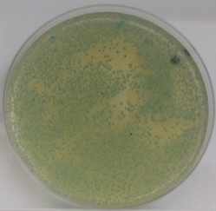
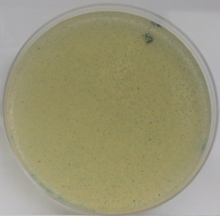
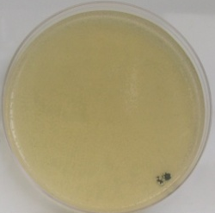
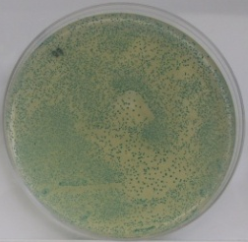
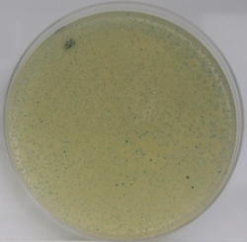
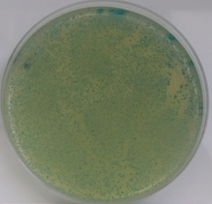
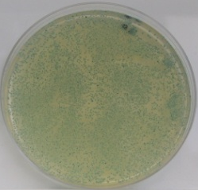
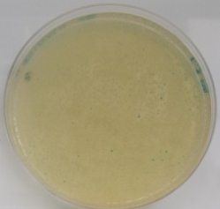
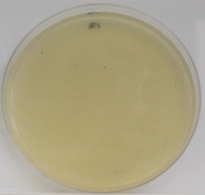
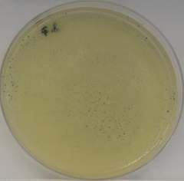
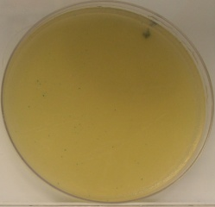
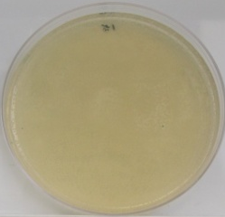
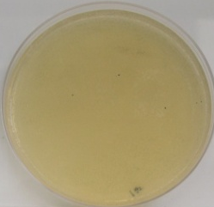
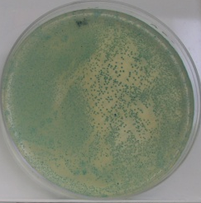
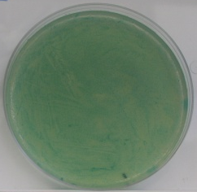
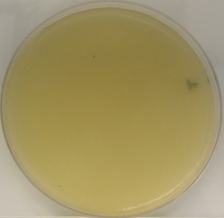
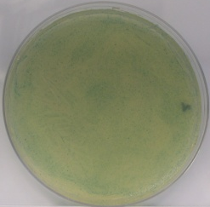
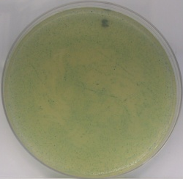
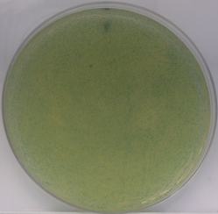
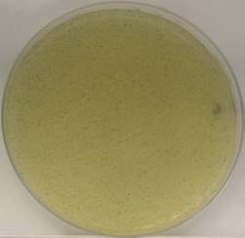
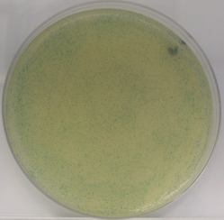
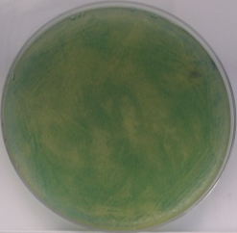
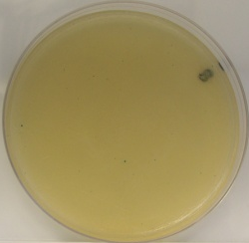
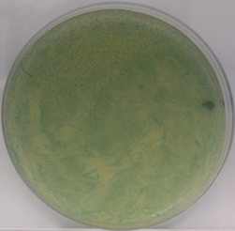
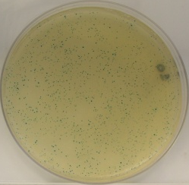
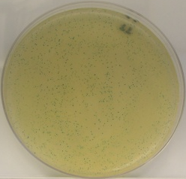
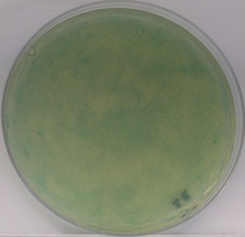

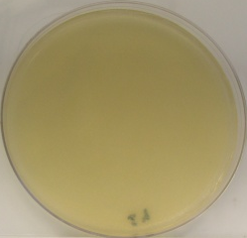
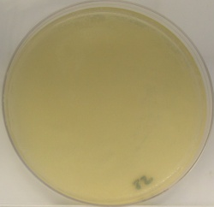
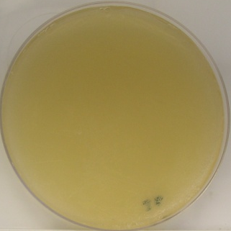

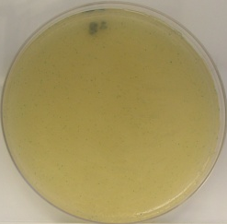
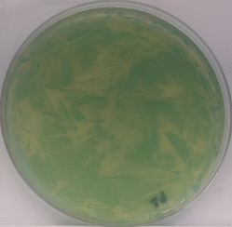
A.
B
Control (-)
ANR_{Vibrio}+AggR
ANR_{Vibrio}+CfaD
ANR_{Vibrio}+Rns
ANR_{Vibrio}+VirF
ANR_{Vibrio}+RegA
ANR_{Vibrio}+GadX
ANR_{Vibrio}+EnvY
ANR_{Vibrio}+GadW
ANR_{Vibrio}+HilD
ANR_{Vibrio}+HilC
ANR_{Vibrio}+ToxT
ANR_{Vibrio}+MelR
ANR_{Vibrio}+AraC
ANR_{Vibrio}+ChbR
ANR_{Vibrio}+EutR
ANR_{Vibrio}+InvF
ANR_{Vibrio}+MxiE
ANR_{Vibrio}+ ANR_{Vibrio}
Control (+)
Control (-)
Cnr2+AggR
Cnr2+CfaD
Cnr2+Rns
Cnr2+VirF
Cnr2+RegA
Cnr2+GadX
Cnr2+EnvY
Cnr2+GadW
Cnr2+HilD
Cnr2+HilC
Cnr2+ToxT
Cnr2+MelR
Cnr2+AraC
Cnr2+ChbR
Cnr2+EutR
Cnr2+InvF
Cnr2+MxiE
Control (+)
Fig S6. Anr_{Vibrio} and Cnr-2 interact with members of AraC/XylS family
Seventeen pKNT25 derivatives encoding AraC transcriptional activators were co-transformed with pUT18ANR_{Vibrio} (Panel A) or pUT18Cnr-2 (Panel B) into E. coli BTH101. The bacterial samples were plated on LB agar plates containing carbenicillin, kanamycin, X-Gal, and IPTG. Data are representative of three independent experiments. .

