Slide 1
Electronic supplementary material
Journal: Chromosoma
Title: Astonishing 35S rDNA diversity in the gymnosperm species Cycas revoluta Thunb
Authors: Wencai Wang, Lu Ma, Hannes Becher, Sònia Garcia, Alena Kovarikova, Ilia J. Leitch, Andrew R. Leitch and Ales Kovarik
Email: kovarik@ibp.cz

Slide 2
Suppl. Table 1. The Pi values calculated for each subregion from genomic (gDNA) and transcriptomic (cDNA) reads of C. revoluta
ªAnnotation of subregions is according to the C. revoluta 7097-bp cluster 4 contig that contained part of ETS and IGS at 5’and 3’end, respectively

Slide 3
Abies
Gnetum
Gymnosperm
Ginkgo
Cycas
Fritillaria
Angiosperm
Suppl. Fig. 1 Schematic diagram showing phylogenetic relationships between the studied species, as adapted from: Chaw SM, Aharkikh A, Sung HM, Lau TC, Li WH (1997) Molecular phylogeny of extant gymnosperms and seed plant evolution: analysis of nuclear 18S rRNA sequences. Molecular Biology and Evolution 14: 56–68.

Slide 4
a
V1 V2 V3 V4 V5 V6 V7
b
D1 D2 D3 D4 D5 D6 D7aD7b D8 D9 D10 D12
0.5 kb
Suppl. Fig. 2 Diagrams showing the structure of (a) 18S and (b) 26S rDNA coding regions of Cycas revoluta. (a) Region selected for bisulfite analysis (Fig. 2c) is indicated by a blue bar. (b) Blue double-headed arrow line indicates the region used for amplification of cDNA sequences (Fig. 6). Green bars (a+b) indicates regions used for genomic and transcriptomic analysis (Fig. 4, Fig. 5, Suppl. Table 1, Suppl. Fig. 8 and Pi calculations (Fig. 3). Black lines indicate positions of probe hybridisation (Suppl. Fig. 5). Approximate position of variable V and D domains (brown arrows above lines) was identified based on the analogy with a Drosophila rDNA gene: Hancock et al. (1988) Molecular coevolution among cryptically simple expansion segments of eukaryotic 26S/28S rRNAs. Mol Biol Evol 5: 377-391. The V2 domain is longer in C. revoluta (and other plants) than in animals.
.

Slide 5
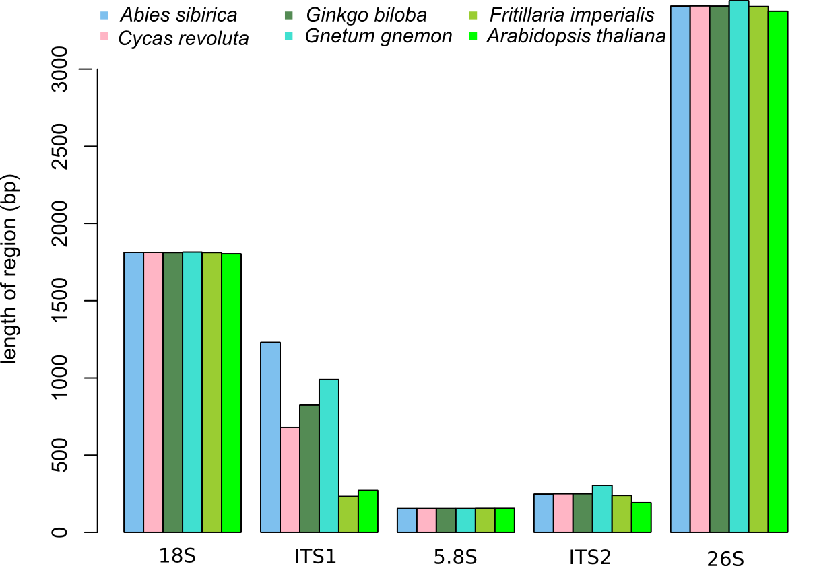
Suppl. Fig. 3 Length variation of different regions of the 35S rDNA consensus sequence among species, based on Illumina data (except Arabidopsis thaliana whose data was downloaded from NCBI (accession number: X52322)).

Slide 6
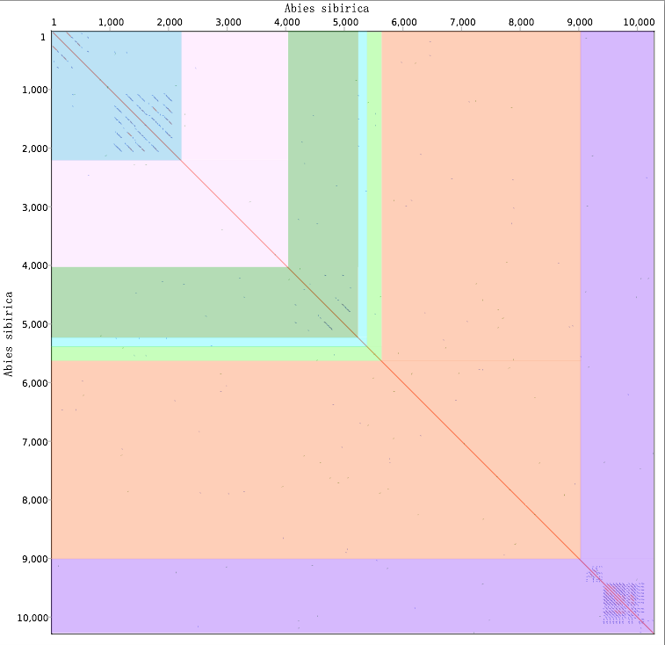
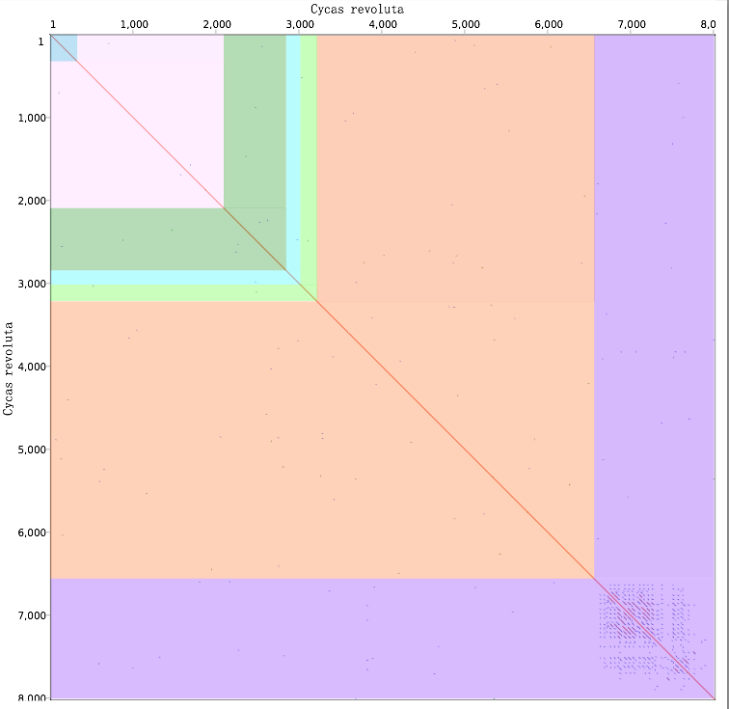
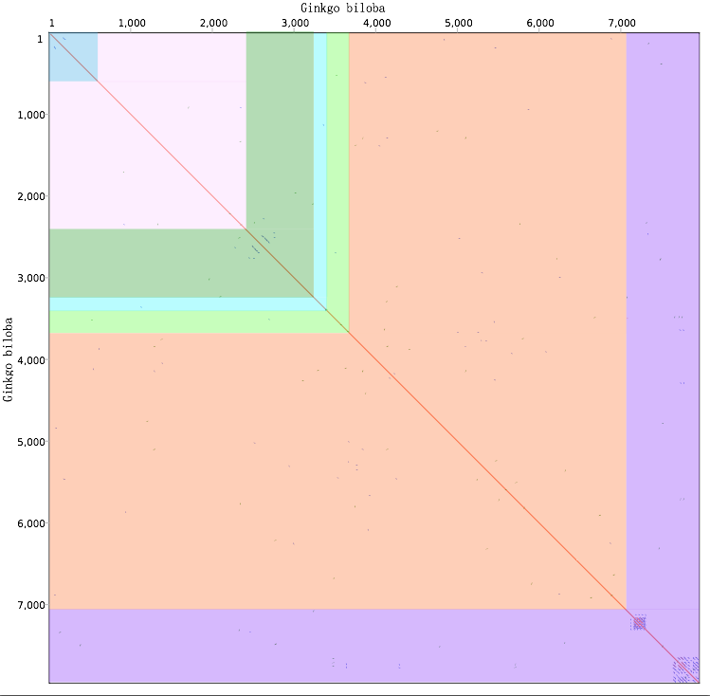
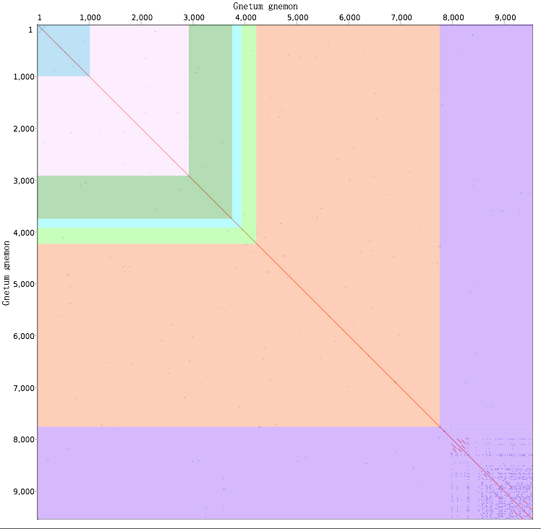
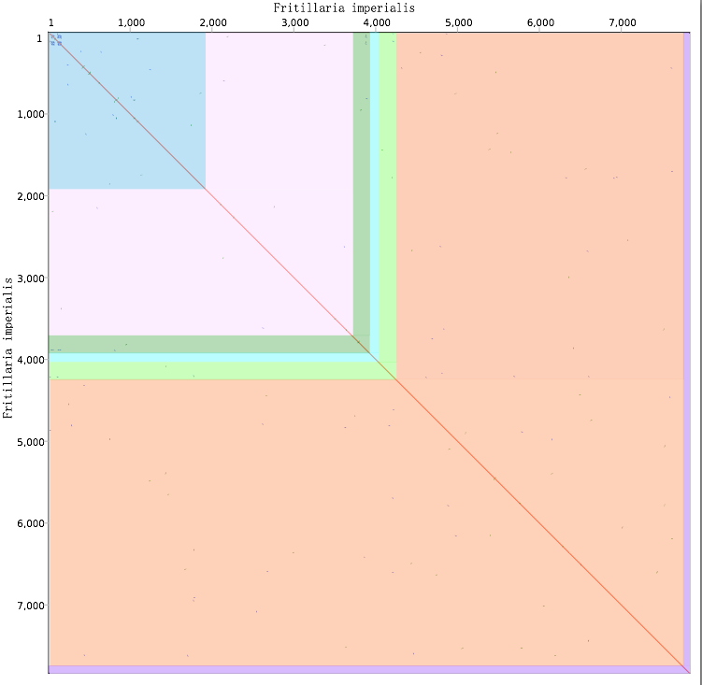
Abies sibirica
Cycas revoluta
Ginkgo biloba
Suppl. Fig. 4 Graphs showing 35S rDNA sequences dot plotted against themselves in species analysed. From top left to bottom right: 5’-IGS (blue box), 18S (pink), ITS1 (dark green), 5.8S (cadetblue), ITS2 (light green), 26S (brown), 3’-IGS (purple). Dotplot analysis was performed via default settings in Geneious 5.6 (Biomatters Ltd.)
Note: All species contained subrepeats in the IGS (purple).
Note: Sequence duplications were detected in ITS1 of Abies siberica and Ginkgo biloba
Gnetum gnemon
Fritillaria imperialis

Slide 7
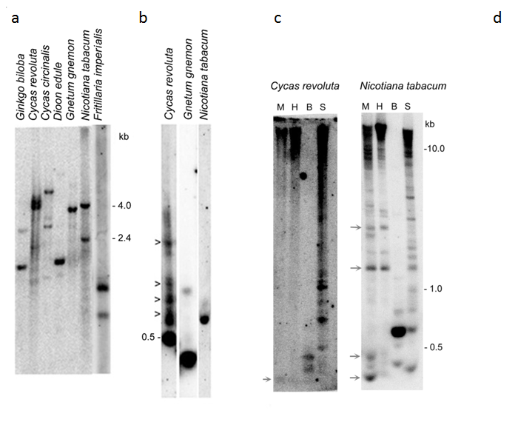
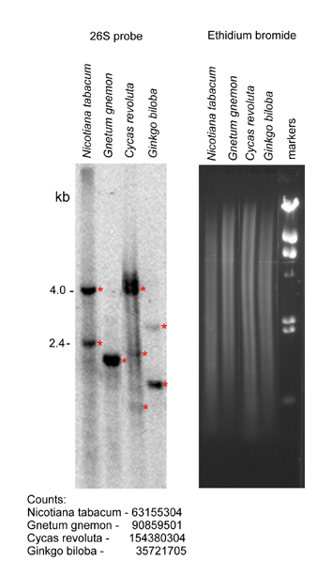
Suppl. Fig. 5 35S rDNA analysed by Southern blot hybridisation in different gymnosperm and angiosperm species. (a) The BstNI-digested genomic DNAs were hybridised with a 26S rDNA probe to reveal the diversity of rDNA families by band complexity. The band in the C. revoluta lane was fuzzy indicating polymorphisms (b) TaqI restriction digestion revealing polymorphisms within the 18S rDNA coding region. Arrowheads indicate fragments resulting from mutated genes in C. revoluta. (c) Methylation analysis of 18S rRNA genes in C. revoluta and Nicotiana tabacum using methylation sensitive and insensitive restriction enzymes. M-MspI, H-HpaII, B-BstNI, S-ScrFI. Arrows indicate hypomethylated MspI/HpaII hybridisation fragments. These fragments were more abundant in N. tabacum compared to C. revoluta DNA. (d) Experimental estimation of 26S gene copies using Southern blot hybridisation. Signal intensities of hybridisation bands (red asterisks) were measured through the counting of radioactivity in selected areas using a Phosphorimager. Copy numbers were calculated based on known copies (3000/1C) in Nicotiana tabacum (Lim et al. 2000) and known 1C values of individual genomes (Bennett and Leitch 2012).

Slide 8
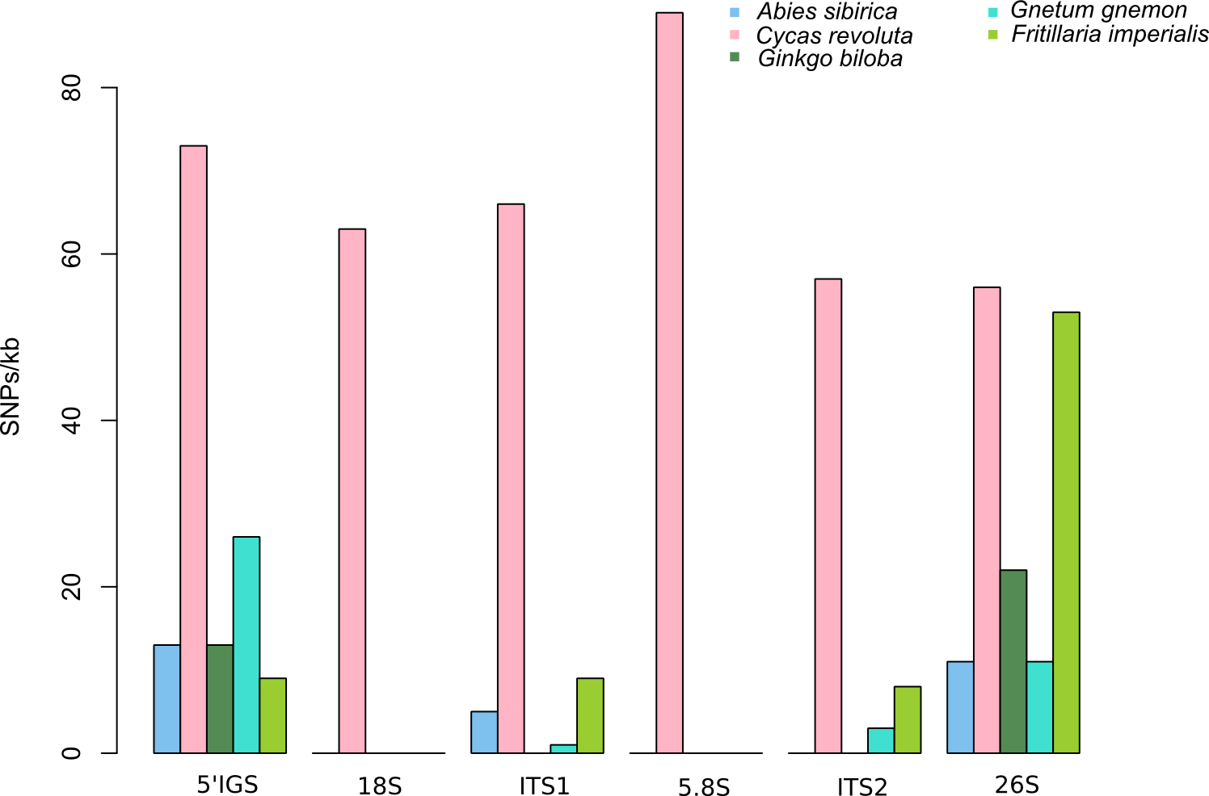
Suppl. Fig. 6 Frequency of SNPs (SNPs/kb) in different regions of 35S rDNA in five species based on Illumina data.

Slide 9
a
All reads
b
Suppl. Fig. 7 (a) G+C content of cumulative reads comprising whole 18S genes. (b) A 3D graph showing the frequency of indels, insertions, replacements and multiple nucleotide variants (MNVs) in each region of the 35S rDNA sequence for six species. Those four types of variation of 35S rDNA in Ginkgo biloba was undetectable

Slide 10
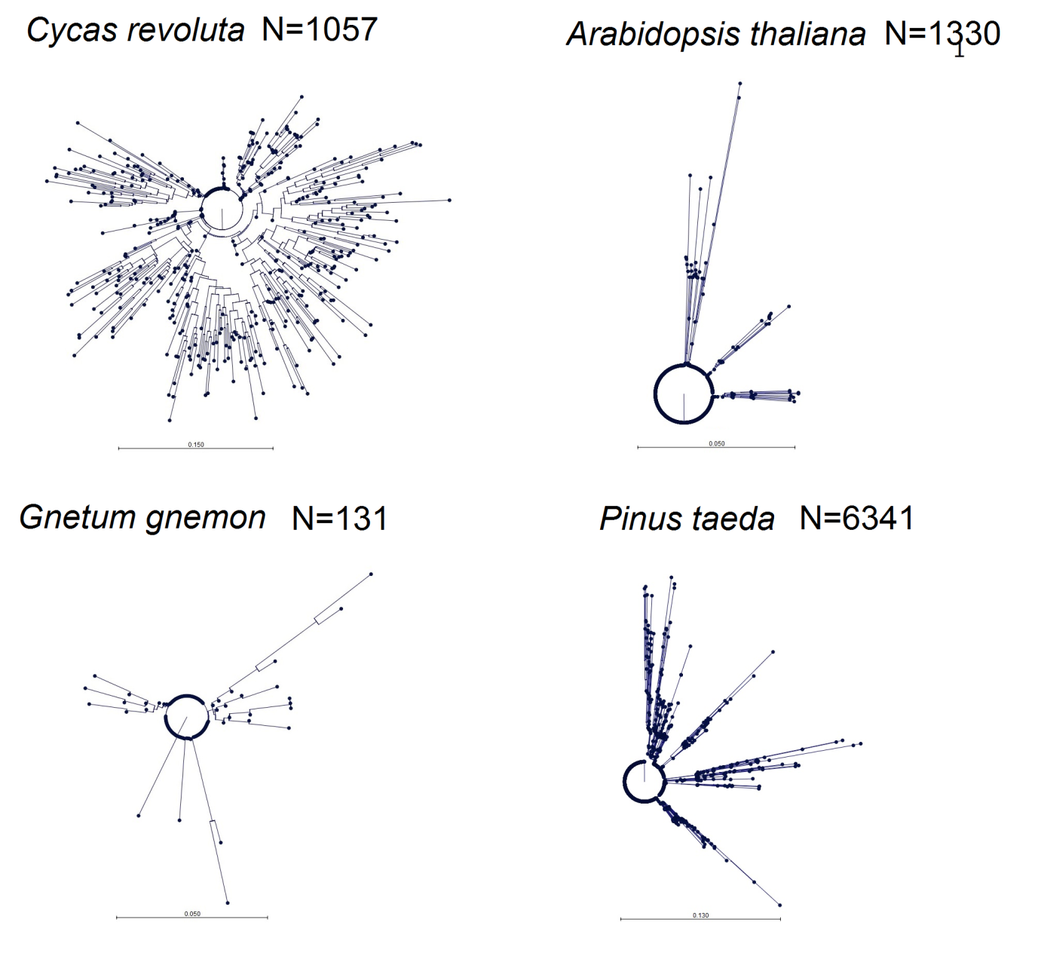
Suppl. Fig. 8 Phylograms showing the contrasting levels of intragenomic sequence diversity in the 26S rRNA gene for a selection of three gymnosperm and one angiosperm species. Phylograms were constructed by extracting reads from the NGS data that aligned to a 42-bp region (Suppl. Fig. 2b) from the 3´end of the 26S rRNA gene and then calculating pairwise distances using a NJ method. Note the large scale bar for C. revoluta indicating high divergence between sequences in this species (N = number of reads analysed)

Slide 11
Suppl. Fig. 9 Frequency of cytosine methylation in 18S rRNA genes of C. revoluta analysed by bisulfite sequencing of 23 Sanger clones. The 18S rDNA domain studied is shown in Suppl. Fig. 2a

Slide 12
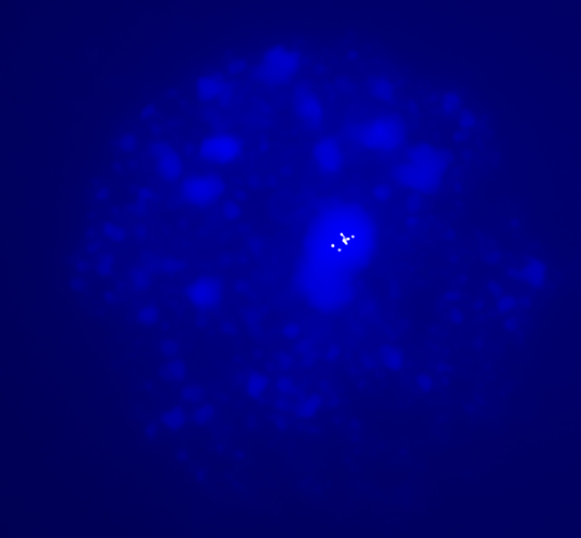
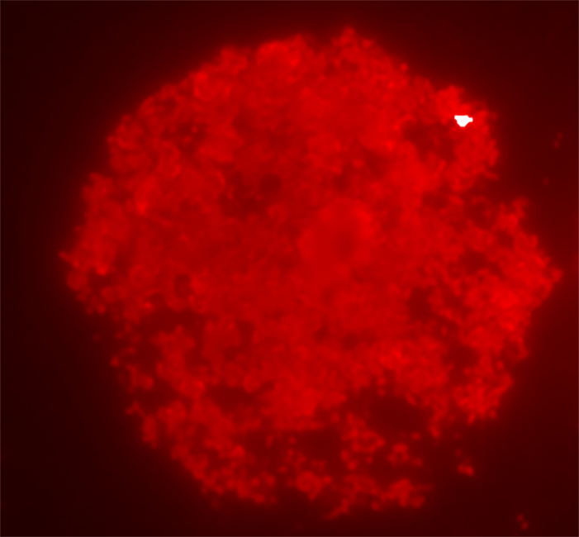


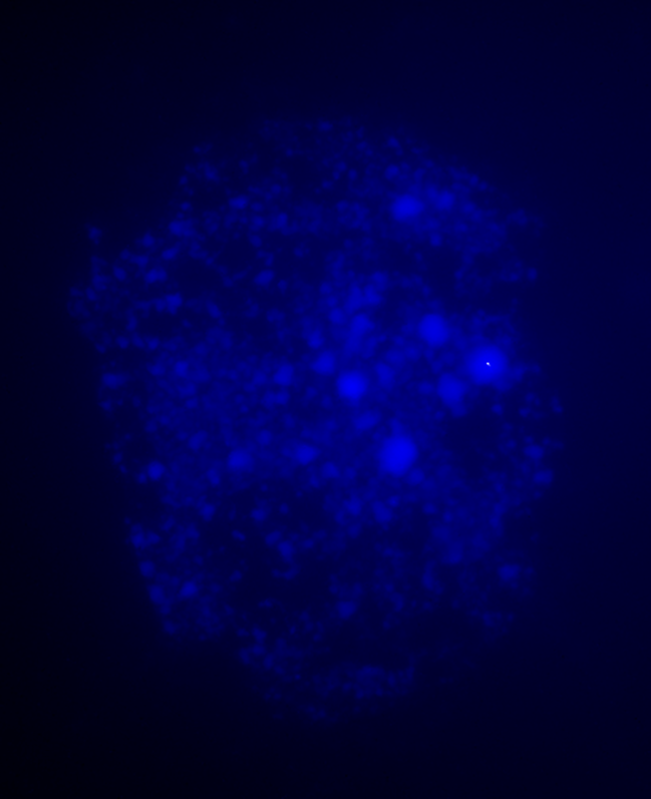
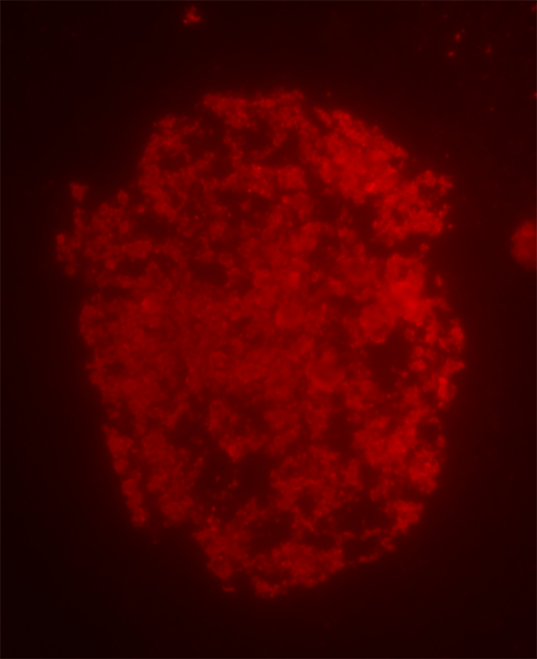
Suppl. Fig. 10 (a) Distribution of 5mC in C. revoluta. Note almost uniform staining of interphase nuclei with an antibody against 5mC. Even in DAPI-positive regions (AT rich), there is no significant enrichment of signals

Slide 13
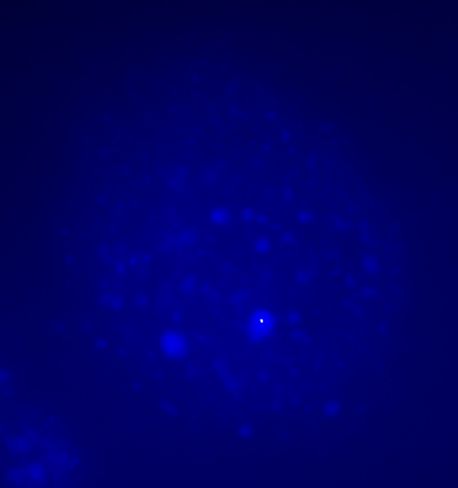
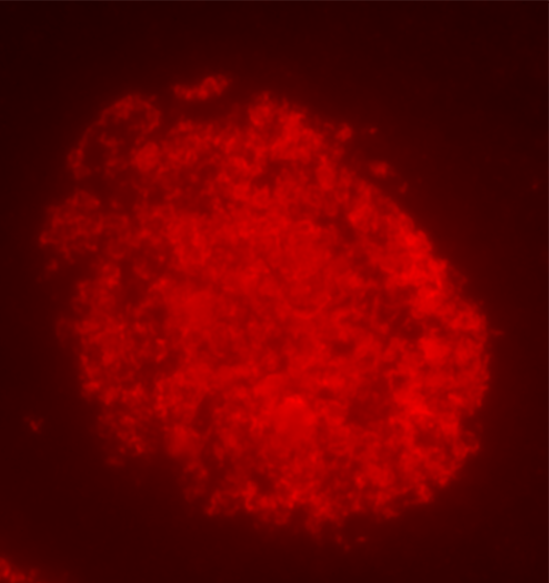
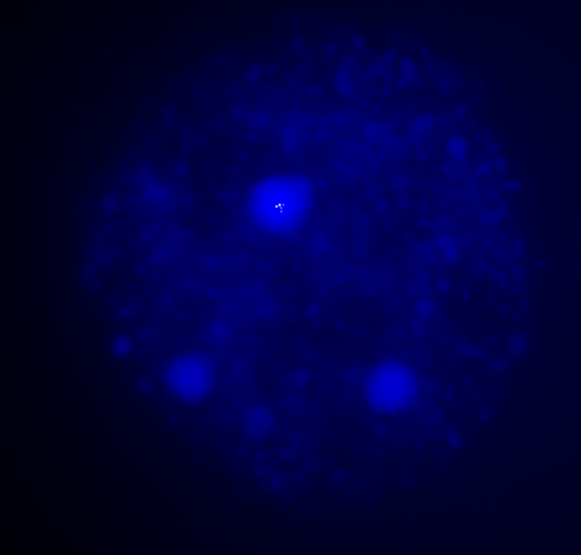
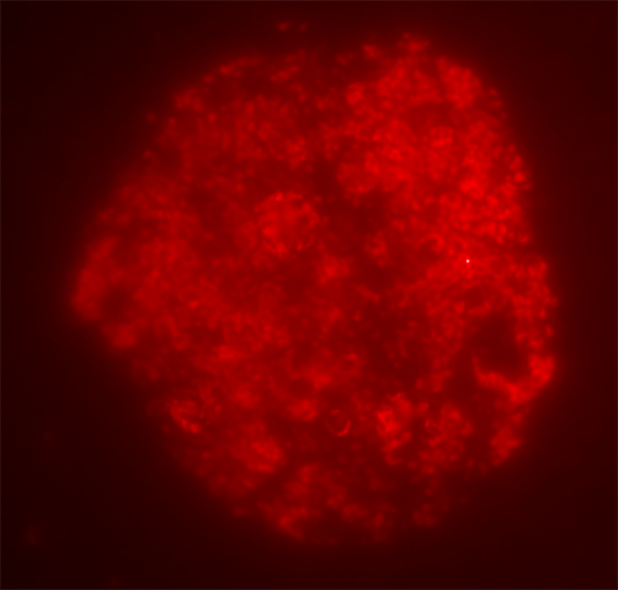
Suppl. Fig. 10 (a) – continued. Results for additional C. revoluta nuclei

Slide 14
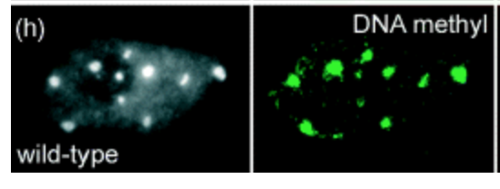
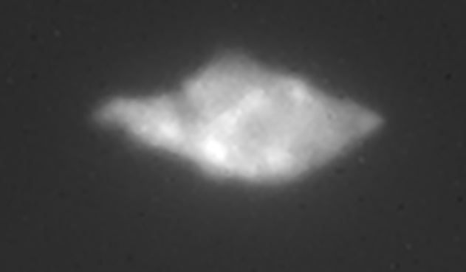
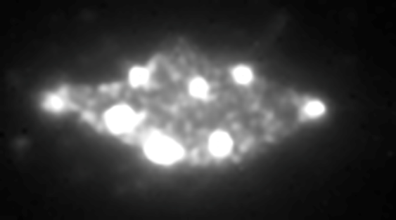
Suppl. Fig. 10 (b) Control experiment in Arabidopsis thaliana confirming the antibody specificity. Note, highly localised 5mC signals within the DAPI-positive chromocenters
DAPI 5mC
from Jasencakova et al. 2003
our test

