Slide 1
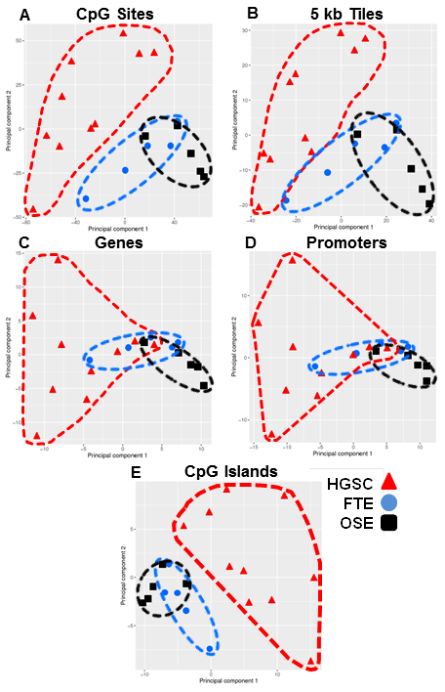
Klinkebiel et al., Fig. S2.
Figure S2. Karpf 450K data principal component analyses (PCA). PCA analyses calculated from Karpf 450K data for HGSC and patient-matched FTE and OSE, based on all genomic: (A) CpG sites (n=476,610) (B) 5 kb tiles (n=134,969) (C) genes (transcription start site to transcription end (n=30,636) (D) promoters (-1500 to +500bp relative to transcription start site, n=30,790) and (E) CpG islands (n=26,589). Analysis was performed using RnBeads software.

