Slide 1
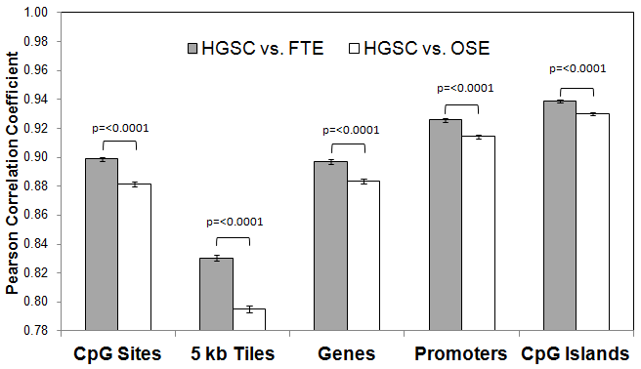
Klinkebiel et al., Fig. S6.
Figure S6. Bowtell 450K Pearson correlation coefficient analysis. Average Pearson correlation coefficients from comparisons of Bowtell 450K HGSC data and Karpf 450K patient-matched FTE and OSE data (n=390 for each comparison; RnBeads analysis). Comparisons are shown for all CpG sites, 5 kb genomic tiled regions, genes (TSS to transcript end), promoters (-1500 to +500 relative to TSS), and CpG islands. Reported p-values were calculated from two-tailed Student's t-Tests.

