Slide 1
Supporting Information for Meta-analysis
Title: Prognostic values of vimentin expression and its clinicopathological significance in non-small cell lung cancer: a meta-analysis of 32 studies with 4118 cases
Authors: Zhihua Ye¹, Xin Zhang¹, Yihuan Luo¹, Shikang Li², Lanshan Huang¹, Zuyun Li¹, Ping Li¹, Gang Chen*¹

Slide 2
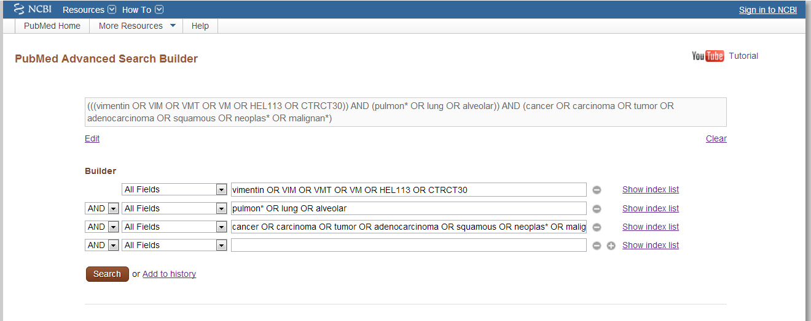
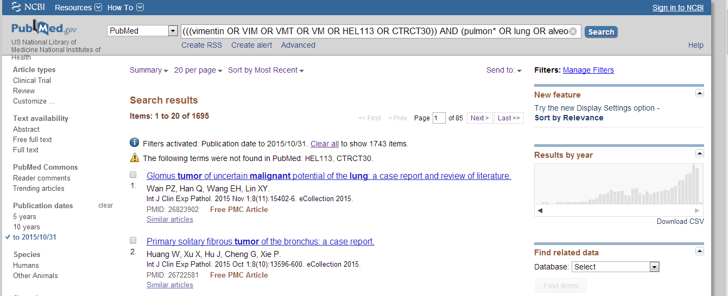
1. A sample of search strategy

Slide 3
2. Data extraction
2.1 Data directly extracted from literatures
2.2 Data calculated by Kaplan-Meier survival curves

Slide 4
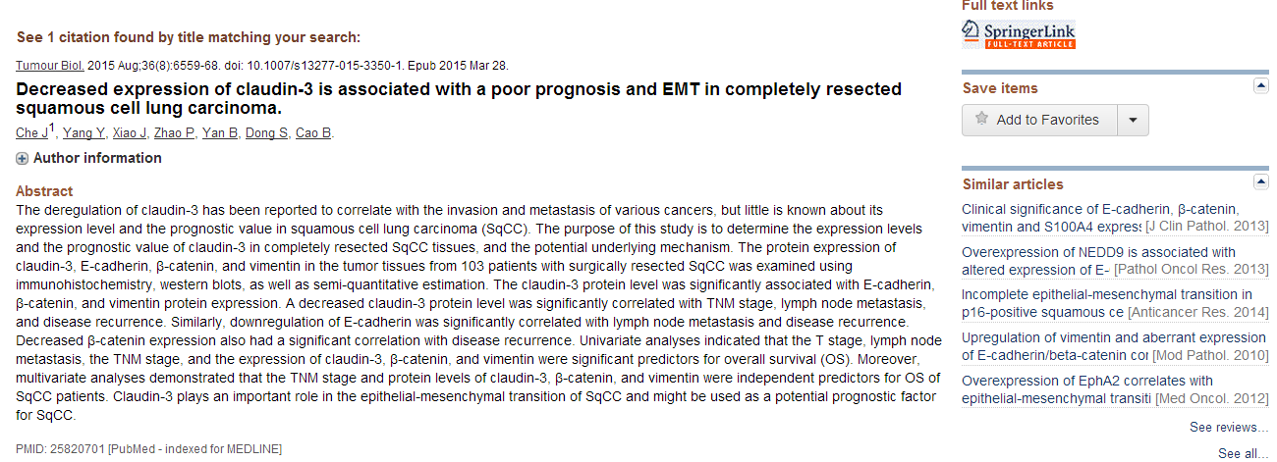
2.1 Data directly extracted from literatures

Slide 5
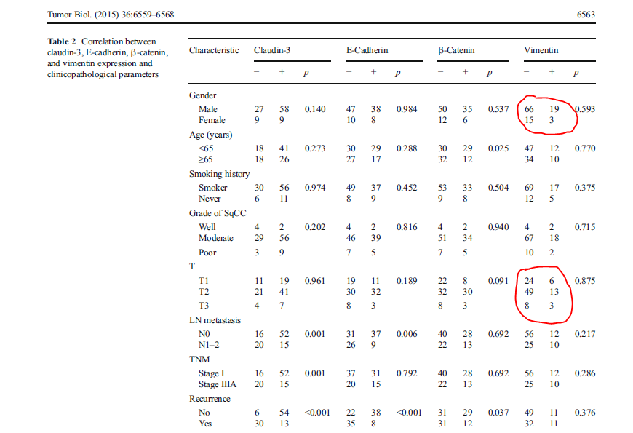
NO 1. number of
patients
NO 2. events of
T classification

Slide 6
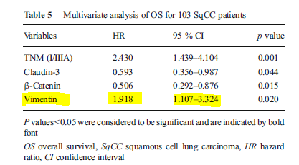
No 3. HR and 95 CI%
of multivariate analysis

Slide 7
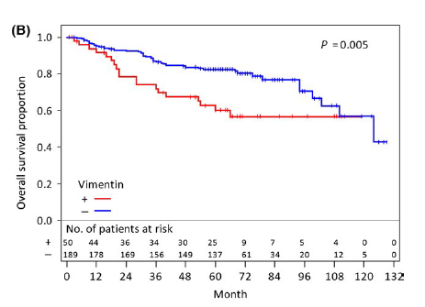
2.2 Data calculated by Kaplan-Meier survival curves
No 4. survival curve
offered in the study

Slide 8
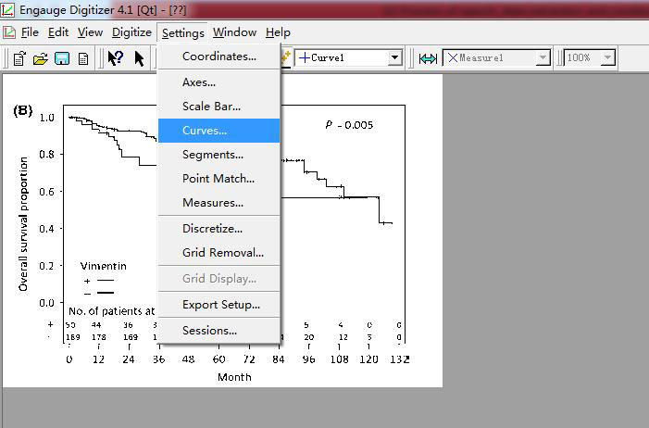
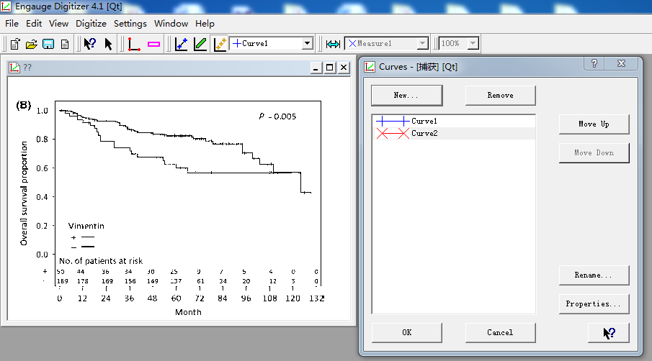
Step 1
Step 2

Slide 9
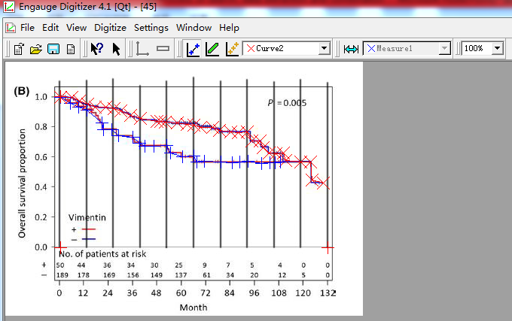
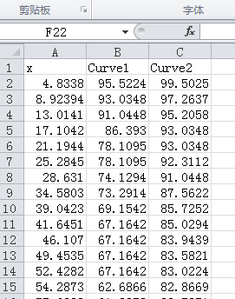
Step 3
Step 4

Slide 10
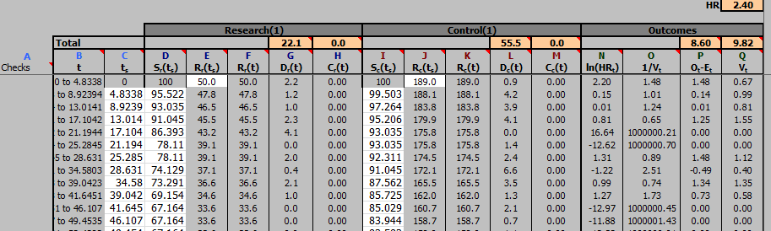
Step 5

Slide 11
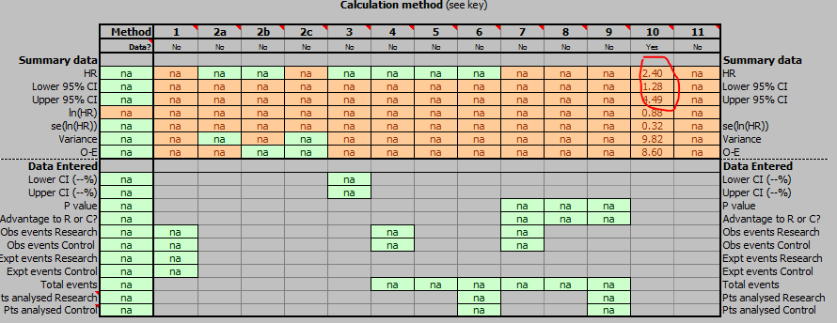
Step 6

Slide 12
3. Data combination
3.1 Meta-analysis for clinicopathological parameters
3.2 Meta-analysis for overall survival (OS), disease-free
survival (DFS)

Slide 13
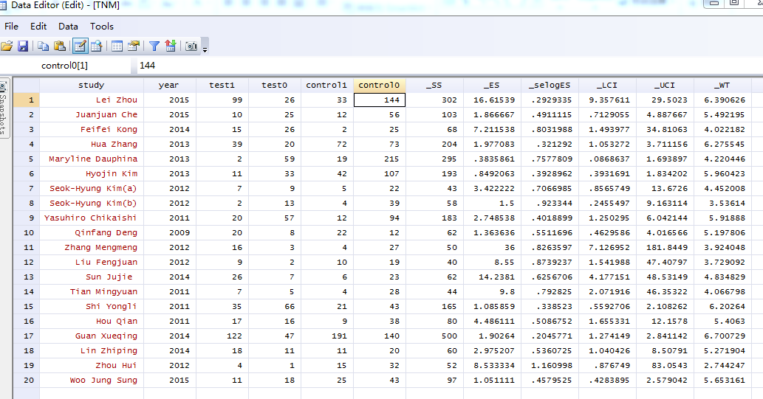
3.1 Meta-analysis for clinicopathological parameters
An example of meta-analysis for clinicopathological parameters:
TNM stage (random-effects model)

Slide 14
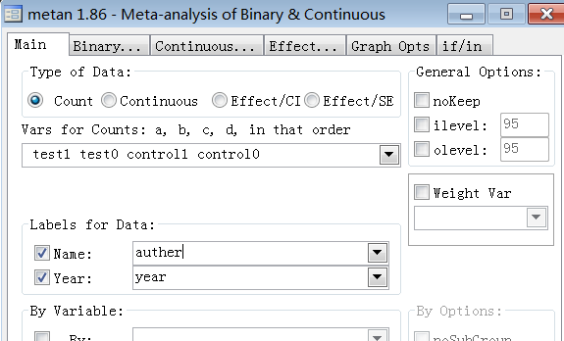
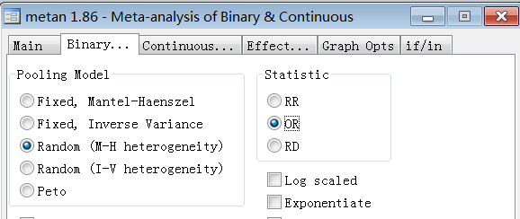

Slide 15
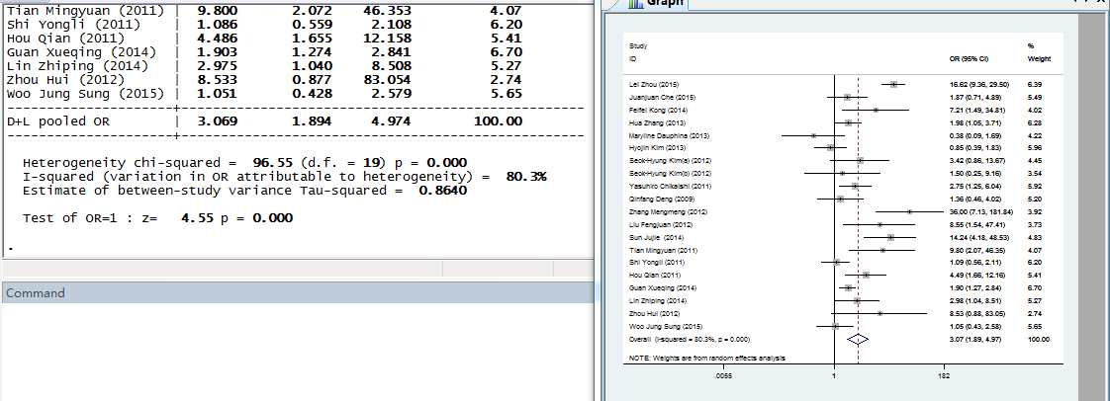

Slide 16
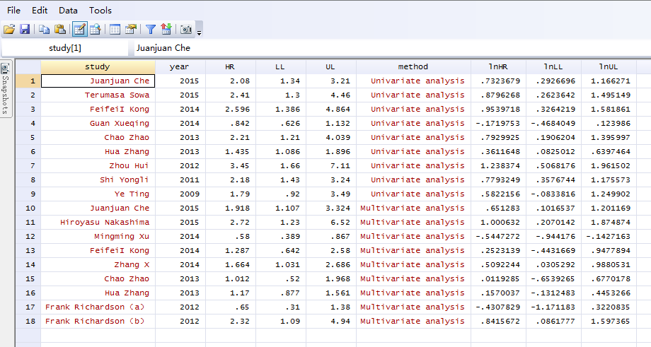
3.2.1 Meta-analysis for overall survival (OS)

Slide 17
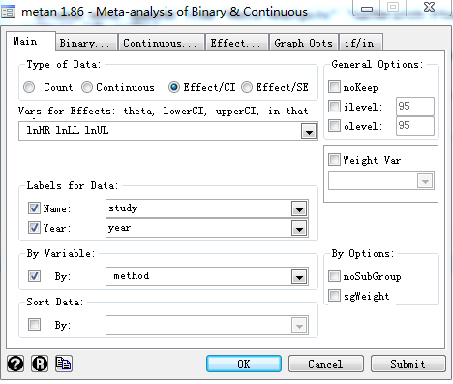
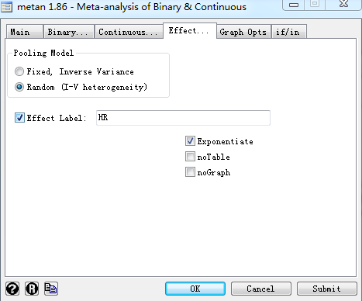

Slide 18
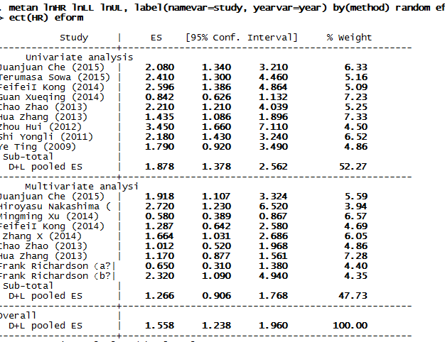

Slide 19
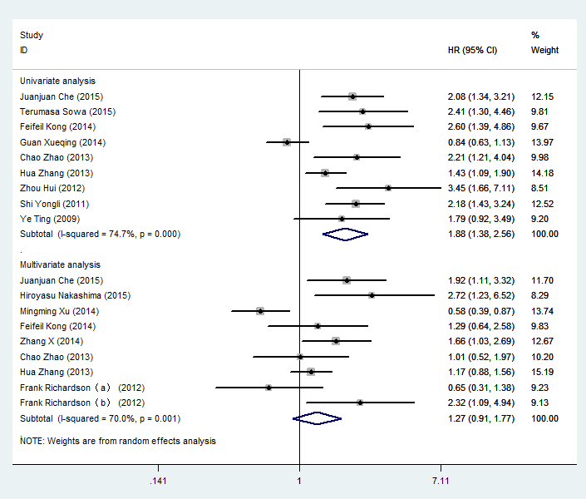

Slide 20
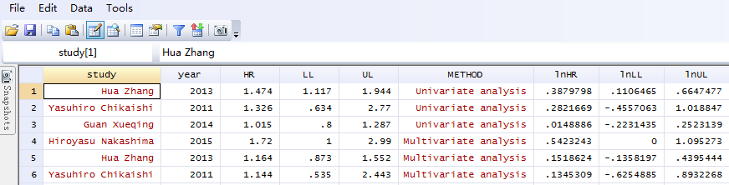
3.2.2 Meta-analysis for disease-free survival (DFS)

Slide 21
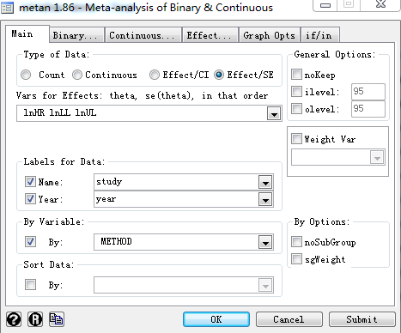
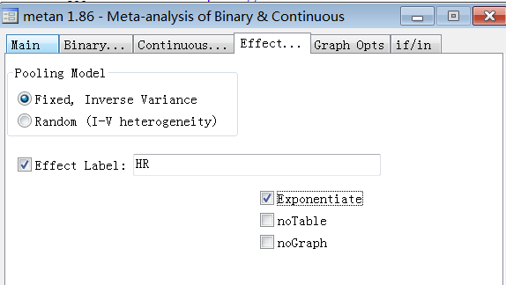

Slide 22
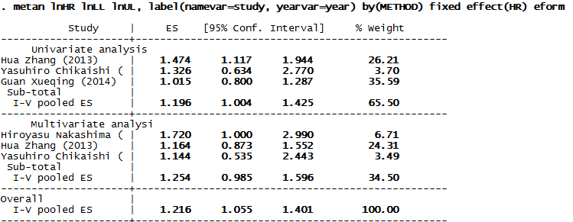
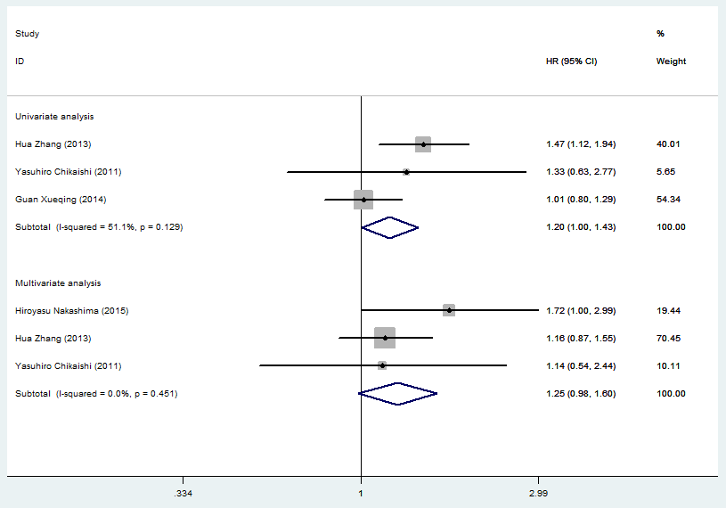

Slide 23
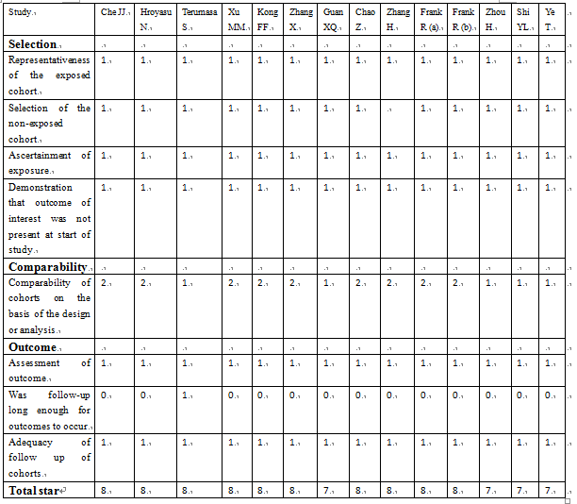
4. Quality assessment of included studies

Slide 24
5. Publication bias
5.1 Begg’s test and funnel plots were employed to estimate publication bias in groups of clinicopathological parameters
5.2 Begg’s test and a funnel plot was employed to estimate publication bias for OS

Slide 25
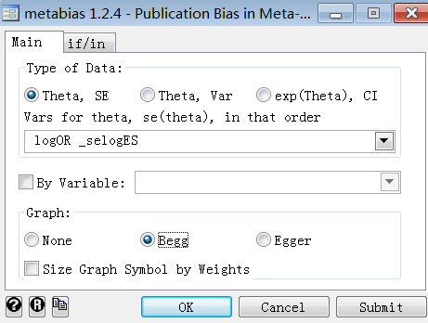
5.1 Begg’s test and funnel plots were employed to estimate publication bias in groups of clinicopathological parameters：
TNM stage

Slide 26
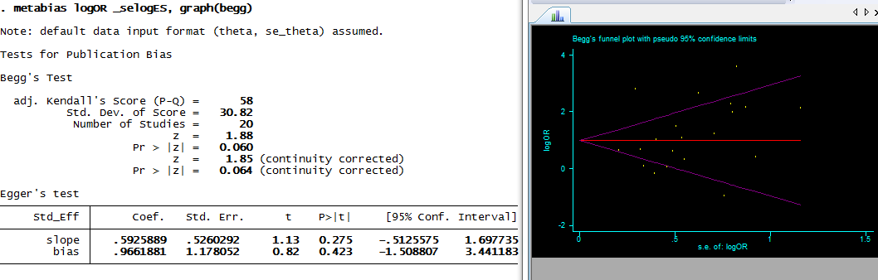

Slide 27
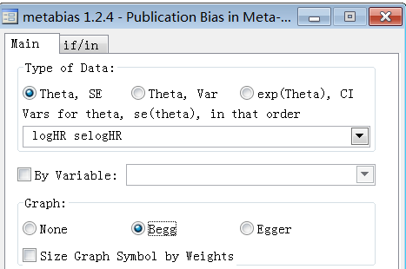
5.2 Begg’s test and a funnel plot was employed to estimate publication bias for OS in univariate analysis

Slide 28
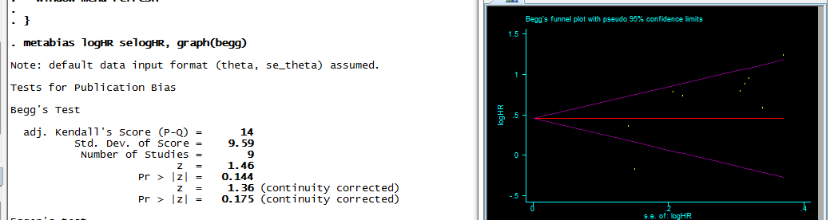

Slide 29
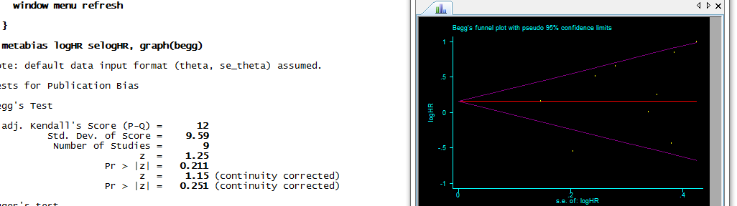
5.3 Begg’s test and a funnel plot was employed to estimate publication bias for OS in multivariate analysis

Slide 30
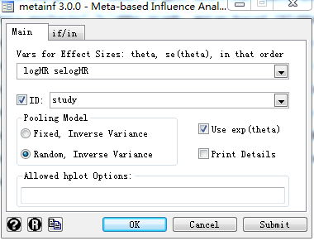
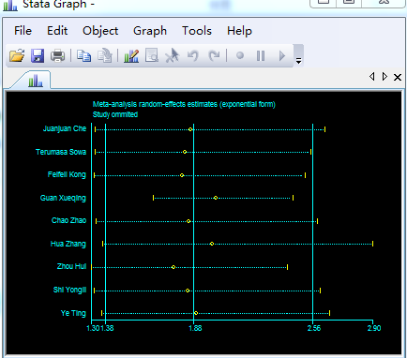
6.1 sensitivity analysis for OS in univariate analysis

Slide 31
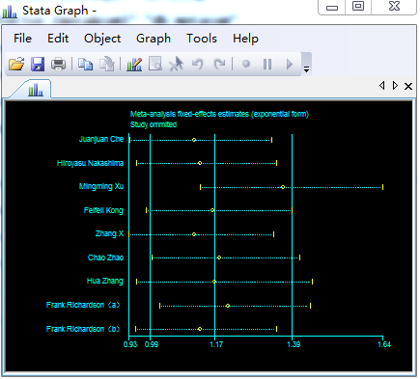
6.1 sensitivity analysis for OS in multivariate analysis

Slide 32
Thank you very much!

