Slide 1
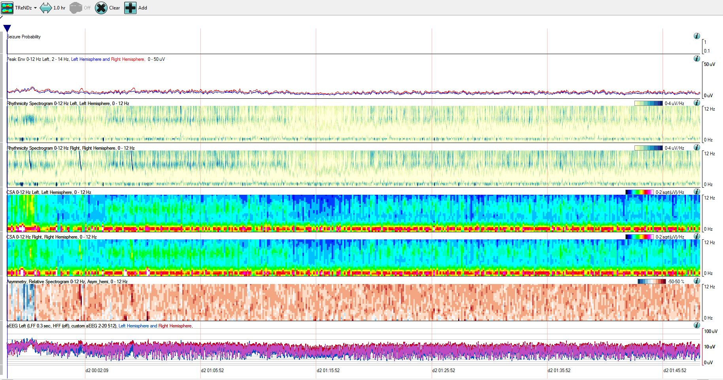
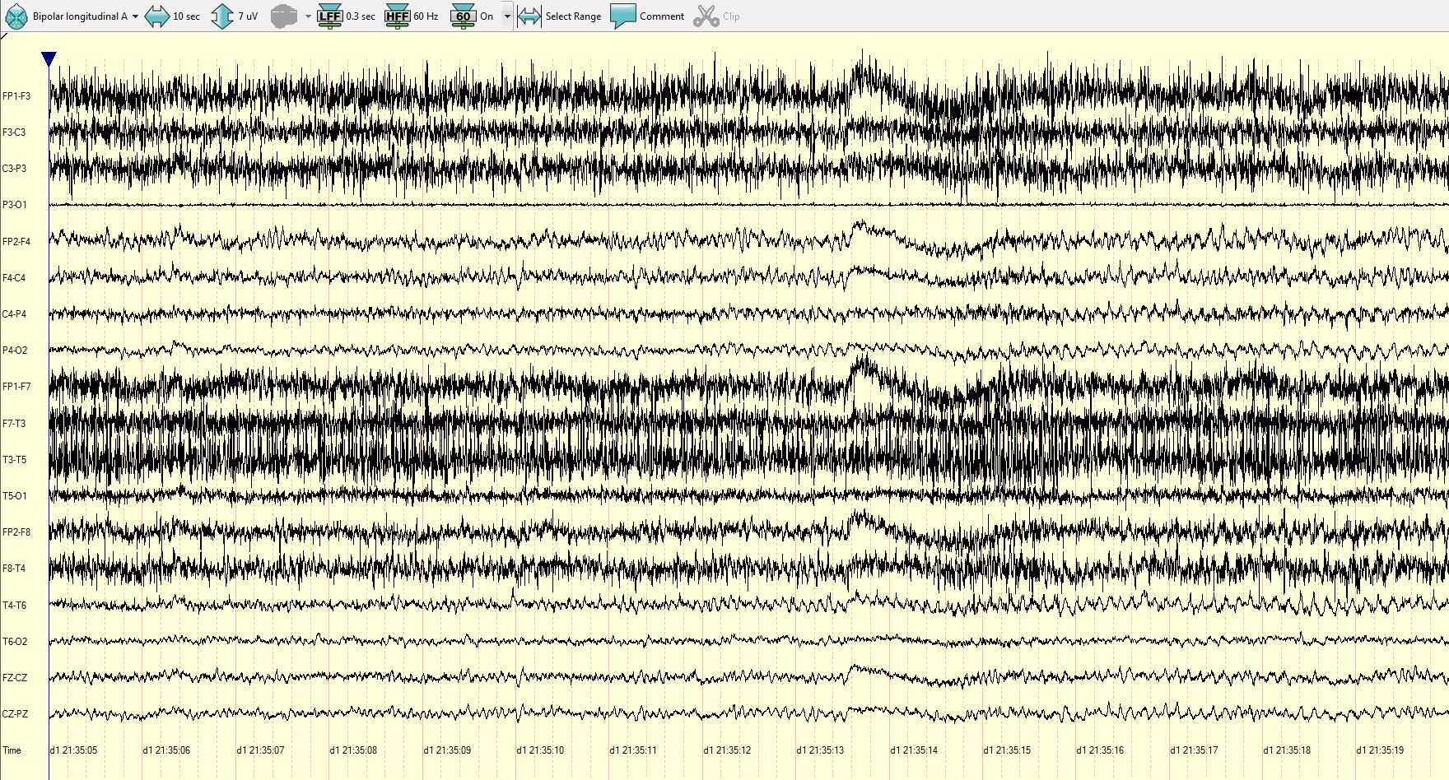
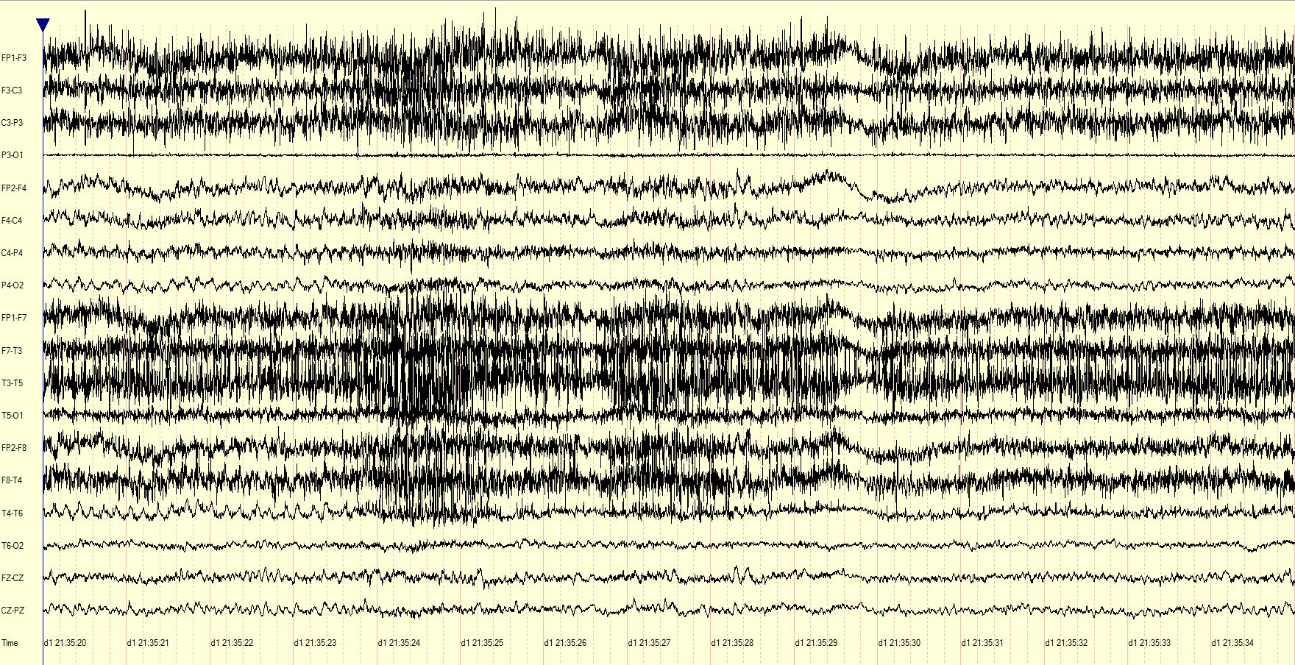
Notes:
SUPPLEMENTARY FIGURE e-2:
Epoch 6: Brief focal seizures not well visualized on QEEG.
LEGEND: This epoch contained focal seizures with onset in the right posterior quadrant consisting of low amplitude, rhythmic alpha frequencies with typical duration less than 30 seconds. The QEEG panel includes three seizures in the one hour display best seen as subtle right hemisphere changes on the rhythmicity spectrogram and aEEG (red arrows). The raw EEG panels show seizure 1, where muscle artifact from ictal motor activity is also seen over the left hemisphere, evident on the asymmetry spectrogram (blue signal change within red box). Seizures 2 and 3 were not associated with ictal motor activity and therefore not as easily appreciated on the asymmetry trend. Automated seizure detection failed to identify any of these seizures.

