Slide 1
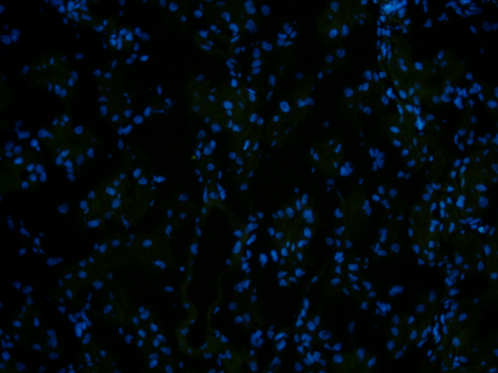
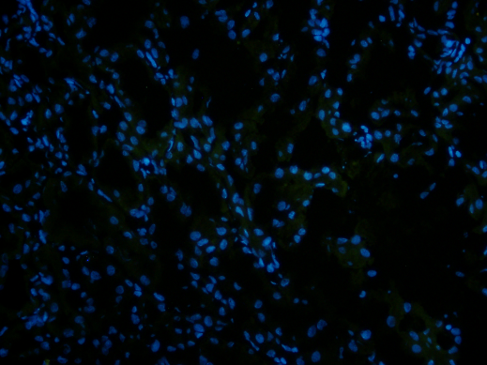
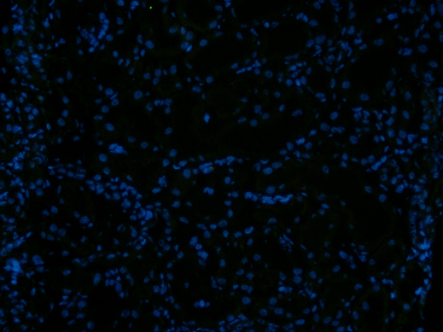
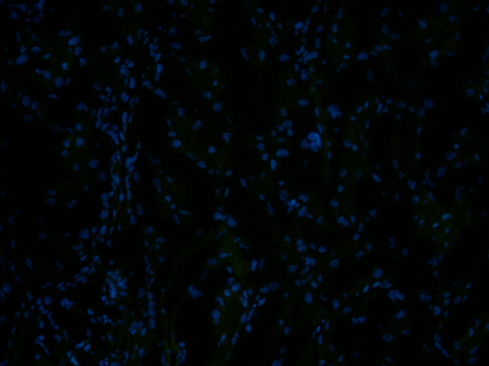
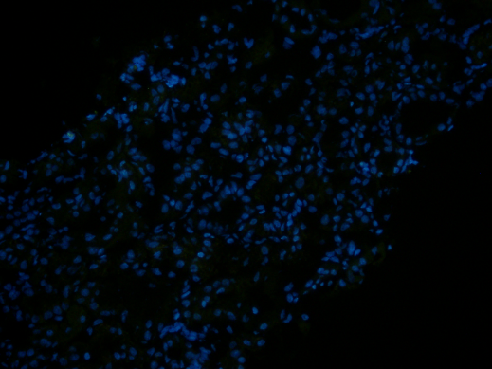
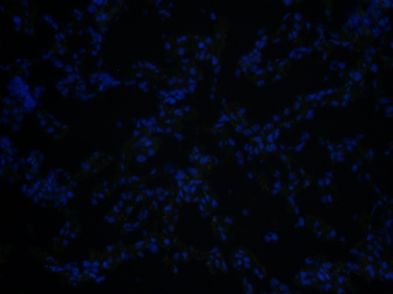
A: Factor B Staining
CTL
VEH
rhC1INH
50µm
50µm
50µm
B: C5b-9 Staining
CTL
VEH
rhC1INH
50µm
50µm
50µm
Supp Fig 2

