Slide 1
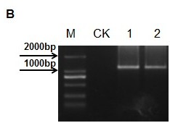
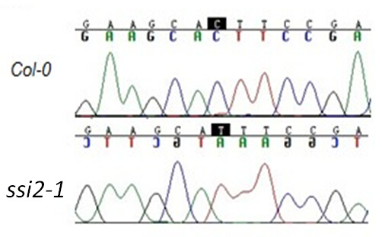
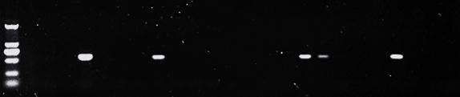
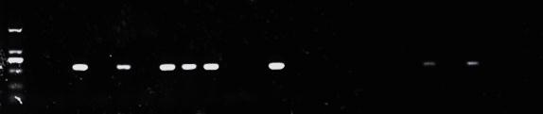
A
B
LBb1.3 + RP
C
M 1 2 3 4 5 6 7 8 9 10 11 12 13 14 15 16 17 18 19 20
Figture S1. Mutant test and transgenic plant confirmation. a Sequencing of the ssi2-1 mutant. b PCR identification of the SALK_039852 mutant. M: DL2000 DNA Marker; CK: Col-0; 1-2: SALK_039852 individuals. c Validation of the transgenic plants by PCR. Upper row displays the amplification results of pSSI2::SSI2_{A257T} with ssi2-2-CAPS1-F/Nos-R primers, bottom row displays the amplification results of pSSI2::SSI2_{R312H}. M: DL 2000 DNA Marker; 1-20: T2 plant populations.

Slide 2
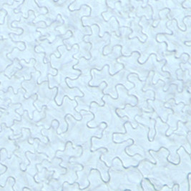
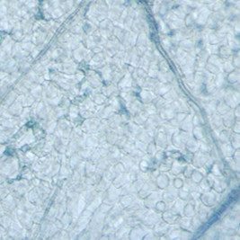
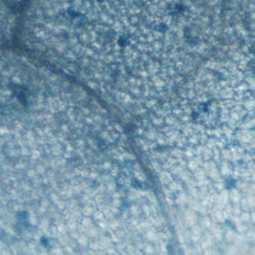
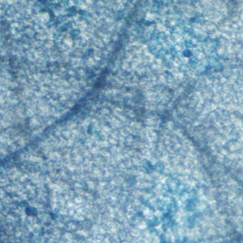
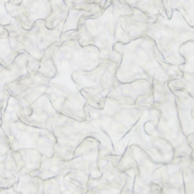
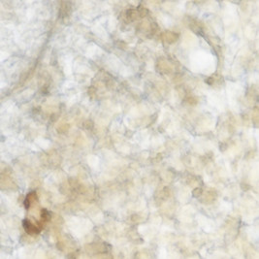
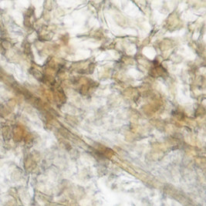
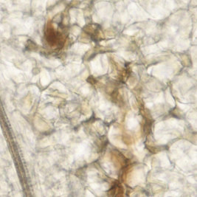
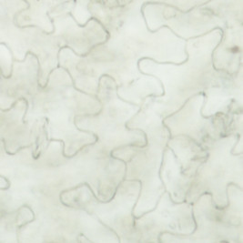
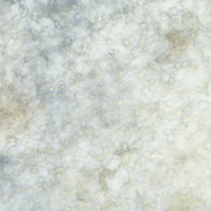
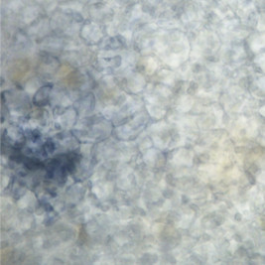
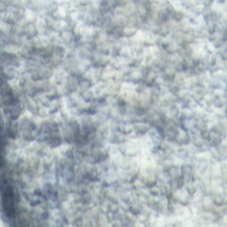
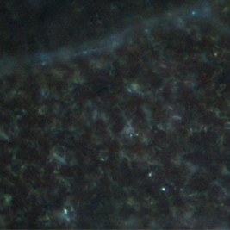
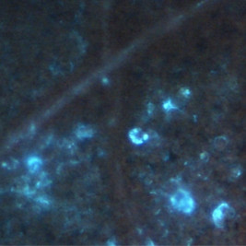
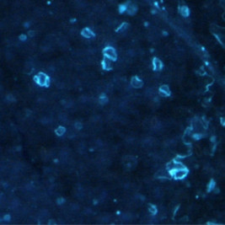
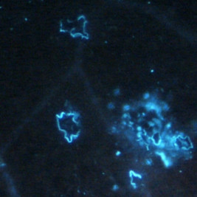
Col-0 ssi2-2 ssi2-1 ssi2-3
Trypan blue staining
DAB staining
NBT staining
Aniline blue staining
Figture S2. Cytological staining of Col-0 and different ssi2 mutant lines. Trypan blue staining was used to test for cell necrosis in the wild-type and the indicated ssi2 mutant lines. DAB and NBT staining were used to detect H₂O₂ and superoxide content; aniline blue staining was used to detect callose deposition. Scale bars = 100 μm.

Slide 3
Figture S3. Quantitative RT-PCR analysis of 14 auxin related genes .

Slide 4
GFP Chlorophyll Transmission Merged
SSI2
ssi2-2
SSI2_{A257T}
SSI2_{R312H}
Figture S4. Subcellular localization of SSI2 and mutant fragments. The SSI2, ssi2-2, SSI2_{A257T}, SSI2_{R312H} gene fragment fused GFP localized to the chloroplasts, the scale bars represent 20 μm.

