Slide 1
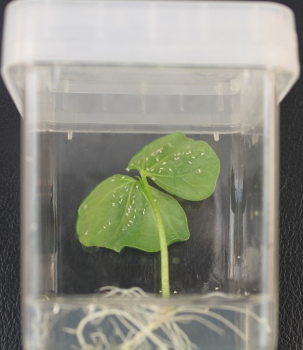
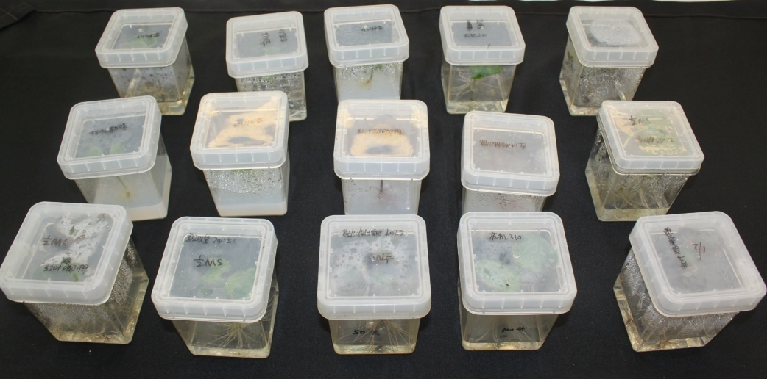
SUPPORTING INFORMATION
Figure S1. Cotton whitefly infestation within a sealed chamber.

Slide 2
PC3 (6.4%)
principal component
Figure S2. Comprehensive evaluation of the RNA-Seq data. (a, b)Analysis of all samples was performed based on FPKM data using PCA. (c) All samples were clustered using the pvclust package.

Slide 3
HR0-12
HR0-24
HR0-24
ZS0-12
ZS0-24
ZS0-48
Figure S3. Test for differential expression in cotton before and after whitefly infestation. Scatter plot indicates the log2 fold change versus mean.
Red indicates DEGs detected with a P-value < 0.01 and a multiple testing adjustment.

Slide 4
HR0-12
HR0-24
HR0-24
ZS0-12
ZS0-24
ZS0-48
Figure S4. Ven diagram showing the overlap of DEGs detected using different analysis methods.

Slide 5
Figure S5. Pie charts represent GO terms (biological_process level 2) in the various treatment groups. The percentage present DEGs counts.

Slide 6
(a)
(c)
(c)
(d)
Figure S6. Network construction of related results. (a) Analysis of network topology through different soft-thresholding limits. (b) Ten modules DEGs were showed by a hierarchical clustering dendrogram. (c) Clustering of the modules. (d) The heatmap shows the eigengene adjacency.

Slide 7
Figure S7. Correlation between qRT-PCR and RNA-Seq results.

