Slide 1
Research Techniques Made Simple:
Genome Editing in Investigative Dermatology
Joan R. Guitart, Jodi Johnson, and Wade Chien
National Institute on Deafness and Other Communication Disorders
National Institutes of Health, Bethesda, Maryland, USA

Slide 2
What is Genome Editing?
Precise modification of the genome at a targeted locus
Allows for:
  precise gene repair
  permanent gene knockout
  Whole gene excision or insertion
Applications of genome editing:
  Development of human disease models in laboratory organisms
  Study gene functions in mammalian cells
  Genetically modify food crops

Slide 3
Programmable designer nucleases
Genome-editing is mediated through programmable designer nucleases, which enact targeted DNA double stranded breaks (DSB)
Components of designer nucleases:
  DNA-binding domain that guides the nuclease to the targeted genomic site
  Nuclease domain that cuts targeted locus, resulting in a DSB
Examples of designer nucleases: ZFN, TALENs, CRISPR
  ZFNs and TALENs rely on DNA-protein interactions to target DNA
  CRISPR relies on DNA-sgRNA hybridization to target DNA

Slide 4
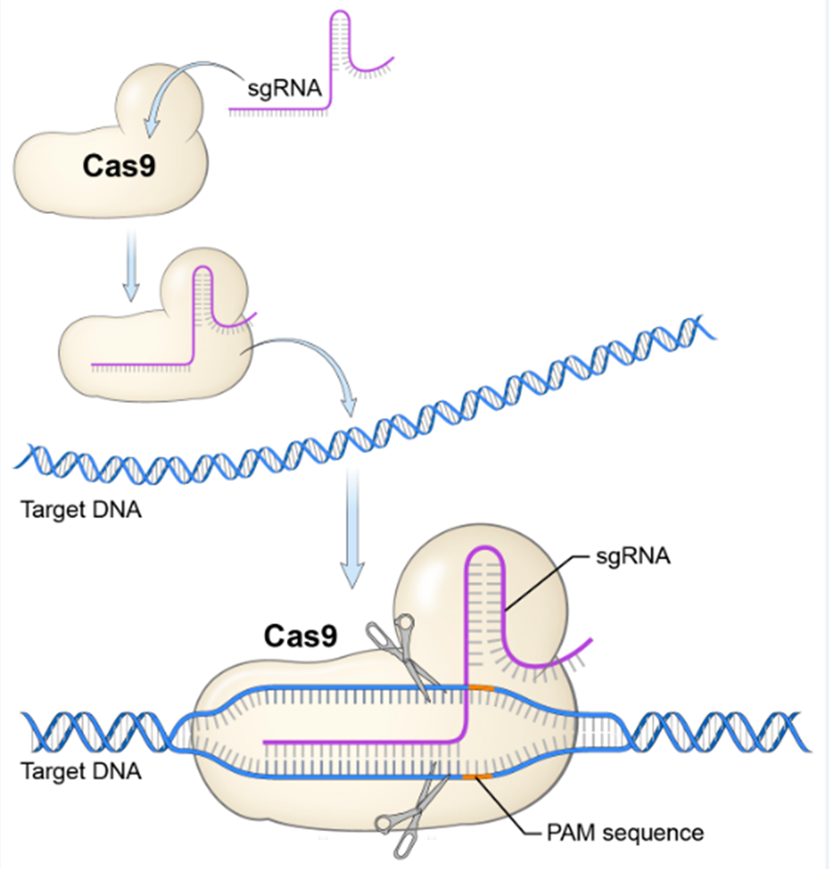
Clustered Regularly Interspaced Palindromic Repeats (CRISPR)
Bacterially derived programmable nuclease
Single guide RNA (sgRNA) directs CRISPR associated nuclease 9 (Cas9) to targeted genomic locus
Nucleotide hybridization of sgRNA and target DNA activates Cas9 nuclease activity, resulting in DNA DSB
Requires NGG Palindromic Adjacent Motif (PAM) immediately downstream of target sequence
Advantages of sgRNA mechanism
  sgRNA can be quickly and cheaply developed to target new genomic sites
  allows for multiple genes to be targeted simultaneously

Slide 5
Strategies of genome editing
Investigators rely on two DNA DSB repair mechanisms to achieve different editing outcomes:
  Non-homologous end joining (NHEJ)
  Homology-directed repair (HDR)
NHEJ
  Cell ligates DNA blunt ends, while randomly inserting or deleting nucleotides
  Results in gene disruption
  May be applied in situations for which gene knockout is beneficial
HDR
  DSB is repaired using externally supplied homologous donor template
  Allows for precise nucleotide modification at targeted locus
  May be applied to repair gene mutations

Slide 6
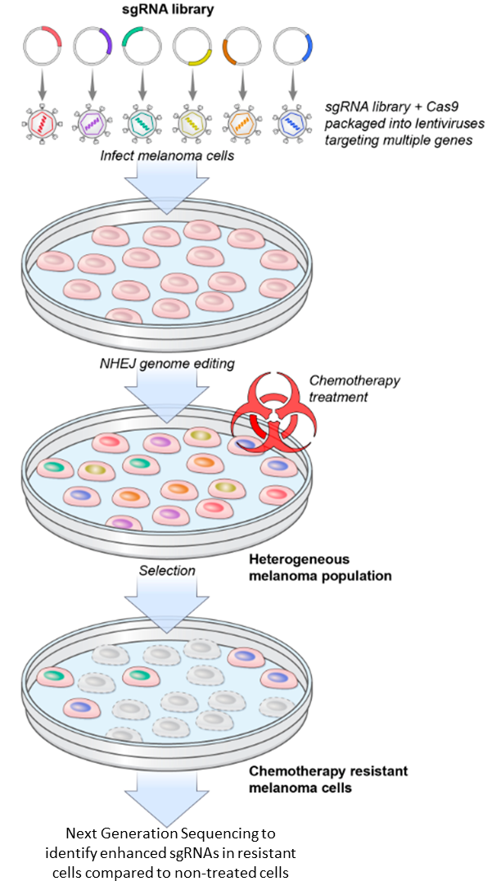
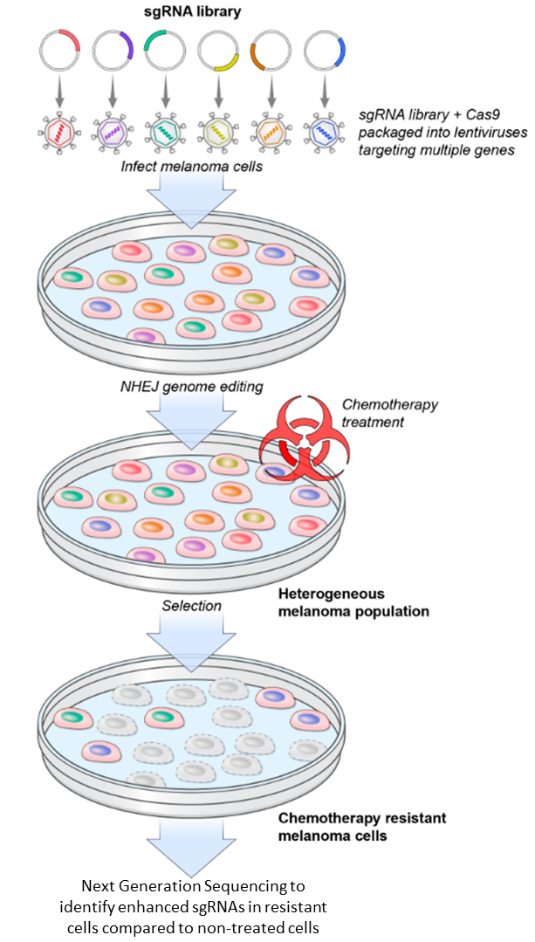
CRISPR sgRNA libraries
Collections of hundreds-to-thousands of unique sgRNAs
In presence of Cas9, sgRNA library can knockout multiple genes simultaneously via NHEJ genome editing
Allows investigators to target whole genome or large groups of genes
Utilized to identify genes and mutations involved in the acquired resistance to a melanoma therapy agent, PLX-4032 (Shalem, 2013; Konermann, 2014)

Slide 7
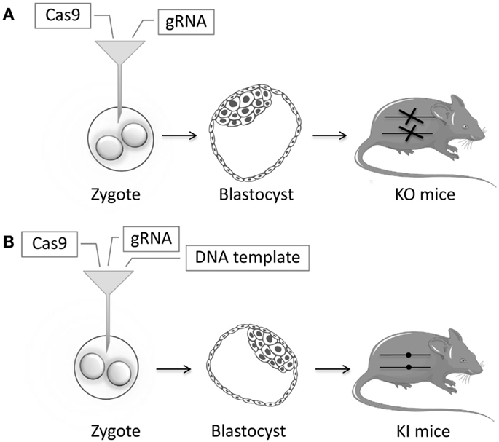
Genome editing and disease modeling
Develop transgenic animals that model after human diseases
Study epidermal gene functions in 3D skin culture models:
  knockout of functional alleles through NHEJ
  Repair of gene mutations through HDR (Sebastiano, 2014)
Ott de Bruin LM, Volpi S and Musunuru K (2015) Novel genome-editing tools to model and correct primary immunodeficiencies. Front. Immunol. 6:250. doi: 10.3389/fimmu.2015.00250
Notes:
Image reference: Ott de Bruin LM, Volpi S and Musunuru K (2015) Novel genome-editing tools to model and correct primary immunodeficiencies. Front. Immunol. 6:250. doi: 10.3389/fimmu.2015.00250
PERMISSION NOT NEEDED
Copyright: © 2015 Ott de Bruin, Volpi and Musunuru. This is an open-access article distributed under the terms of the Creative Commons Attribution License (CC BY). The use, distribution or reproduction in other forums is permitted, provided the original author(s) or licensor are credited and that the original publication in this journal is cited, in accordance with accepted academic practice. No use, distribution or reproduction is permitted which does not comply with these terms.

Slide 8
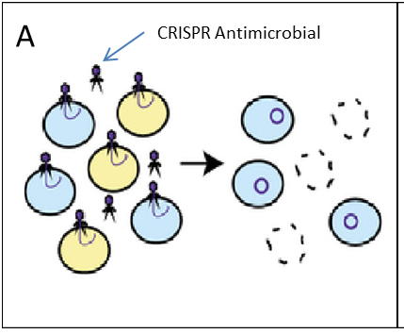
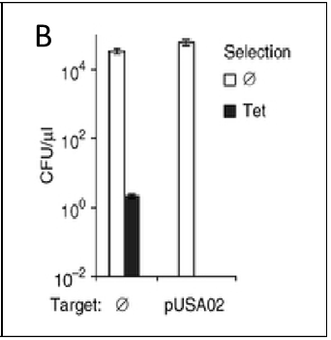
Therapeutic applications of genome editing
CRISPR-mediated antimicrobial (Bikard, 2014)
  CRISPR treatment of a mixed staphylococcus population of a non-resistant colony (blue) and an antibiotic-resistant colony (yellow) results in killing of the targeted strain and delivery of an immunizing phagemid to the rest of the population.
  CRISPR-mediated immunization against tetracycline (Tet) resistance. pUSA02 condition were treated with CRISPR antimicrobial targeting a Tet-resistance plasmid. After Tet-resistance plasmid transfer, bacteria subjected to CRISPR (pUSA02) were vulnerable to tetracycline and did not grow colonies, indicating NHEJ knockout of Tet-resistance plasmid. Abbreviations: Ø = Non-treated; CFU = colony forming units.

Slide 9
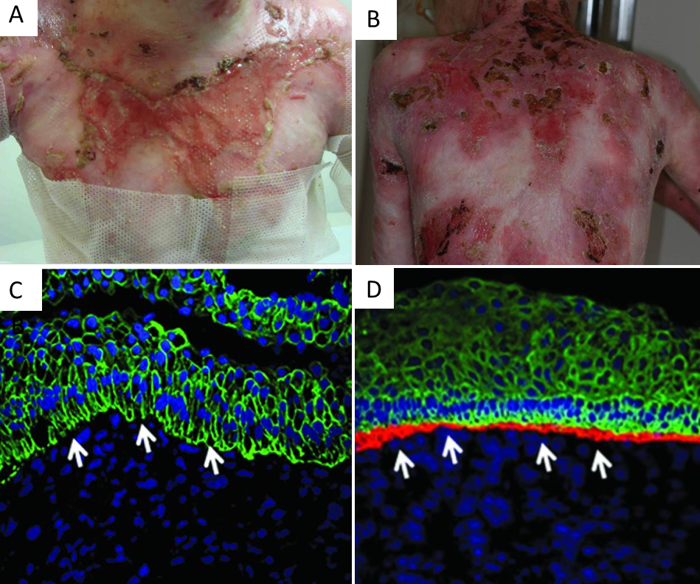
Therapeutic applications of genome editing
Talen-mediated gene correction for recessive dystrophic epidermolysis bullosa (RDEB) (Osborn, 2013)
RDEB is a blistering skin disorder caused by a mutation in the COL7A1 gene (A, B)
RDEB results in a loss of wild-type VII collagen (COL7A) in the epidermal-dermal junction (EDJ) (C)
TALEN-mediated correction via HDR of COLA7A1 gene results in the generation of an integral EDJ containing functional COL7A protein (D)
Notes:
TALEN-mediated genome editing for correction of recessive dystrophic epidermolysis bullosa (RDEB). (A, B) RDEB patients suffering from chronic blistering. (C) Confocal image of the epidermal-dermal junction in non-corrected RDEB cells, in which collagen7A is not detected. (D) Confocal image of the epidermal-dermal junction in gene corrected RDEB cells, in which collagen7A is detected in the red channel.

Slide 10
Advantages of genome editing
Allows for precise gene repair or permanent gene knockout
CRISPR sgRNA honing mechanism makes genome editing technology much easier to develop and produce compared to traditional designer nucleases
CRISPR sgRNAs allow for multiple genes to be targeted simultaneously
Can be used for genome-wide screens to identify genes and mutations responsible for complex biological processes
Allows for the development of transgenic animal disease models
Genome editing technologies show promise as a therapeutic tool to treat genetic blistering diseases and as a selective anti-microbial agent

Slide 11
Limitations of genome editing
Genome editing modules may cut a non-targeted homologous site, resulting in an off-targeted mutation with potentially adverse consequences to the host
sgRNA design is restricted to gene targets containing an adjacent PAM site
Variable sgRNA efficiencies
Low homology-directed-repair efficiency
Current genome editing RDEB therapeutic studies rely on inducible pluripotent stem cell (iPSC) technology, which can acquire mutations during reprogramming and form tumors if transplanted into patients.

