Slide 1
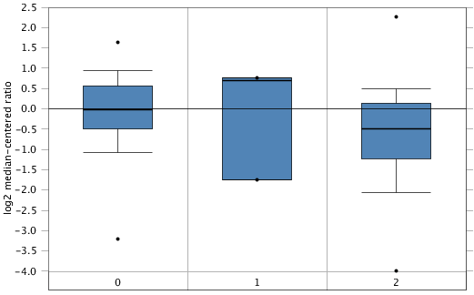
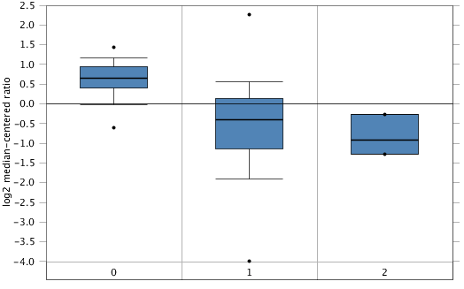

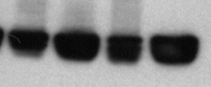
A
B
0 = no value 200
1 = Ductal Breast Carcinoma in Situ 3
2 = Invasive Ductal Breast Carcinoma 190
0 = no value 61
1 = primary site 529
2 = metastasis 3
C
ER
66kD
b-Actin
GI-LM2
GI101A
GI-LM2-C
GI-LM2-G
Supplemental Figure 1

Slide 2
A
IF: EMT-markers in sphere cells
bf
Gal3
CDH1
Vim
merge
GI-LM2C
GI-LM2G
B
GI-LM2C
GI-LM2G
Supplemental Figure 2

Slide 3
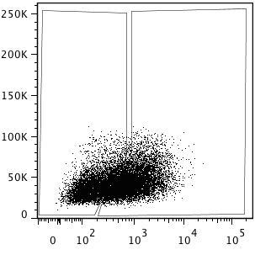
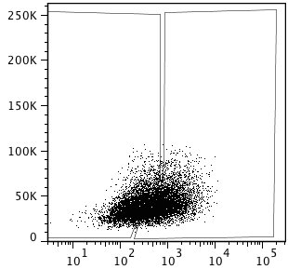
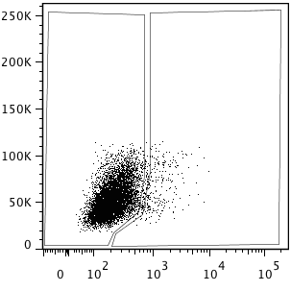
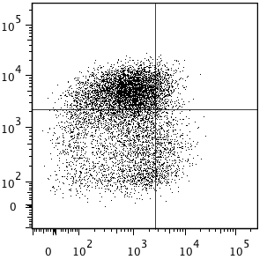
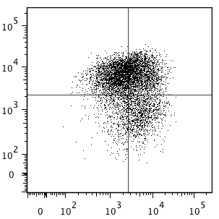
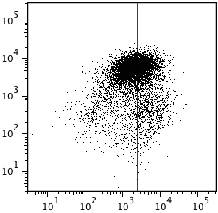
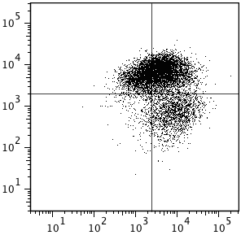
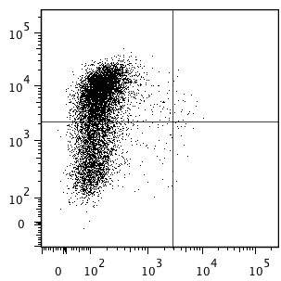
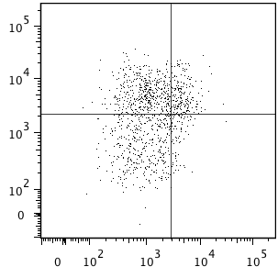
A
GI-101A
GI-LM2C
GI-LM2G
49.8%
43.8%
52.6%
47.4%
96.2%
2.96%
SSC
SSC
SSC
Gal3
Gal3
Gal3
52.2%
38.8%
43.3%
25.4%
66.2%
39.7%
CD44
CD44
CD24
CD24
CD24
B
 | GI101A |  | GI-LM2C
 | Gal3^{neg} | Gal3^{pos} | Gal3^{neg} | Gal3^{pos}
CD24^{neg} | 85.1% | 46.6% | 57.0% | 28.5%
EpCAM^{pos} | 19.7% | 53.7% | 25.4% | 74.9%
Supplemental Figure 3
Notes:
Figure Gal3 B_CSC 20130624
Nachman 6 color 20120928

Slide 4
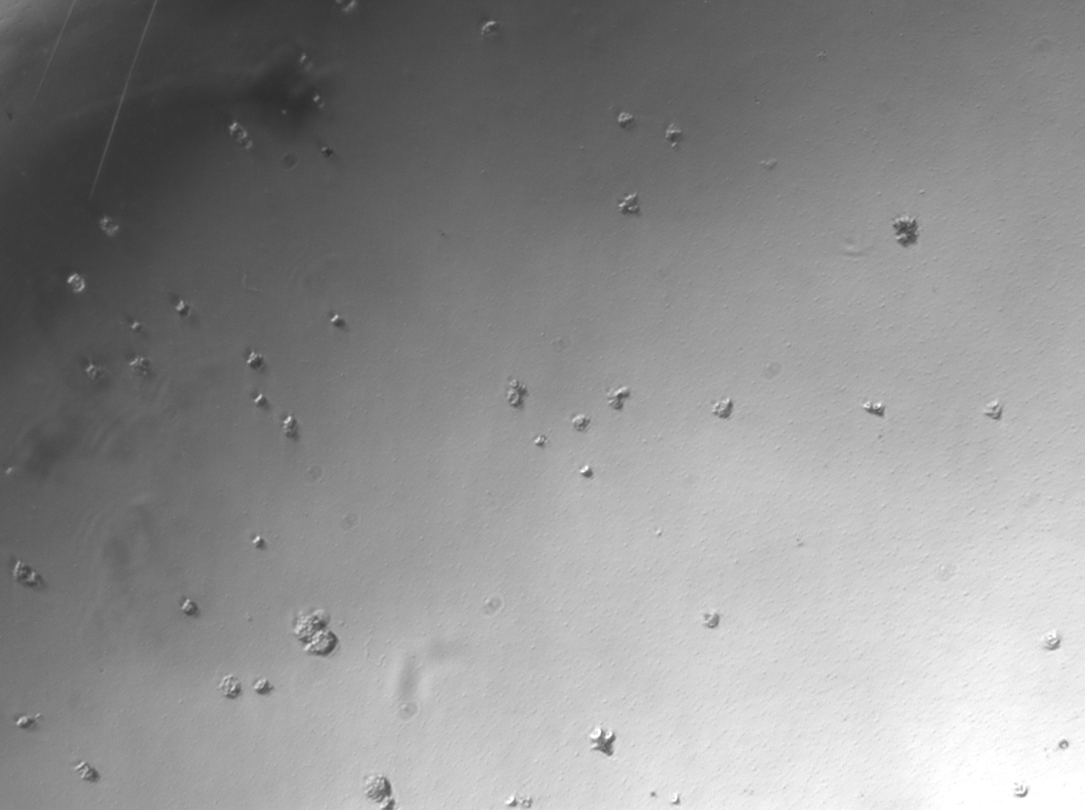
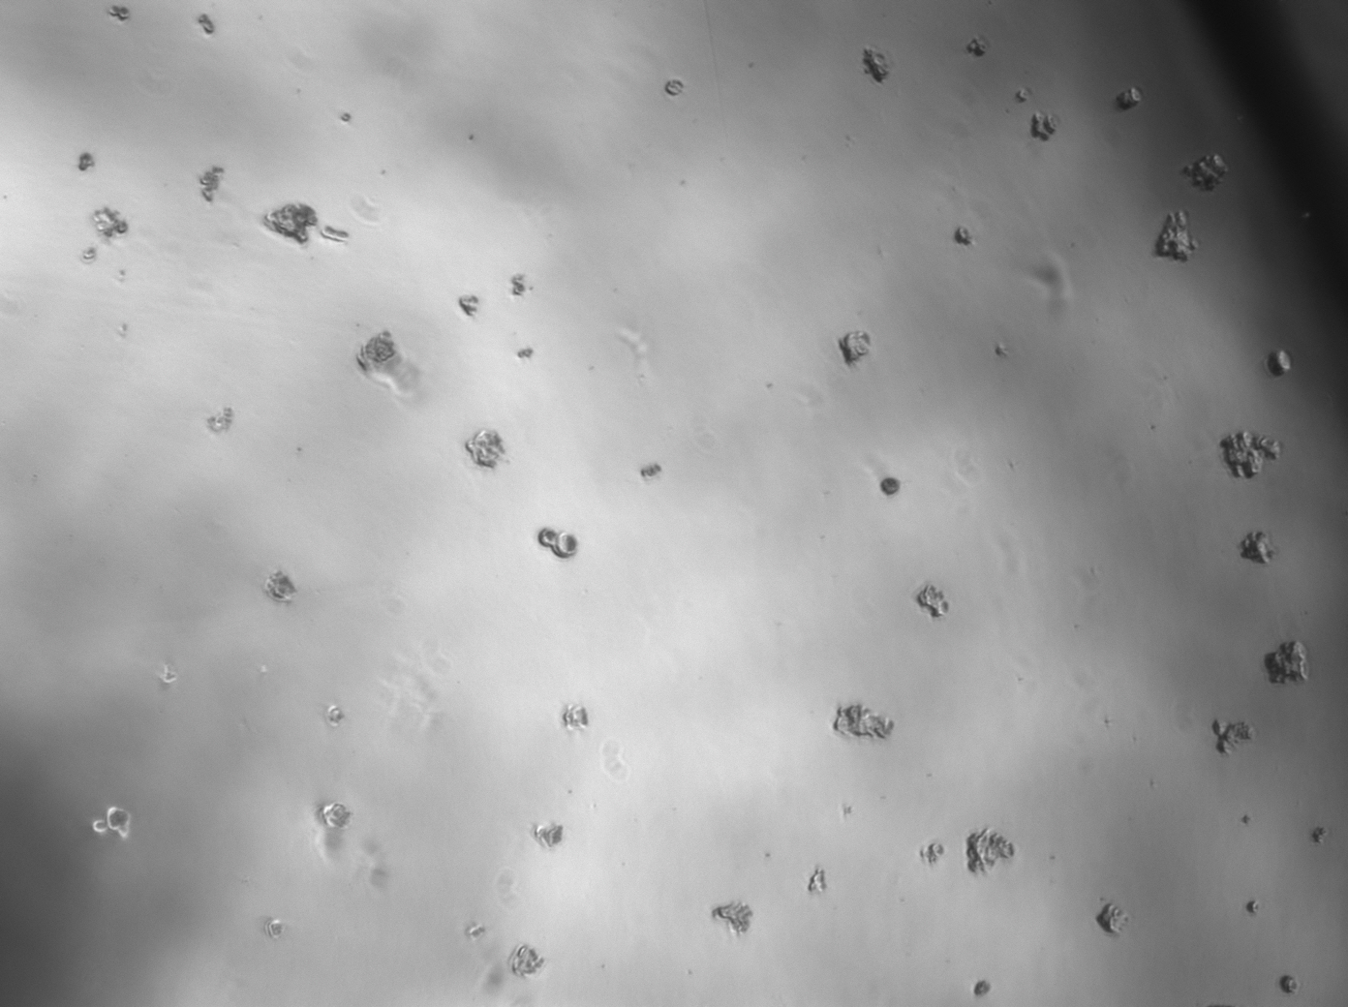
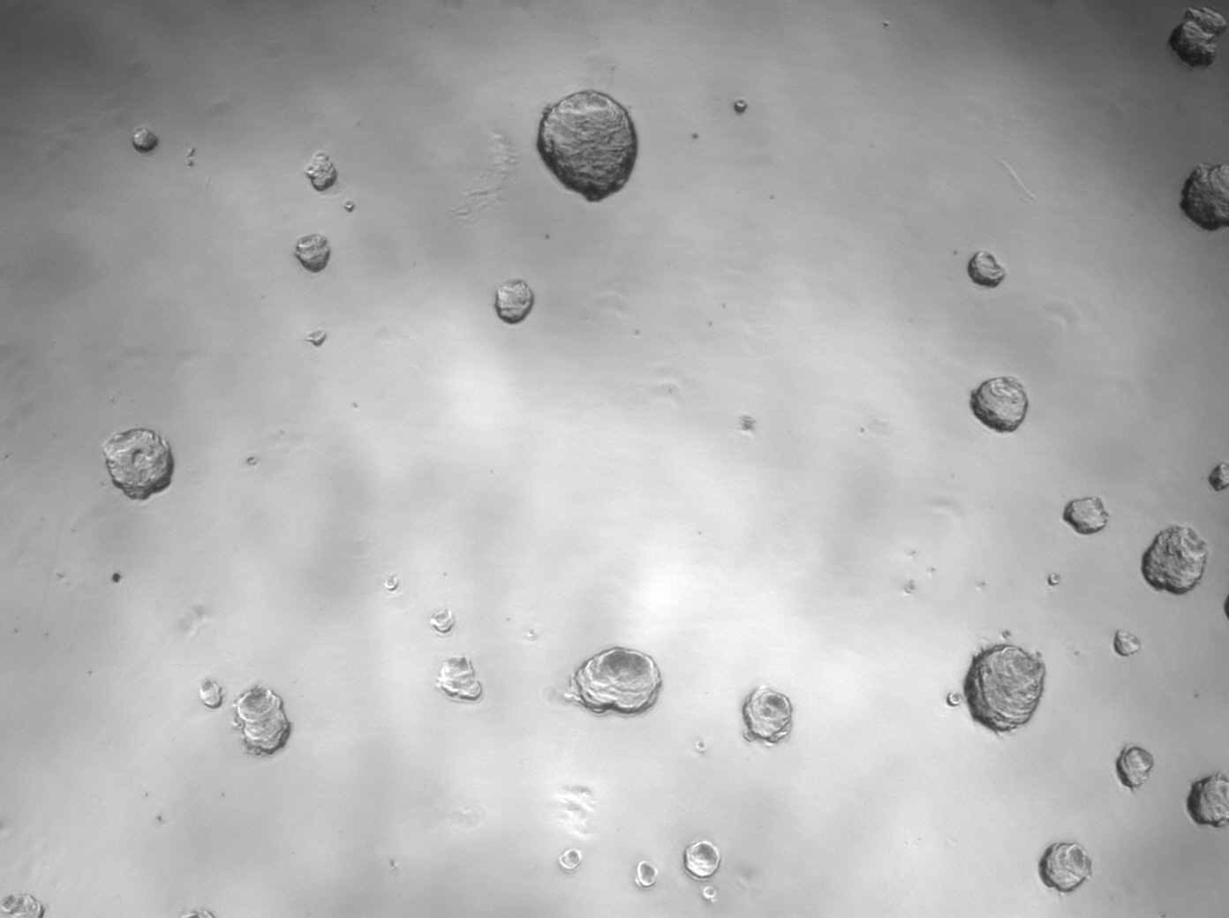
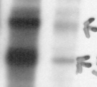
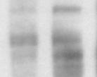

A
GI-101A
GI-LM2C
GI-LM2G
B
C
Tcf4
58 / 79kD
Axin2
98 / 95kD
b-Actin
GI-LM2-G
GI-LM2-C
Supplemental Figure 4

