Slide 1
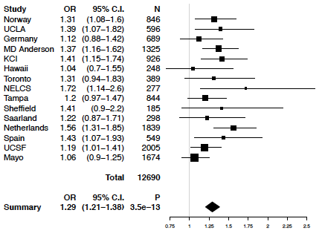
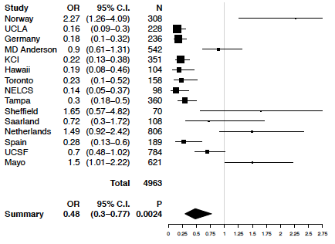
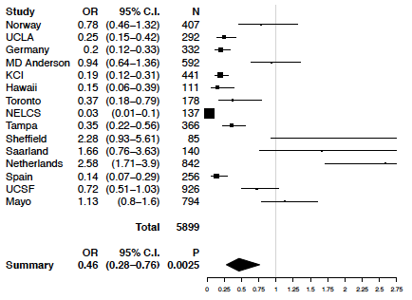
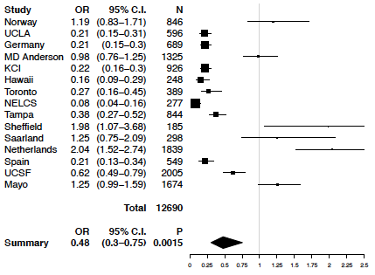
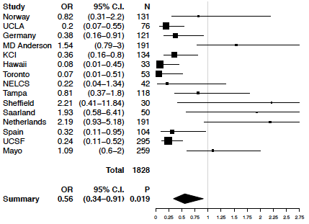
Figure S1. CHRNA5 rs16969968 predicts risk of lung cancer. Smoking cessation decreases probability of lung cancer regardless of CHRNA5 rs16969968 genotype.
(A) rs16969968 increases lung cancer
(C) Smoking cessation decreases lung cancer, stratified by rs16969968
Rs16969968=GG
(B) Smoking cessation decreases lung cancer
Rs16969968=GA
Rs16969968=AA
Quit: individuals who report having quit smoking when ascertained as cases of lung cancer or controls.
N=12,690 (6988 cases of lung cancer and 5702 controls)
All are ever smokers (5833 active smokers, 6857 smokers who have quit)
Adjusted for age, sex and rs16969968. P_{het} = 0.196, <1e-16, <1e-16, <1e-16, 3.36e-06
0,0,0,3.36e-06
Notes:
Phet==0 is a mystery to me… but I guess that value is rounded without too much precision...

Slide 2
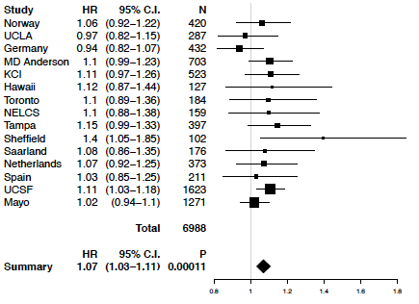
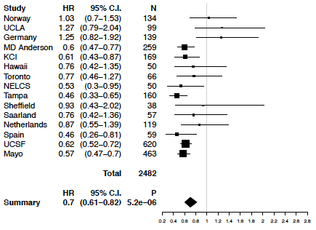
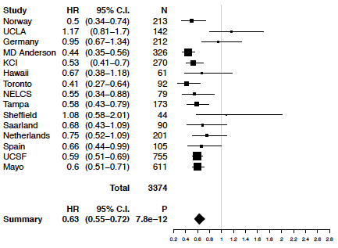
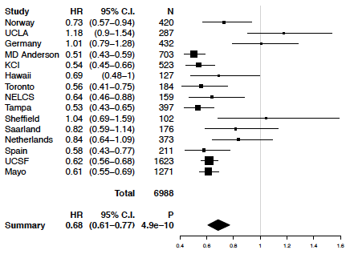
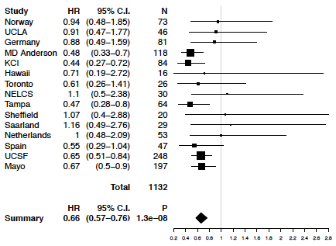
Figure S2. CHRNA5 rs16969968 predicts earlier lung cancer. Smoking cessation delays lung cancer, regardless of CHRNA5 rs16969968 genotype.
(A) rs16969968 predicts early lung cancer diagnosis
(C) Smoking cessation delays lung cancer diagnosis, stratified by rs16969968
Rs16969968=GG
(B) Smoking cessation delays lung cancer diagnosis
Rs16969968=GA
Rs16969968=AA
Quit: individuals who report having quit smoking when ascertained as cases of lung cancer.
N=6,988 cases of lung cancer who are ever smokers. (3,471 current smokers, 3,517 former smokers who have quit.)
Adjusted for sex and rs16969968. P_{het} = 0.561, 2.87e-08,0.002, 0.001,0.344

Slide 3
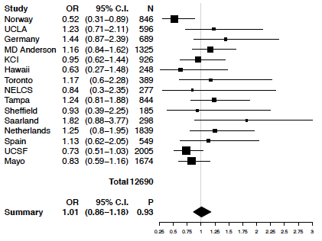
Figure S3. Meta-analysis: No interaction of smoking cessation and CHRNA5 rs16969968 on risk for lung cancer
Quit: individuals who report having quit smoking when ascertained as cases of lung cancer or controls.
N=12,690 (6988 cases of lung cancer and 5702 controls.
All are ever smokers (5833 active smokers, 6857 smokers who have quit)
Adjusted for age, sex and rs16969968. P_{het} = 0.139

Slide 4
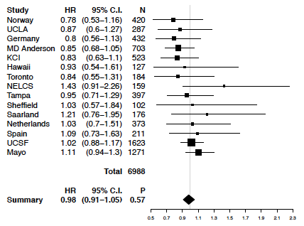
Figure S4. Meta-analysis: No interaction of smoking cessation and CHRNA5 rs16969968 on diagnosis age of lung cancer
Quit: individuals who report having quit smoking when ascertained as cases of lung cancer.
N=6,988 cases of lung cancer who are ever smokers. (3471 active smokers, 3517 smokers who have quit.)
Adjusted for sex and rs16969968. P_{het} = 0.542

