Slide 1
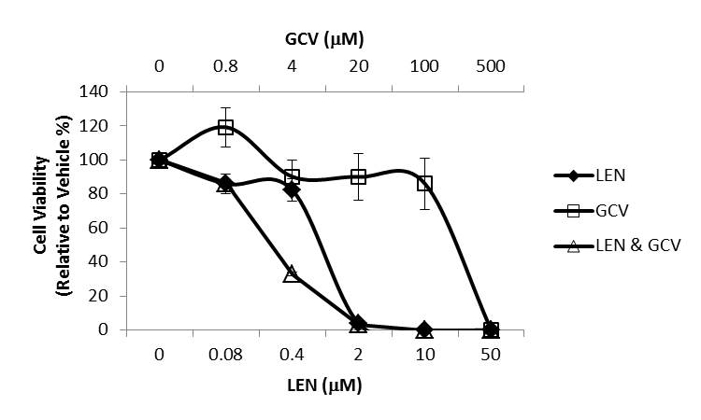
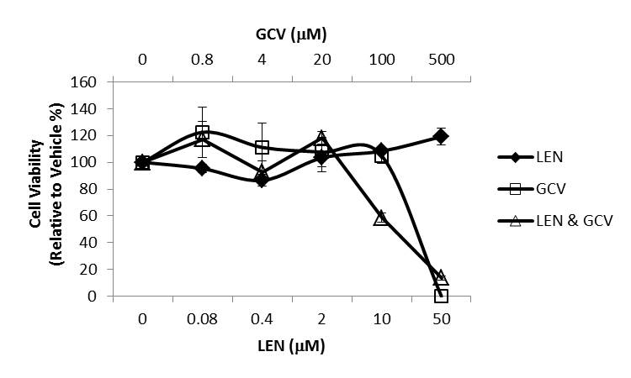
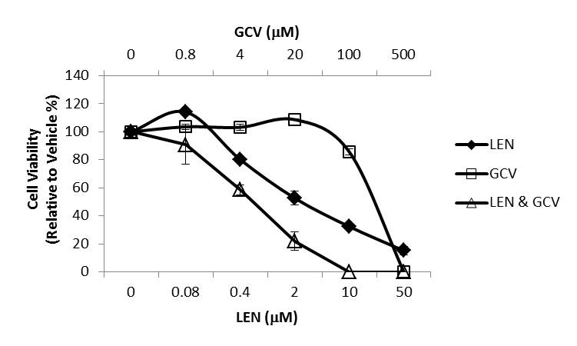
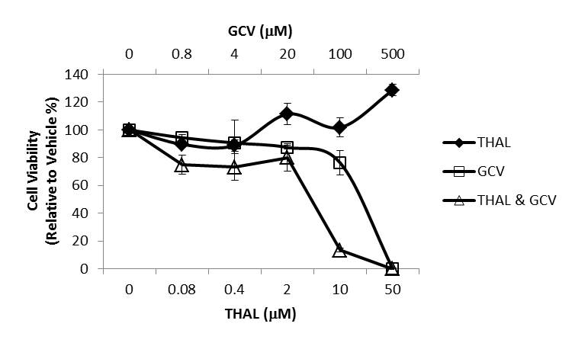
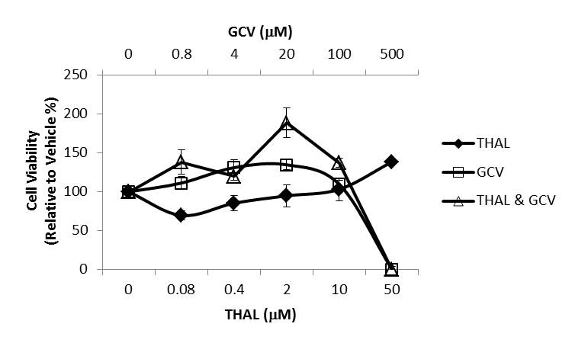
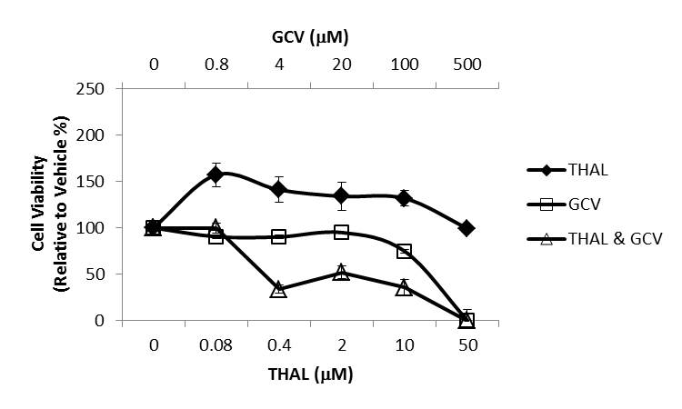
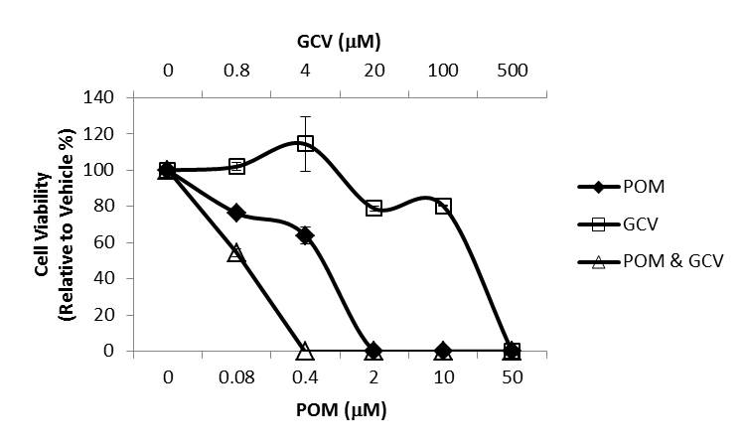
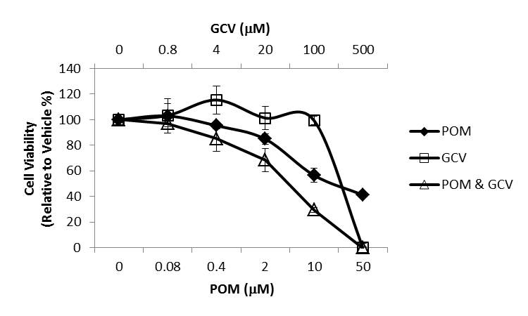
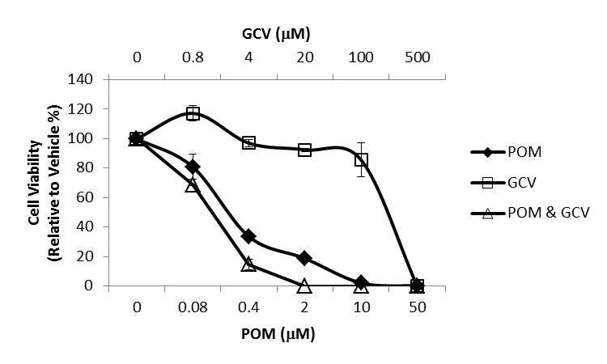
Supplemental Figure 1
(A)
DAUDI
(B)
KEM-I
(C)
MUTU-I
*
*
*
*
*
*
*
*
*
*
*
*
*
*

Slide 2
Supplemental Figure 2
1 Cycle
(A)
SC
DEX (40mg)
DEX
DEX
DEX
SC
Thalidomide (THAL 100mg)
Lenalidomide (25mg)
DAYS
(B)

