Slide 1
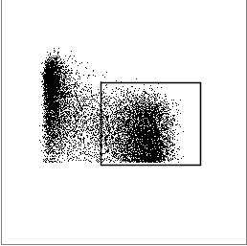
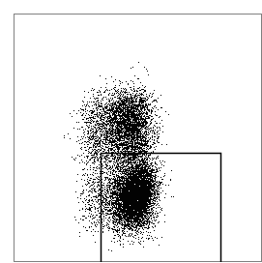
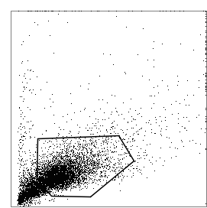
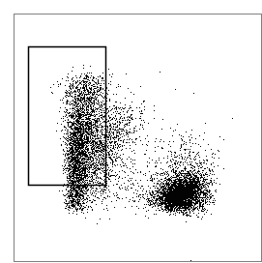
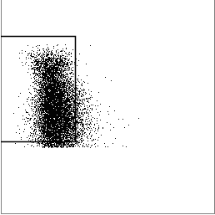
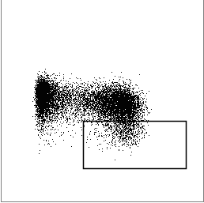
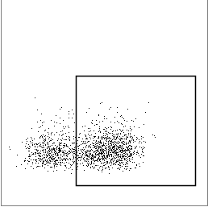
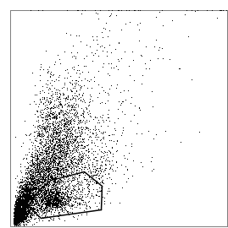
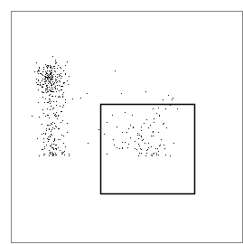
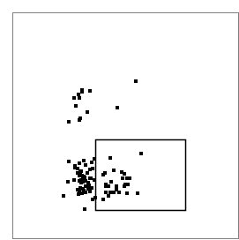
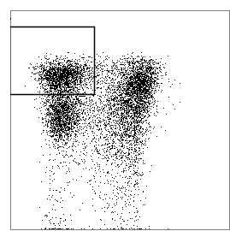
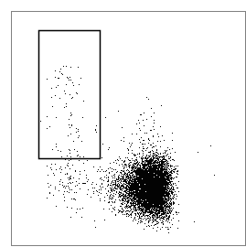
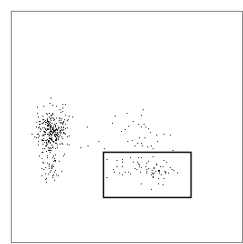
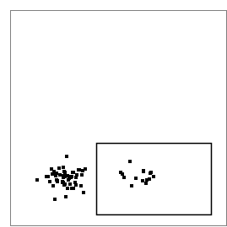
Supplemental Figure. S1
Conv NK cells
A)
33%
Lymphocytes
CD56
NKG2C
SSC-A
CD57
FCεRγ
FSC-A
Live
CD56+
CD56+
CD3-
7.5%
Adaptive NK cells
CD56
CD56
FCεRγ
FSC-A
Live/dead marker
CD19, CD14
CD3
CD57
NKG2C
B)
Conv NK cells
6%
Lymphocytes
CD56
NKG2C
SSC-A
FSC-A
CD57
FCεRγ
Live
CD45+
CD56+
CD3-
3%
Adaptive NK cells
CD45
CD56
FCεRγ
FSC-A
Live/dead marker
CD19, CD14
CD3
CD57
NKG2C

Slide 2
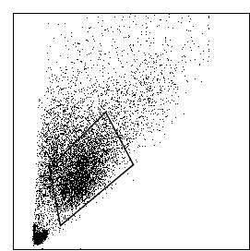
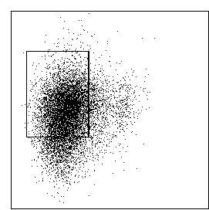
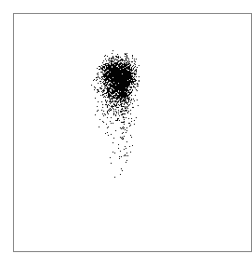
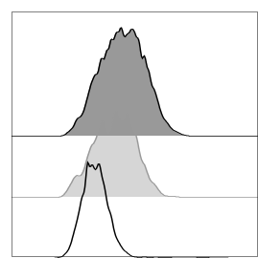
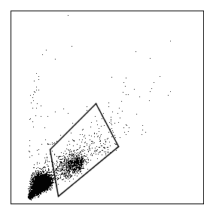
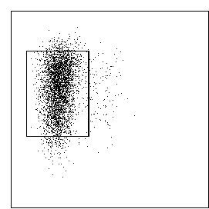
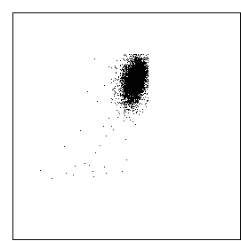
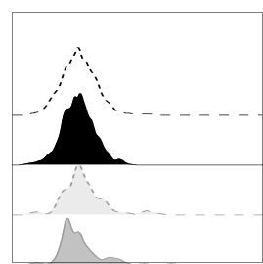
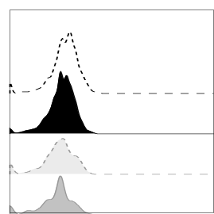
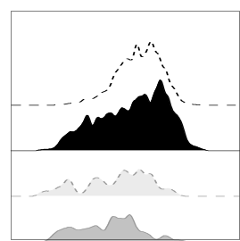
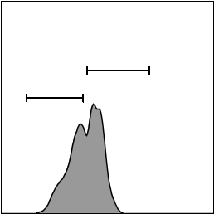
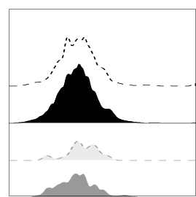
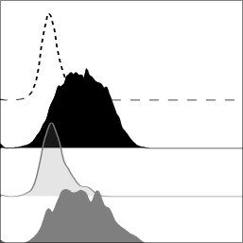
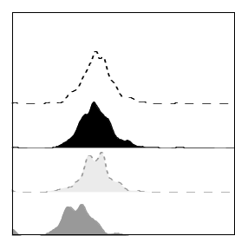
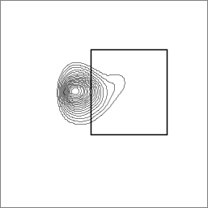
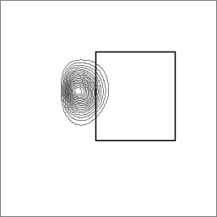
Supplemental Figure. S2
A)
B)
MFI
760
683
156
MDSC
SSC-A
CD33
CD11b
FSC-A
Live/dead marker
Lin-
HLA-DR
Counts
Monocytes
CD16
SSC-A
CD33
CD11b
Conv NK cells
Adaptive NK cells
FSC-A
Live/dead marker
Lin-
HLA-DR
Isotype Ctrl
C)
NKp44
PD-1
TIM-3
D)
MFI
159
146
197
158
MFI
294
253
218
192
MFI
910
749
650
559
TIGIT+++
TIGIT-/+
MFI
146
135
174
127
MFI
75
539
122
526
MFI
180
183
164
58
CD56
23%
10.7%
NKp46
CD96
NKG2A
Conv NK+MDSC
IFNγ
Conv NK+Monocytes
Adaptive NK+MDSC
Adaptive NK+Monocytes

Slide 3
Supplemental Figure. S3
A)
B)
C)

Slide 4
Supplemental Table. 1
Marker | Clone | Fluorochrome | Manufactory
CD3 | OKT3 | APC/CY7 | Biolegend
CD3 | OKT3 | BV785 | Biolegend
CD56 | NCAM | APC/CY7 | Biolegend
CD56 | NCAM | PE/CY7 | Biolegend
CD57 | NK-1 | BV605 | BD Biosciences
CD45 | HI30 | BV711 | Biolegend
HLA-DR | L243 | AF488 | Biolegend
CD11b | ICRF44 | PE | Biolegend
CD33 | WM53 | APC | Biolegend
CD66b | G10F5 | AF700 | Biolegend
CD14 | M5E2 | Pacific B | BD Biosciences
CD14 | M5E2 | APC/CY7 | BD Biosciences
CD19 | HIB19 | APC/CY7 | BD Biosciences
CD16 | 3G8 | AF700 | Biolegend
NKp44 | P44-8 | APC | BD Biosciences
NKp46 | 9E2 | PerCP-eFluor® 710 | BD Biosciences
DNAM-1 | 11A8 | APC | Biolegend
pZAP/Syc | 17A/P-ZAP70 | AF647 | BD Biosciences
pERK | 20A | APC | BD Biosciences
CD155 (PVR) | SKII.4 | PerCP/Cy5.5 | Biolegend
CD112 (Nectin2) | TX31 | PE/CY7 | Biolegend
CellTrace |  | Violet | Invitrogen
CD107a | H4A3 | PerCP/Cy5.5 | Biolegend
IFNγ | 4S.B3 | BV650 | Biolegend
Ki67 | B56 | AF700 | BD Biosciences
TIGIT | 741182 | APC | R&D systems
ROS |  | 520 nm | eBiosciences
CellTracker |  | Blue | Invitrogen
NKG2C | 134591 | PE | R&D systems
FCεRγ | RB Polyclonal | FITC | EMD millipore
PD-1 | MIH4 | APC | eBiosciences
NKG2A | 131411 | APC | R&D
TIM-3 | F38-2E2 | BV421 | Biolegend
CD96 | NK92.39 | APC | Biolegend
TNFα | MAb11 | BV421 | BD Biosciences
Fixable dead cell marker |  | Near-IR | Invitrogen
Supplemental Table. 1 Antibodies and fluorescent dyes used in different experiments.

