Slide 1
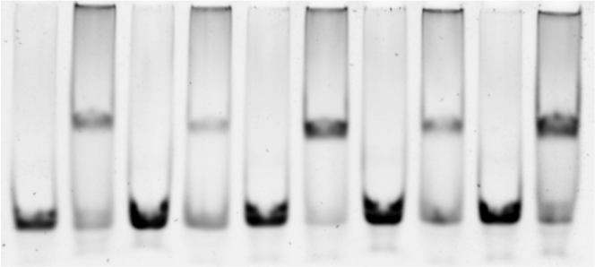
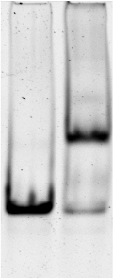
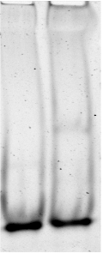
Pr89 |  | Pr90 |  | Pr91 |  | Pr92 |  | Pr93
- | + | - | + | - | + | - | + | - | +
Pr99
- | +
Pr101
- | +
Primer Name | Sequence | # bp between repeats
Pr89 | 5’-TAAGTACTATACAATAGAGTAGTAG-3’ | 9
Pr90 | 5’-TAAGTACTATACATATAGAGTAGTAG-3’ | 10
Pr91 | 5’-TAAGTACTATACATATATAGAGTAGTAG-3’ | 12
Pr92 | 5’-TAAGTACTATACATATAATAGAGTAGTAG-3’ | 13
Pr93 | 5’-TAAGTACTATACAATATAATAGAGTAGTAG-3’ | 14
Pr99 | 5’-TAAGTACTATAAACAATATAATAAAGAGTAGTAG-3’ | 18
Pr101* | 5’-GTACTATACAGCCTGGAGTAG-3’ | 11
*Changed TATAA in the middle of Pr68 TACT(N₁₁)AGTA to GCCTG

