Slide 1
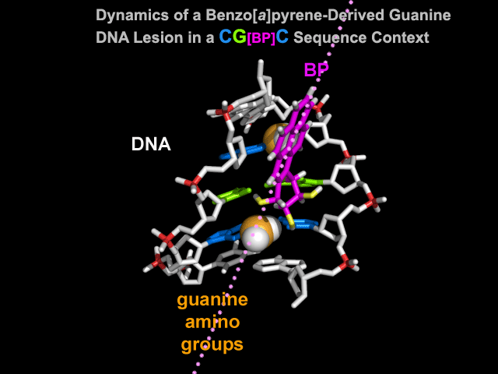
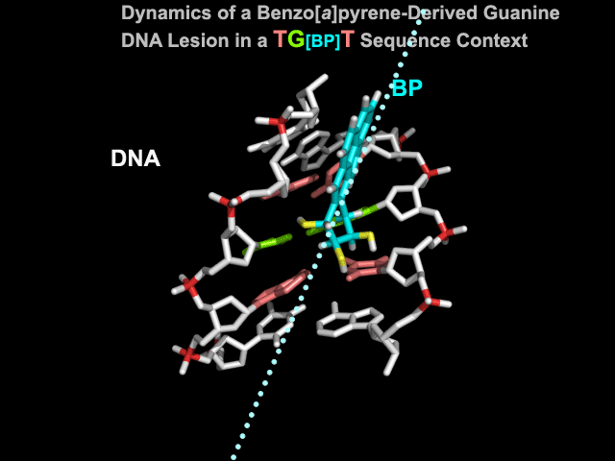
Dynamic recognition of DNA damage
Supplemental movie 3
Notes:
Damage recognition is dynamic so it involves a dance between the DNA lesions and the actual protein which embraces the damage.

