Slide 1
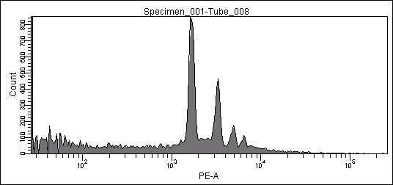
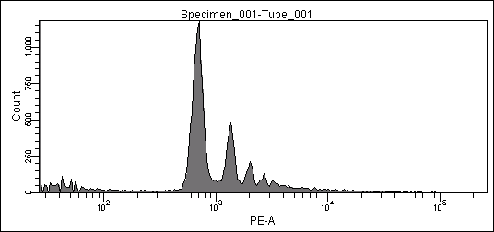
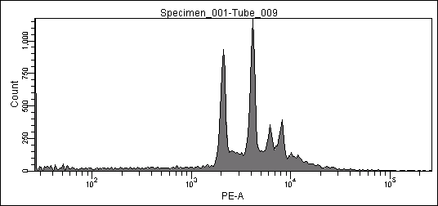
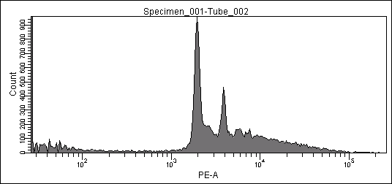
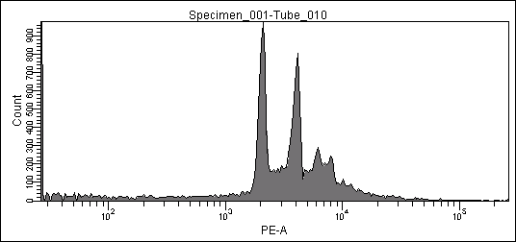
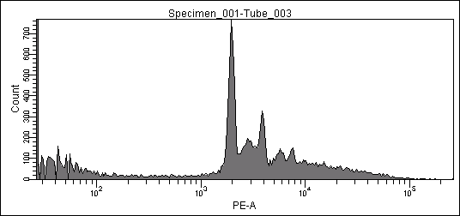
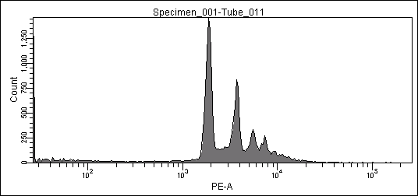
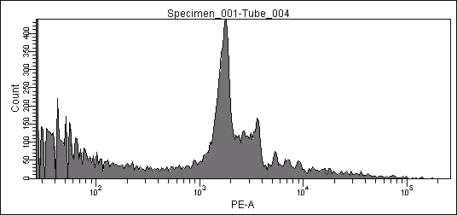
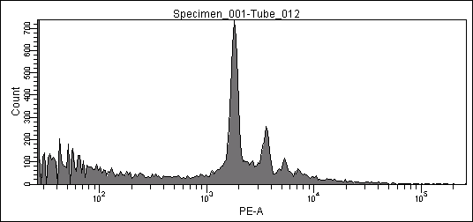
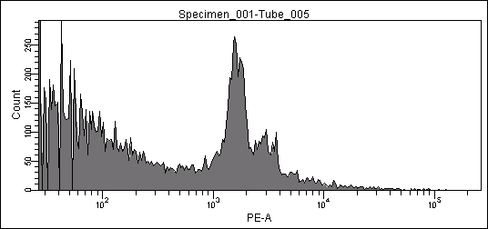
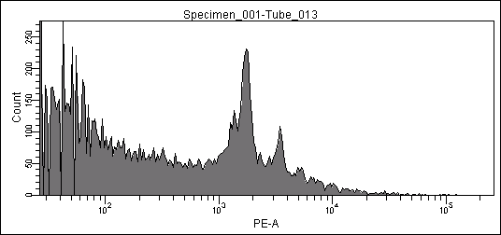
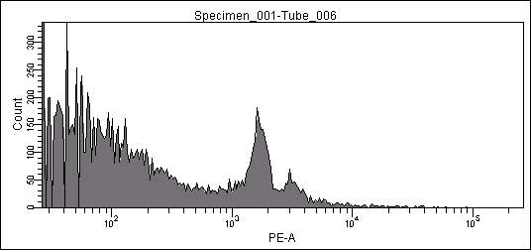
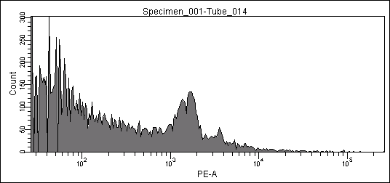
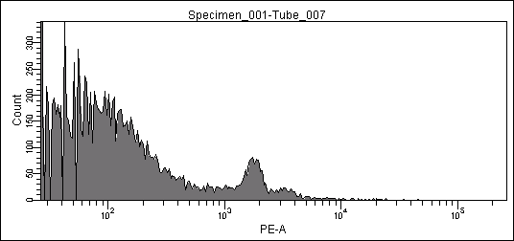
Supplementary figure 2
a
SW48
LS174T
(h)
C
12
24
48
72
96
120
C
12
24
48
72
96
120
Cleaved PARP
β-actin
b
SW48
LS174T
control
subG1
9.8%
subG1
8.2%
12h
subG1
6.9%
subG1
9.1%
24h
subG1
7.6%
subG1
13.9%
48h
subG1
5.9%
subG1
21.5%
72h
subG1
23.2%
subG1
32.8%
96h
subG1
32.8%
subG1
40.4%
120h
subG1
35.3%
subG1
47.9%

