Slide 1
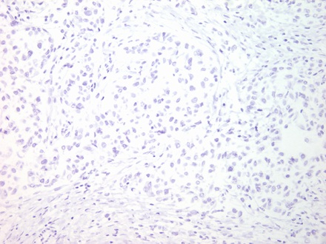
Supplementary Figure 1
Negative controls
DDR1
DDR2
normal
breast tissue
Invasive
carcinoma
Supplementary Figure 1. Four examples of negative controls for DDR1 and DDR2 immunostaining in normal breast tissues and in invasive carcinomas of the breast using prediluted Polymer Negative Control Serum (mouse and rabbit). 200x.

