Slide 1
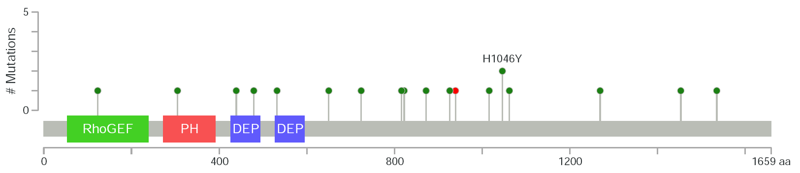
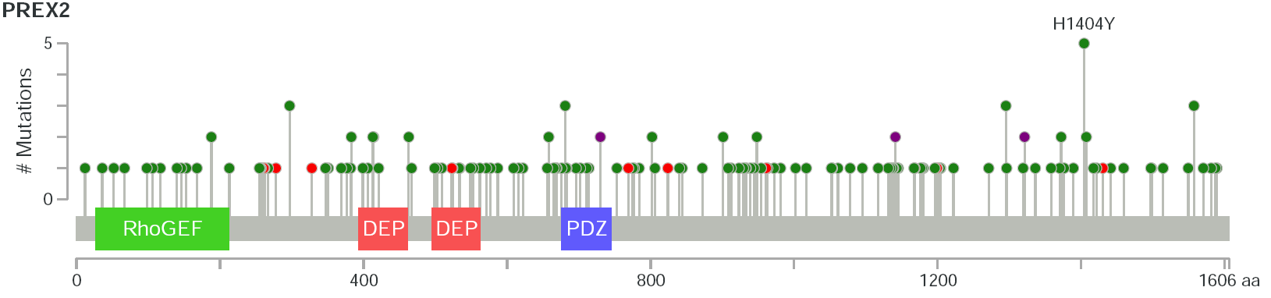
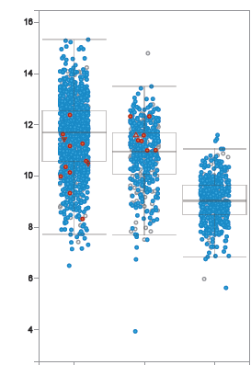
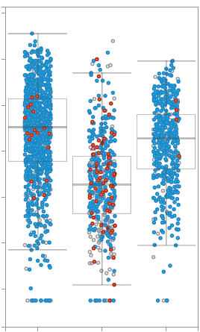
Figure S1
A
PREX1
PREX2
B
C
PREX1 mRNA Expression
PREX2 mRNA Expression
16
10
14
8
12
6
PREX1 expression-RNA-Seq V2 (log2)
PREX2 expression-RNA-Seq V2 (log2)
10
4
8
2
6
0
4
-2
Breast
Melanoma
Prostate
Breast
Melanoma
Prostate
Not Sequenced
Not Sequenced
Not Mutated
Not Mutated
Missense
Missense
Splice
Splice
Nonsense
Nonsense
Frameshift

