Slide 1
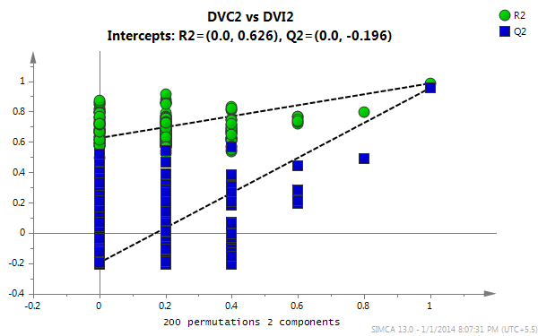
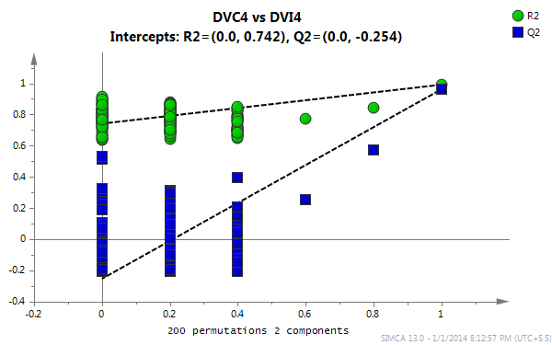
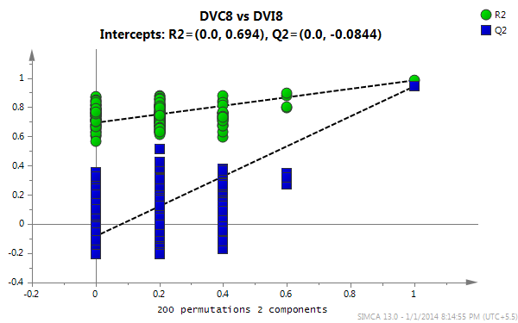
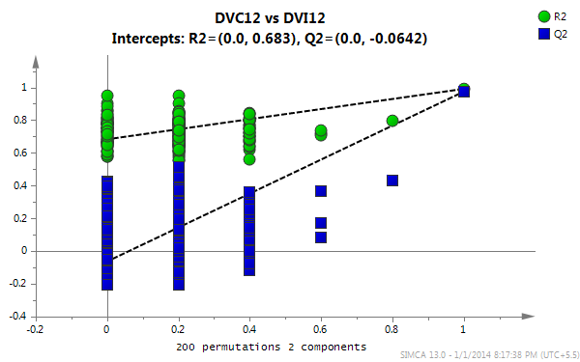
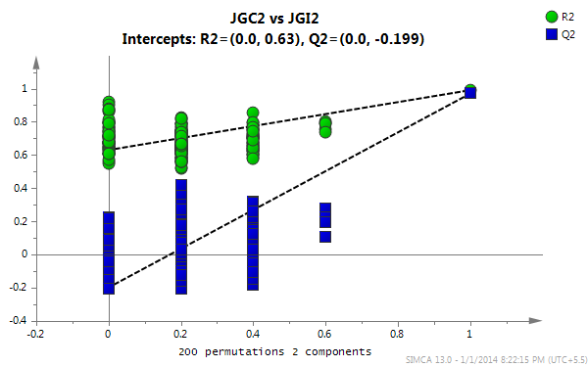
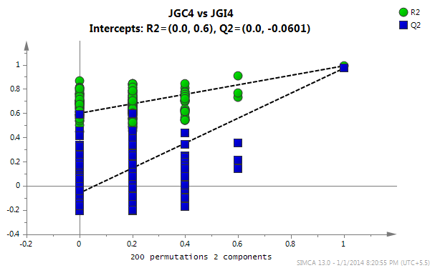
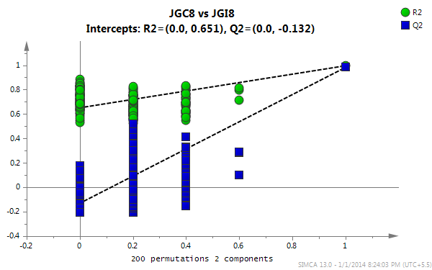
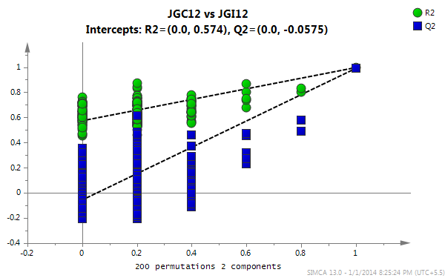
a
b
c
d
e
f
g
h
Figure S2: Permutation test results for OPLS-DA models with two components and 200 permutations. Models of (a-d) resistant (DV) chickpea plants are shown at 2, 4, 8 and 12 DAI and (e-h) susceptible (JG62) of same stages. a: DVC2 vs. DVI2 (intercepts: R²=0.0, 0.626; Q²=0.0, -0.196); b: DVC4 vs. DVI4 (intercepts: R²=0.0, 0.742; Q²=0.0, -0.254); c: DVC8 vs. DVI8 (intercepts: R²=0.0, 0.694; Q²=0.0, -0.0844); d: DVC12 vs. DVI12 (intercepts: R²=0.0, 0.683; Q²=0.0, -0.0642); e: JGC2 vs. JGI2 (intercepts: R²=0.0, 0.63, Q²=0.0, -0.199); f: JGC4 vs. JGI4 (intercepts: R²=0.0, 0.6; Q²=0.0, -0.0601); g: JGC8 vs. JGI8 (intercepts: R²=0.0, 0.651, Q²=0.0, -0.132) and h: JGC12 vs. JGI12 (intercepts: R²=0.0, 0.574, Q²=0.0, -0.0575).

