Slide 1
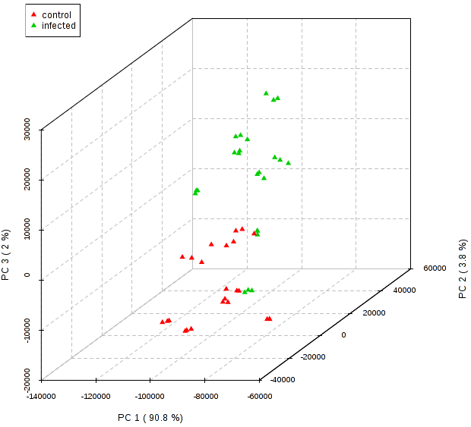
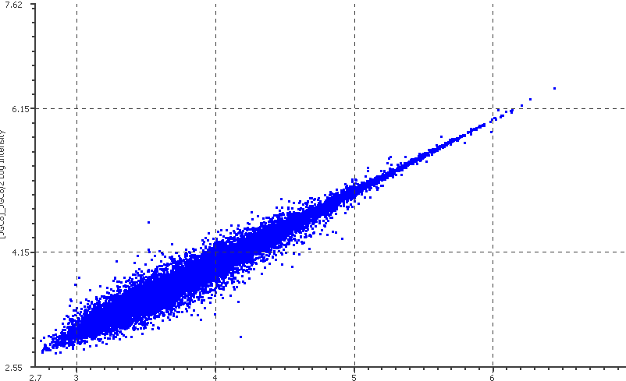
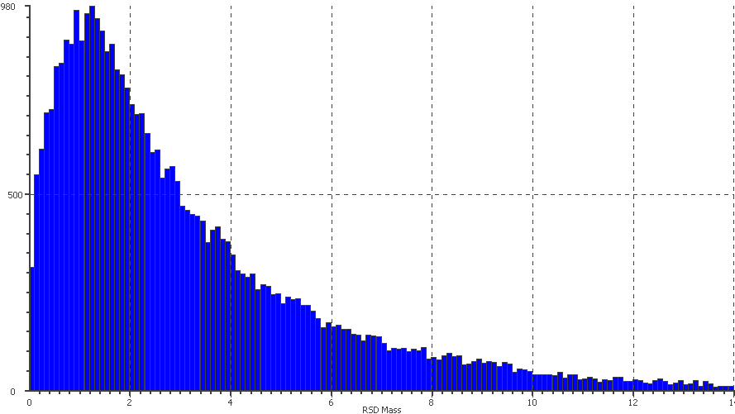
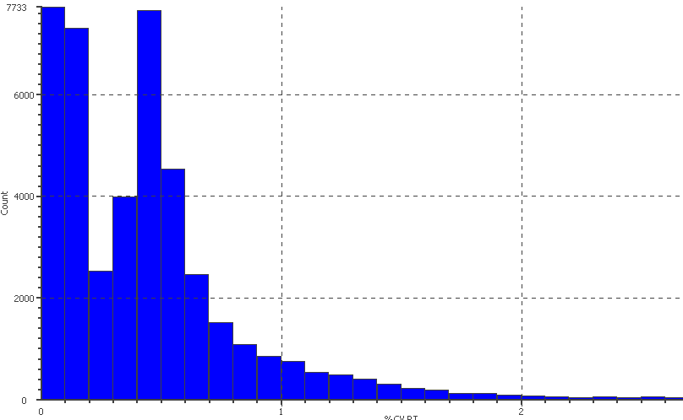
a
b
Replicate 2
Replicate 1
c
d
Count
Count
PPM
% CV RT
Figure S5: Protein quality control measurements. (a) PCA plot indicating clear separation between control and inoculated samples; (b) reproducibility of intensity in replicates of samples; (c) majority of ion counts with less than 3 ppm error; and (d) percent coefficient of variance of retention time (% CV RT).

