Slide 1
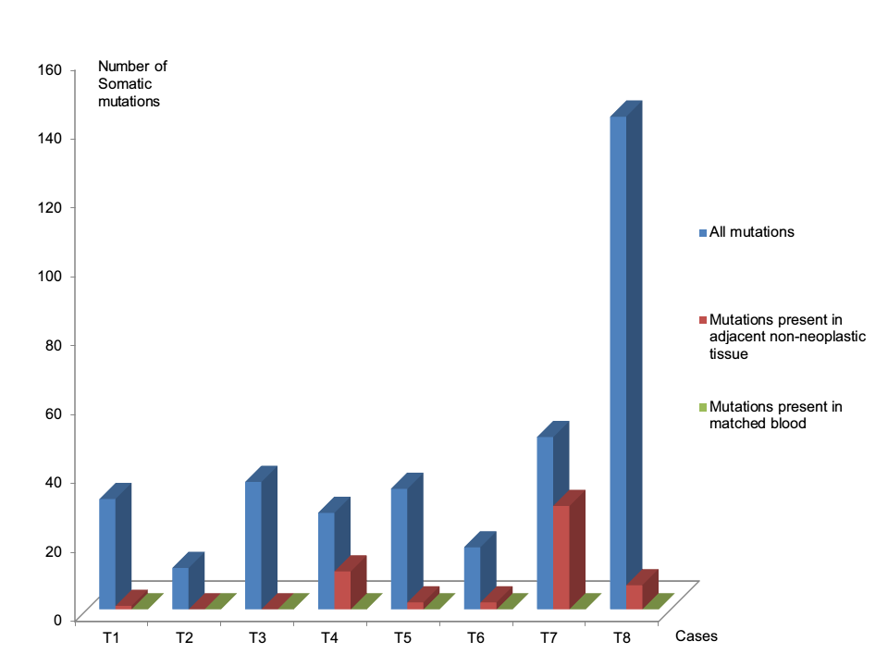
Supplementary Figure 1: An example of previous observation of neoplasm contamination in adjacent non-neoplastic tissues.

Slide 2
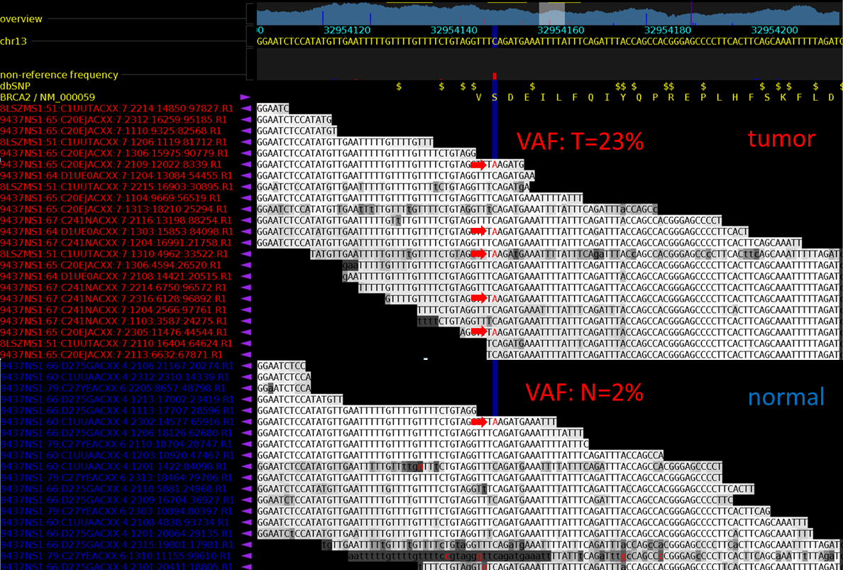
Supplementary figure 2: An example of one somatic mutation (BRCA2 S3041*) present in the matched normal data from adjacent non-neoplastic tissue.

Slide 3
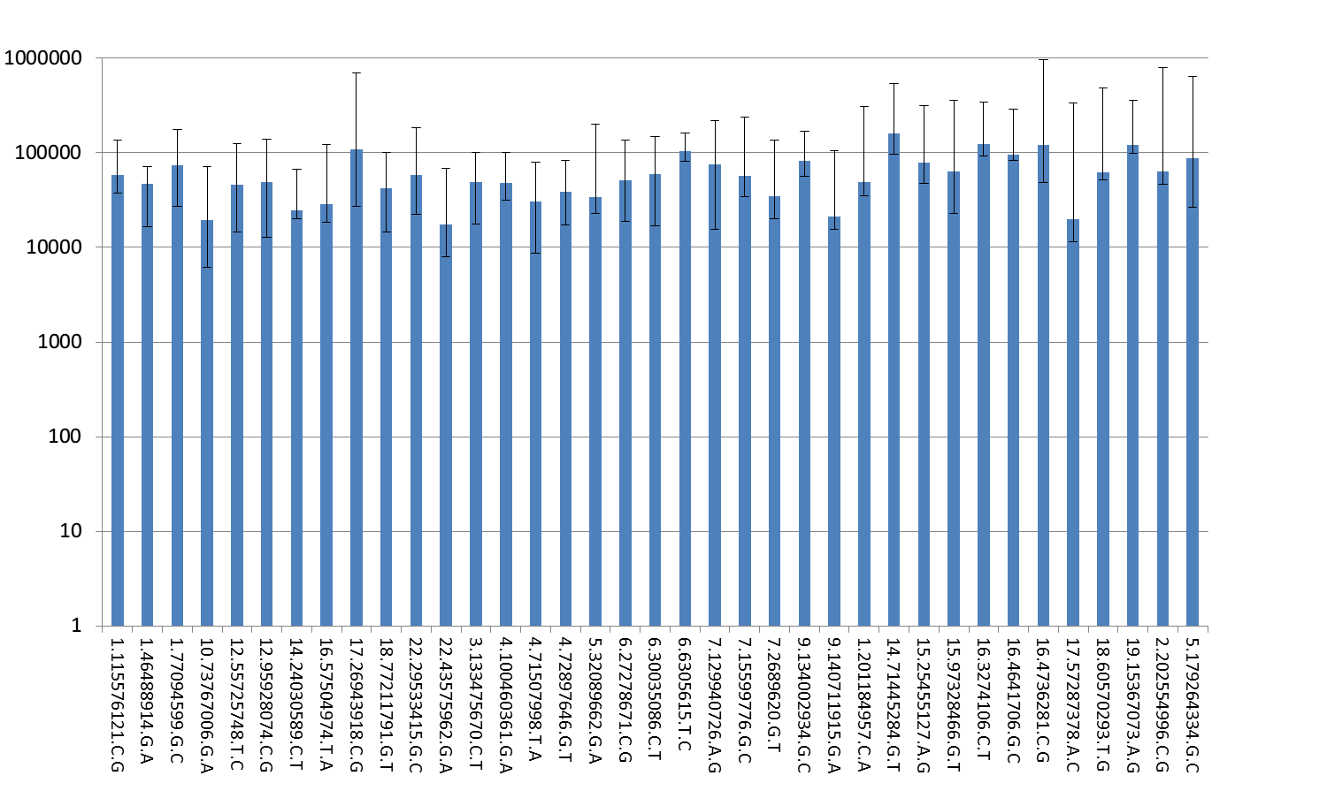
Supplementary Figure 3: Coverage by targeted capture sequencing (TAS)
Coverage (X)
SNV IDs*
*SNV IDs format is dot-deliminated, including the following fields in hg19: 1)chr; 2) posiition; 3) reference allele; 4) mutant allele.

Slide 4
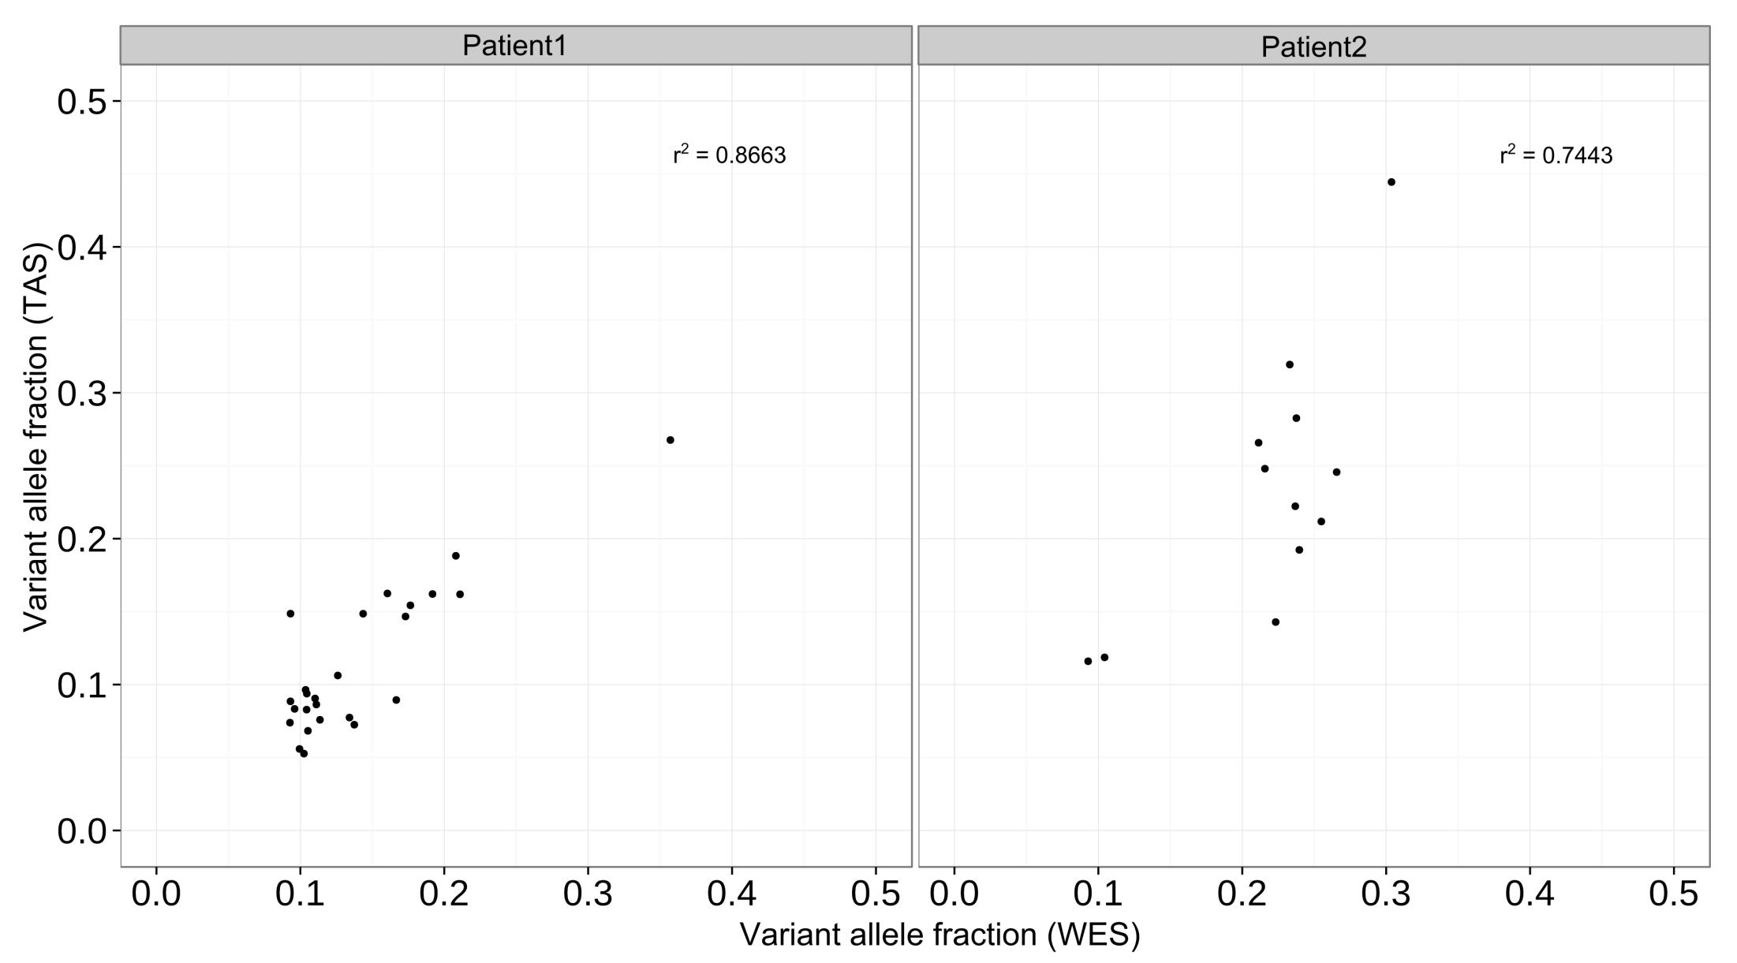
Supplementary Figure 4: Concordance of variant allele fraction (VAF) between whole-exome sequencing (WES) and targeted capture sequencing (TAS)

