Slide 1
Multimedia appendix 1
Screenshots of the treatment platform

Slide 2
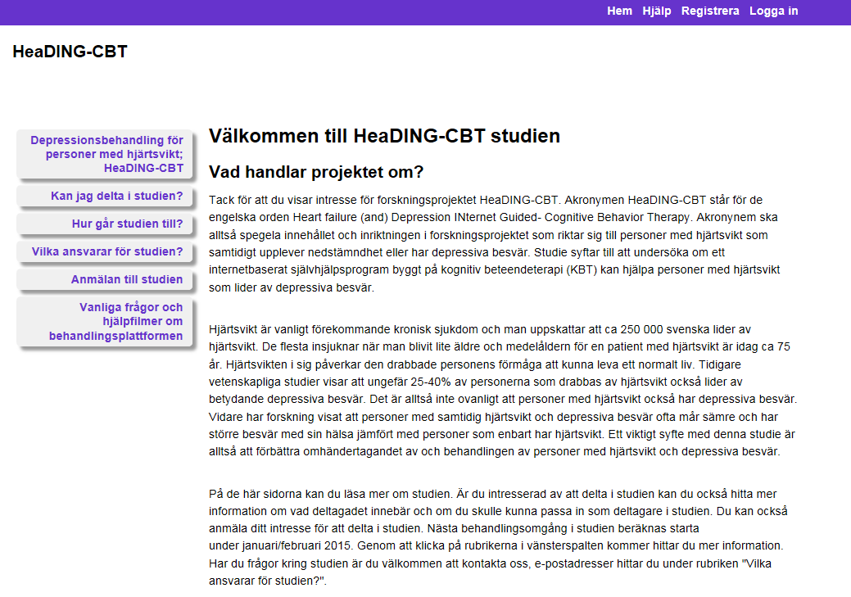
Screenshot of the public web-site

Slide 3
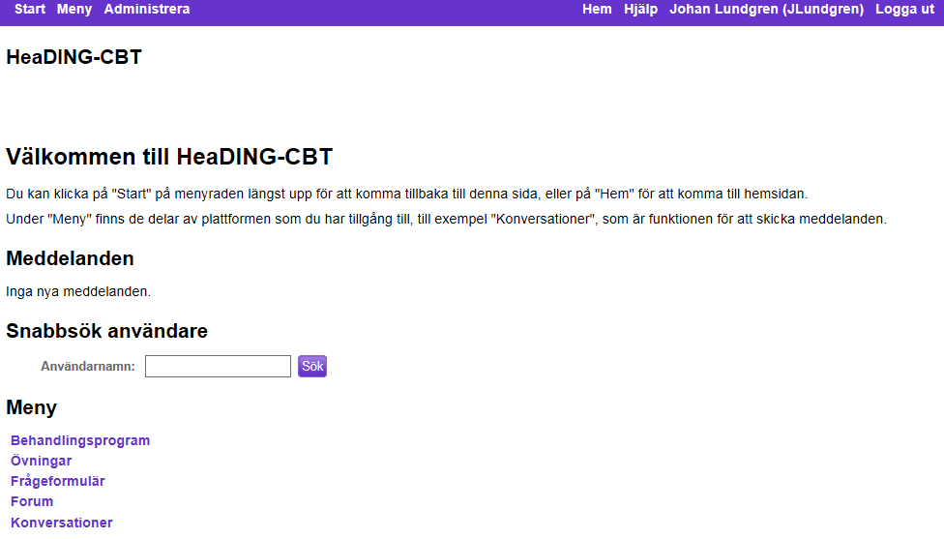
Screenshot of the start-page (logged in)

Slide 4
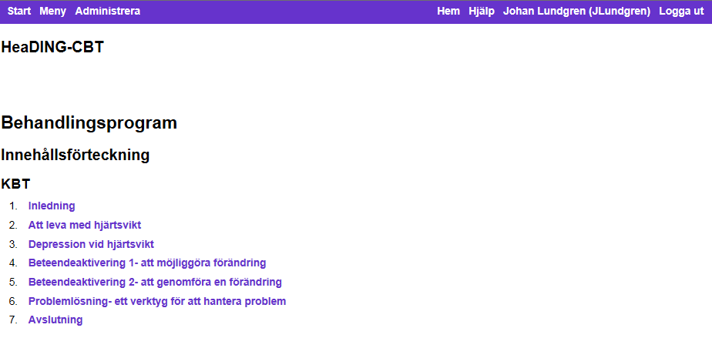
Screenshot of the module headings

Slide 5
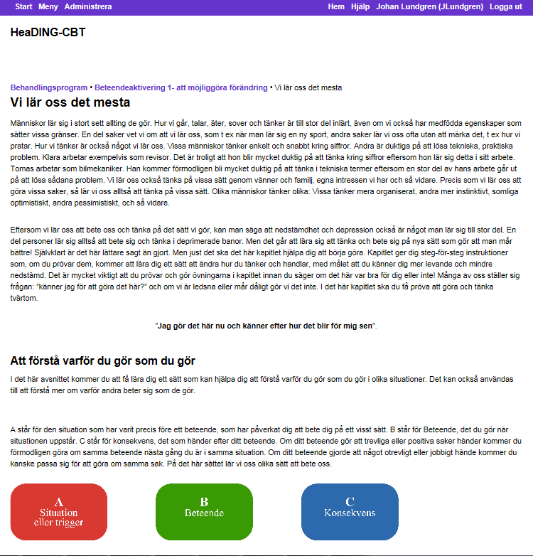
Screenshot of part of text in module

Slide 6
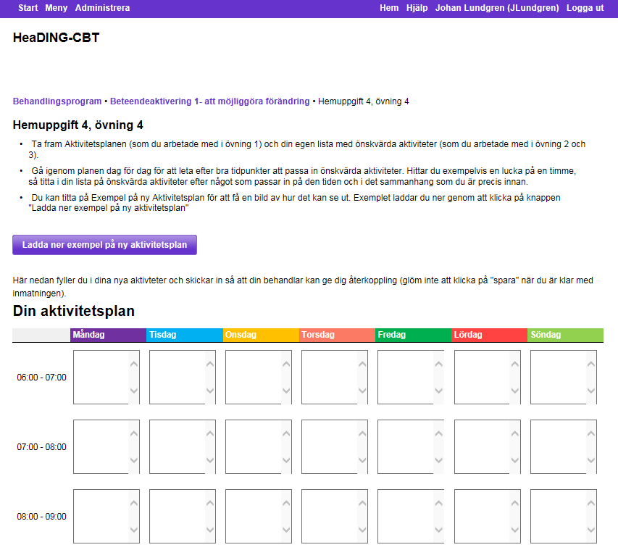
Screenshot, example of homework assignment

