Slide 1
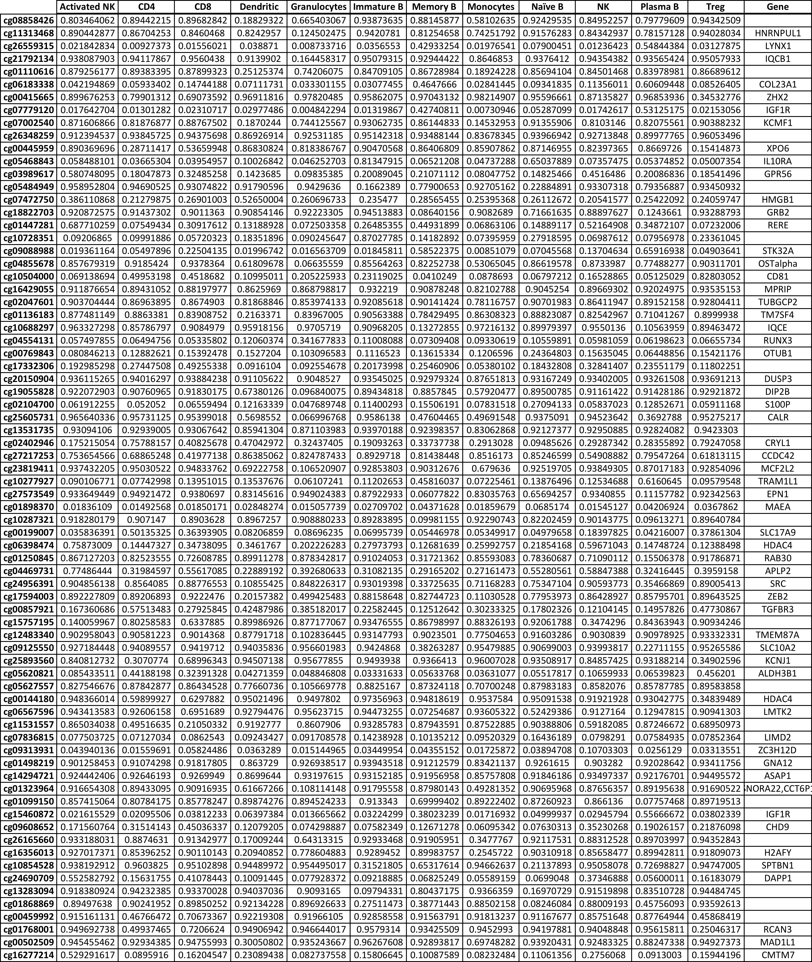
Supplementary Table 1. The methylation of top 74 loci for each leukocyte subtype in the created 450K reference library

Slide 2
Supplementary Table 2. Additional blood 450K methylation datasets evaluated for variation analyses

