Slide 1
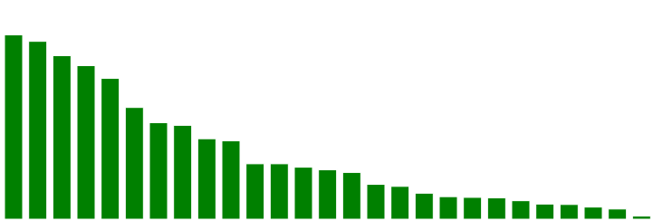
Supplemental FIGURE 1
Lung SC (UCOLOGNE)
Uterine CS (TCGA)
Uterine (TCGA)
Prostate (FHCRC)
DLBC (TCGA)
Melanoma (Broad)
Cholangiocarcinoma (TCGA)
Colorectal (Genentech)
Lung SC (JHU)
Mutation frequency
Melanoma (TCGA)
Glioma (UCSF)
Lung adeno (Broad)
6%
5%
4%
3%
2%
1%
0%
Breast (BCCRC 2012)
MM (Broad)
Stomach (TCGA)
Cervical (TCGA)
Breast (Broad)
Bladder (TCGA)
Testicular germ cell (TCGA)
Prostate (SU2C)
Ovarian (TCGA)
PCPG (TCGA)
Colorectal (TCGA)
Lung adeno (TCGA)
Head & neck (TCGA)
Prostate (TCGA)
LGG-GBM (TCGA 2016)
Cancer type/study
Supplemental Fig. 1: Frequency of FOXA2 mutation by cancer study. Uterine carcinosarcoma and carcinoma have the second- and third-highest mutation rate (5.3% and 4.8% respectively) Mutations were reported in 27 different studies which include 40 or more tumors each. Small cell (neuroendocrine) lung cancers had rates of mutation (5.5% and 2.4%) comparable to those seen in uterine cancers. Data adapted from CBioPortal (May 15, 2016) Gao et al. Sci. Signal. 2013 & Cerami et al. Cancer Discov. 2012 cBioPortal.
Notes:
Supplemental Fig. 1: Frequency of FOXA2 mutation by cancer study. Uterine carcinosarcoma and carcinoma have the second- and third-highest mutation rate (5.3% and 4.8% respectively) Mutations were reported in 27 different studies which include 40 or more tumors each. Small cell (neuroendocrine) lung cancers had rates of mutation (5.5% and 2.4%) comparable to those seen in uterine cancers. Data adapted from CBioPortal (May 15, 2016) Gao et al. Sci. Signal. 2013 & Cerami et al. Cancer Discov. 2012 cBioPortal.

