Slide 1
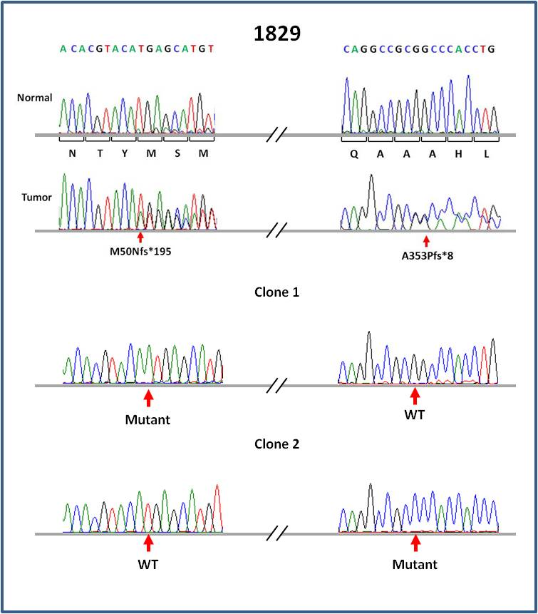
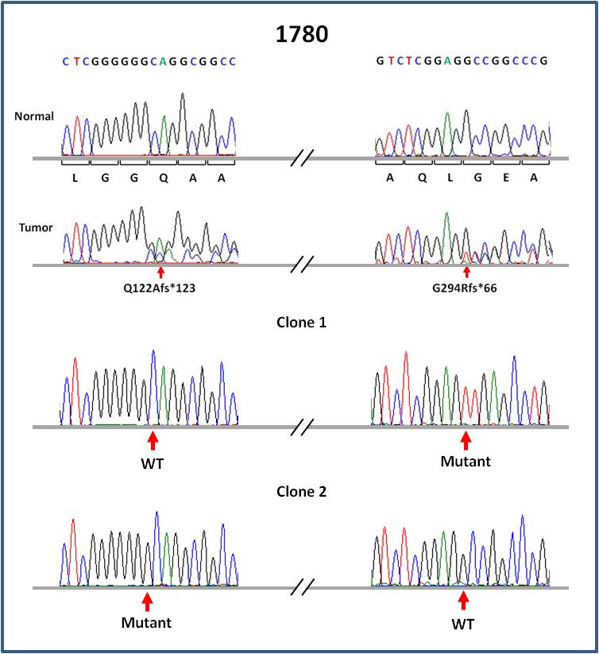
Supplemental FIGURE 2
A
B
Supplemental Fig. 2: FOXA2 mutations are in trans in tumors caring two mutations. (A) Tumor 1829 in exon 2 shows mutations at c.148InsA and c.1056_1075del (absent in normal blood). Lower panels show sequences for separate clones carrying either c.148InsA or c.1056_1075del. (B) Tumor 1780 harbors mutations at c.363InsG and c.879_902del (absent in normal blood). Lower panel sequence for separate clones carrying either c.363InsG or c.879_902del. WT, wild-type.

