Slide 1
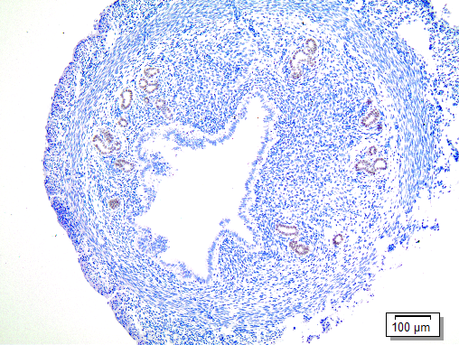
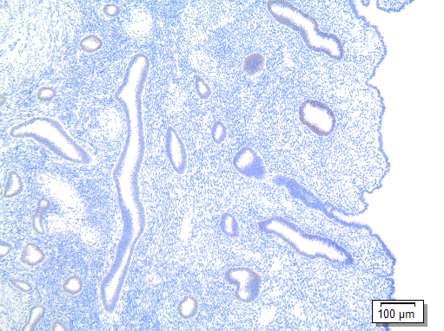
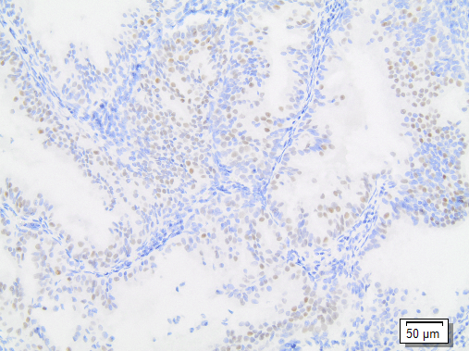
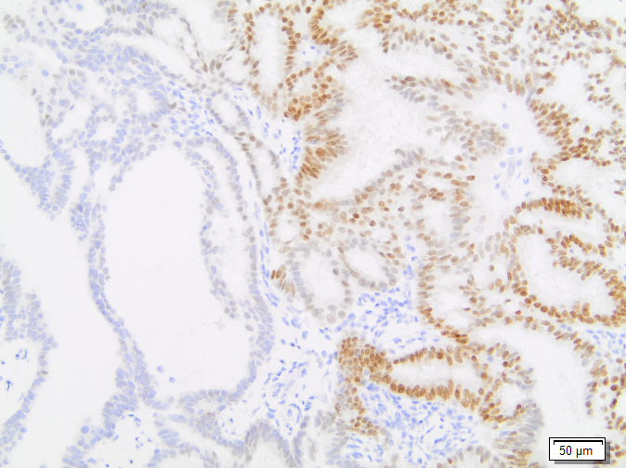
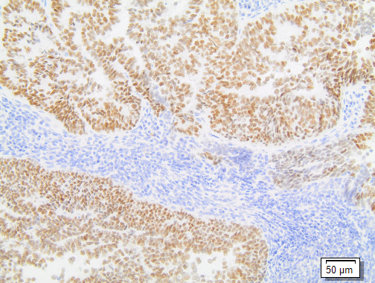
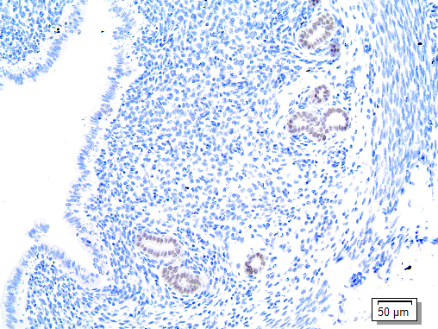
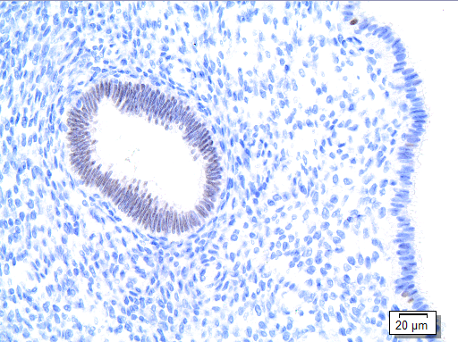
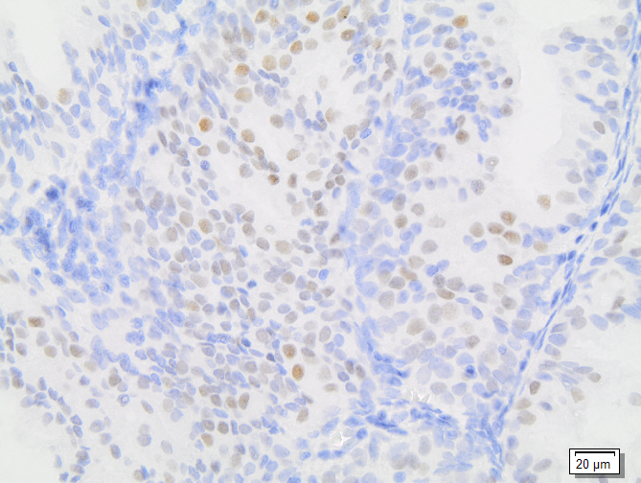
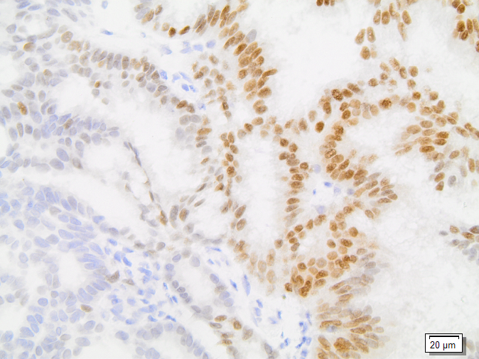
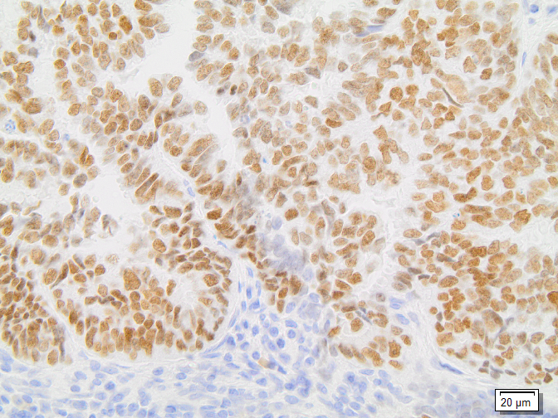
Supplemental FIGURE 4
Endometrioid endometrial cancer
Murine endometrium
Normal human endometrium
A
C
E
G
I
B
D
F
H
J
Supplemental Fig. 4: FOXA2 expression in normal endometrium and endometrial cancers. (A,B) Mouse endometrium shows expression of FOXA2 in the deep glands. 10x and 20x magnification. (C,D) Normal human endometrium shows no detectable FOXA2 expression in the superficial epithelium with diffuse nuclear staining of the deep glands. 10x and 40x magnification. (E-J) Representative endometrioid endometrial carcinomas show variable FOXA2 expression within individual tissues and between samples. Staining is specific to epithelial component and primarily nuclear. E,G,I – 20x magnification; F,H, J – 40x magnification. IHC using C-terminal antibody (Abcam EPR4466). Scales as indicated.
Notes:
Supplemental Fig. 4: FOXA2 expression in normal endometrium and endometrial cancers. (A,B) Mouse endometrium shows expression of FOXA2 in the deep glands. 10x and 20x magnification. (C,D) Normal human endometrium shows no detectable FOXA2 expression in the superficial epithelium with diffuse nuclear staining of the deep glands. 10x and 40x magnification. (E-J) Representative endometrioid endometrial carcinomas show variable FOXA2 expression within individual tissues and between samples. Staining is specific to epithelial component and primarily nuclear. E,G,I – 20x magnification; F,H, J – 40x magnification. IHC using C-terminal antibody (Abcam EPR4466). Scales as indicated.

