Slide 1
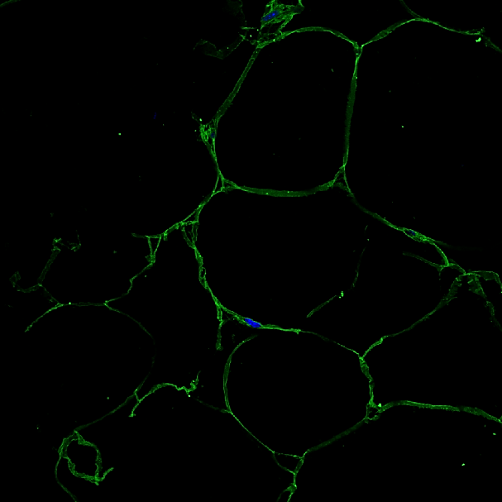


Perilipin FITC
Nucleus HOECHST
Perilipin FITC
MacroH2A1.2 TRITC
Merge
Wild Type
TG

