Slide 1
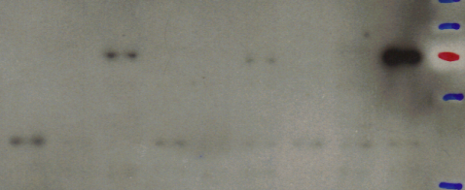
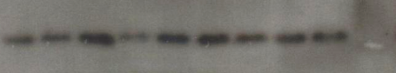
MacroH2A1.1
70 kDa
55 kDa
MacroH2A1.2
70 kDa
55 kDa
Histone H3
15 kDa
CTRL
CTRL
CTRL
Macro1.1
Macro1.2
Macro1.1
Macro1.2
Macro1.1
Macro1.2
Day 1
Day 5
Day 15

