Slide 1
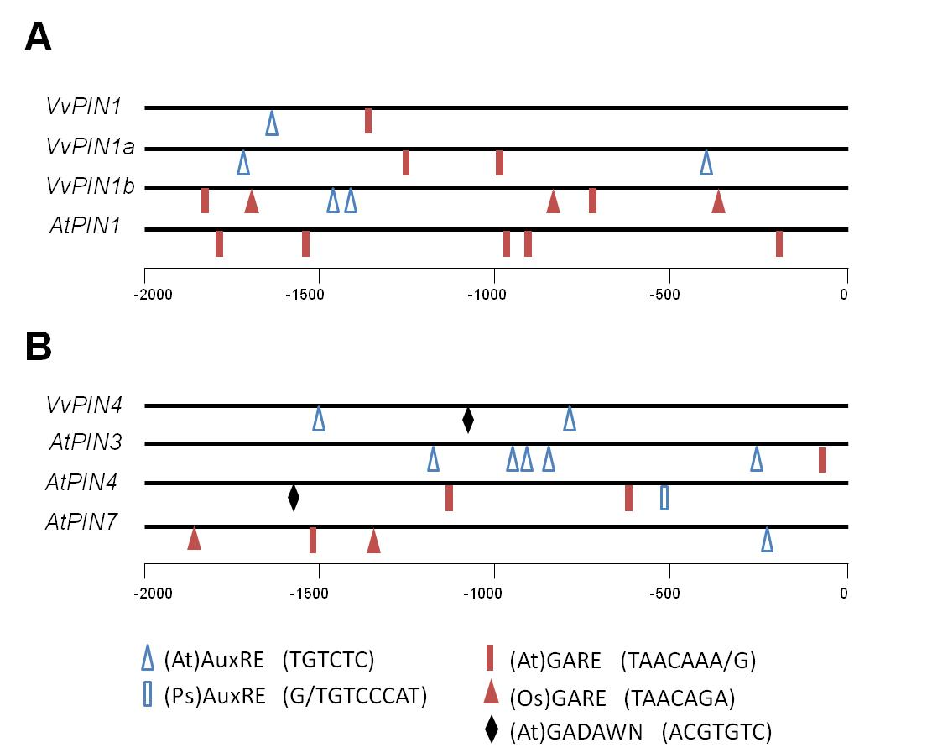
Figure S1. Putative auxin and GA cis-regulators present in VvPINs promoters. Arabidopsis auxin-responsive element, (At)AuxRE, pea auxin-responsive element, (Ps)AuxRE, Arabidopsis GA-responsive element, (At)GARE, rice GA-responsive element, (Os)GARE, and Arabidopsis GA-negative responsive element, (At)GADAWN, are represented within the 2-kb promoter region of VvPIN1, VvPIN1a, VvPIN1b and AtPIN1 (A) and of VvPIN4, AtPIN3, AtPIN4 and AtPIN7 (B).

