Slide 1













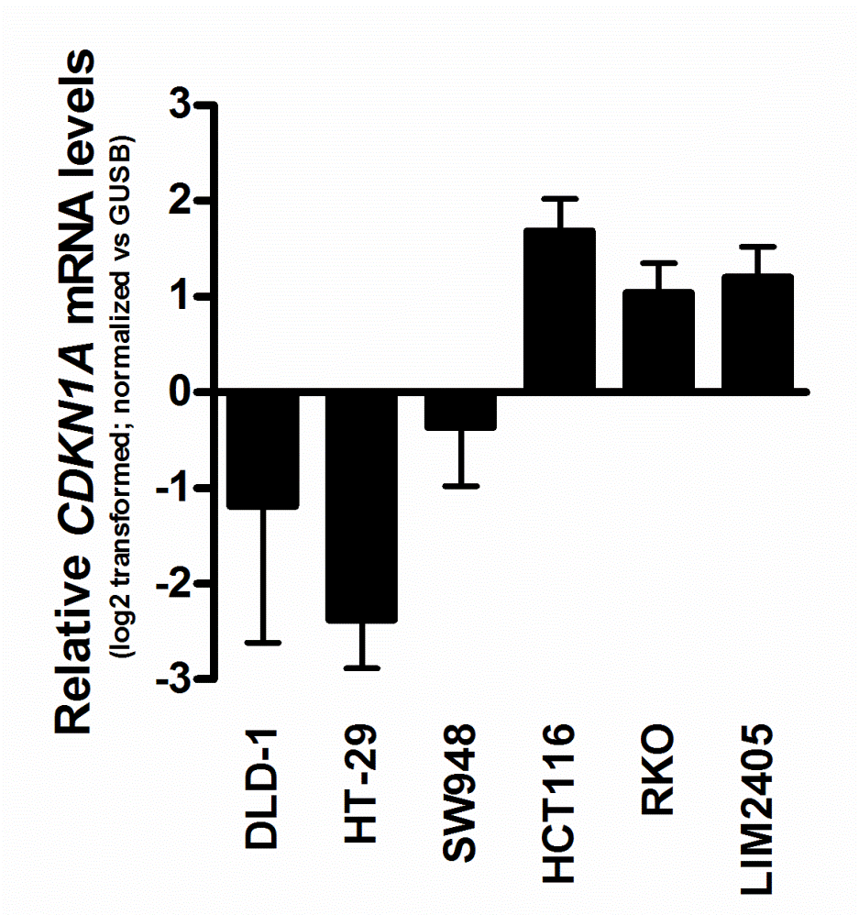
















A
LIM2405
B
HCT116
C
GFP
p53(R248W)
GFP
p53(R248W)
MLN0128
Control
901+128
Control
901+128
Control
901+128
MLN0128
PD901
PD901
Control
901+128
PARP
PARP
cl-PARP
clPARP
cl-PARP/ERK
1.0 0.9 1.2 3.2 1.0 1.9 1.0 1.5
pAKT (S473)
cl-Caspase7
pS6 (S235/236)
cl-Caspase7/ERK
1.0 4.6 1.1 24.1 3.2 8.9 1.7 18.2
pERK (T202/Y204)
pAKT (S473)
*
ERK
pS6 (S235/236)
Tubulin
pERK (T202/Y204)
HCT116
LIM2405
F
GFP
p53(R248W)
GFP
p53(R248W)
ERK
PD901
PD901
MLN0128
Control
MLN0128
PD901
Control
901+128
901+128
PD901
MLN0128
Control
MLN0128
Control
901+128
901+128
D
E
c-Myc
p53 mutant
p53 wild-type
p21
SW948
HCT116
LIM2405
GAPDH
DLD-1
HT-29
RKO
HCT116
LIM2405
p53
G
shTP53
shCTRL
shTP53
shCTRL
Control
Control
Control
Control
p21
PD901
PD901
PD901
PD901
Tubulin
p53
p21
pERK (T202/Y204)
*
ERK
Figure S3.

