Slide 1
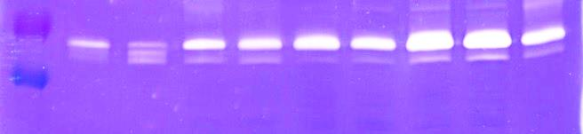
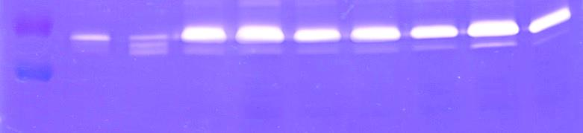
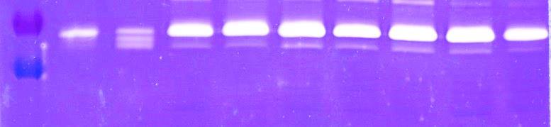
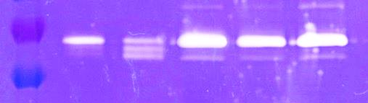
1
2
P1
P2
P3
P4
P5
P6
P7
72kDa-
55kDa-
1
2
P8
P9*
P10*
P11
P12
P13
P14
72kDa-
55kDa-
1
2
P15*
P16*
P17
P18*
P19*
P20*
P21*
72kDa-
55kDa-
1
2
P22*
P23
P24
72kDa-
55kDa-
S1 Fig. zymograms of all protein extracts tested in this study
Asterisk indicates samples from patients with bicuspid aortic valves

