Slide 1
Supplementary Fig S1.
A.
U251T3
LN229
U87ΔEGFR
*
*
*
Cytotoxicity (%)
Nec-1 (-)
Nec-1 (+)
Nec-1 (-)
Nec-1 (+)
Nec-1 (-)
Nec-1 (+)
B.
U251T3
*
Cytotoxicity (%)
C.
shSC
shRIPK1
U251T3
LN229
U87ΔEGFR
T98G
*
*
*
*
Cytotoxicity (%)
JNKi (-)
JNKi (+)
JNKi (-)
JNKi (+)
JNKi (-)
JNKi (+)
JNKi (-)
JNKi (+)
Bort
oHSV
Bort+oHSV

Slide 2
Supplementary Fig S2.
A.
Nec1 (-)
Nec1 (+)
B.
shSC
shRip1
*
*
*
*
Virus titer (pfu/mg)
Virus titer (pfu/mg)
oHSV
Bort+oHSV

Slide 3
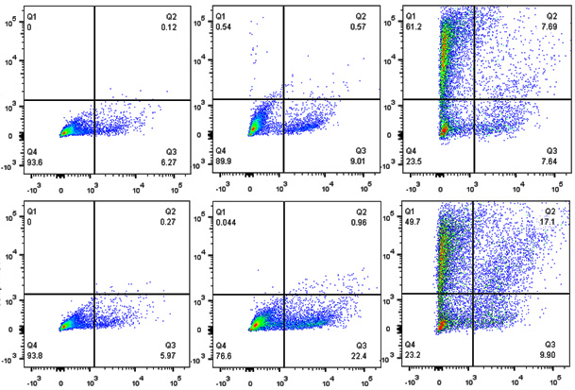
Supplementary Fig S3.
A.
PBS
Bort
oHSV
B.
NK (-)
NK (+)
*
*
NK (-)
Dead Cell (%)
GFP
NK (+)
PBS
Bort
oHSV
Live/Dead (PacBlue)

Slide 4
Supplementary Fig S4.
DB7 (n=9)
Survival Rate (%)
P=0.0229
*
oHSV (2.5 X 10⁵ pfu) injection
Days

