Slide 1
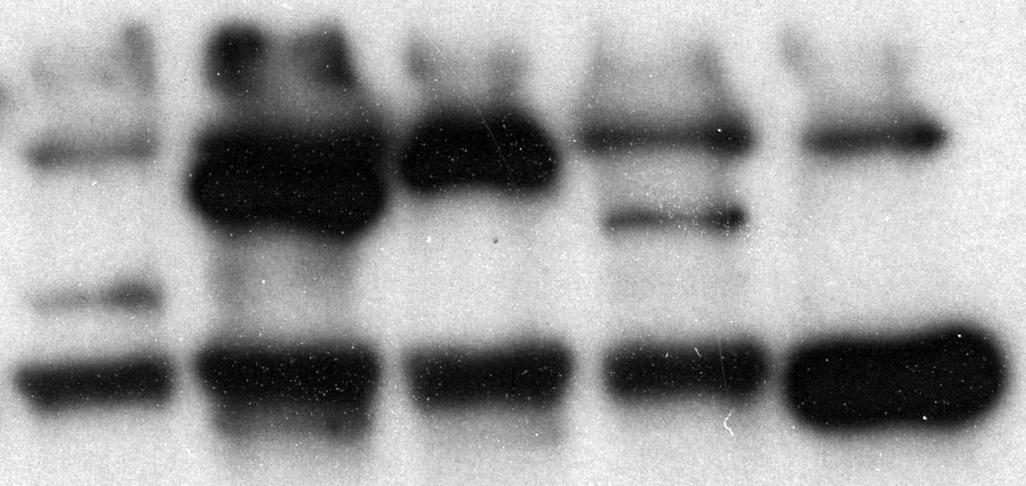
A.
B.
Supplementary Fig. S2
Flag-F1
Flag-F2
Flag-F3
Vector
Flag-F6
*
95
72
α-Flag
Percent growth
*
52
IP (α-Flag)
Growth (day)
(A) ectopic expression of ATM-interacting p400 fragments in U2OS cells. U2OS cells were infected with lentivirus expressing Flag-tagged p400 fragments and selected for 5 days against puromycin. Total 500 μg of protein was immunoprecipitated with M2 agarose and analysed by immunoblotting with anti-Flag antibody. (B) growth curve of puromycin-selected U2OS cells. U2OS cells were infected with lentivirus expressing Flag-F1or Flag-F6, and selected for 5 days against puromycin. Each cell line was seeded in 96-well plate in triplicate and monitored for the cell proliferation.

