Slide 1


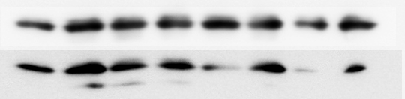
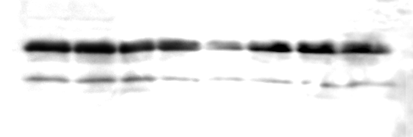
A)
B)
NSC 126405 (uM) 0 0.5 1 5
PUMA
shSCR shRAPTOR
BCL-2
NSC 126405 (uM) 0 0.5 1 5 0 0.5 1 5
RAPTOR
MCL-1
ACTIN
BCL-XL
ACTIN
BIM
FOLD BIM INCREASE 1 2.1 1.8 2.0 1 1.1 0.9 1.3
BIM
EL
L
FOLD BIM INCREASE 1 2.1 2.3 2.5
SUPPL fig 4

