Slide 1
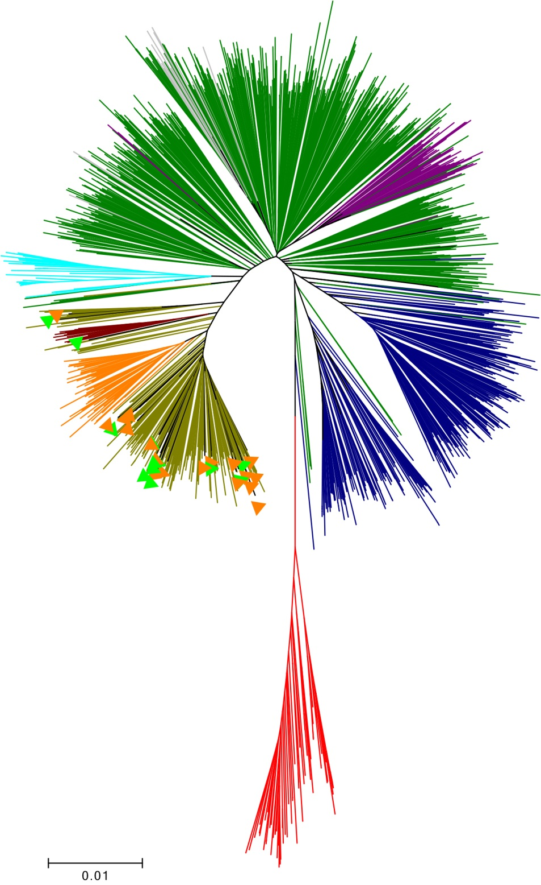
GC
MALT
hspEAsia
hspMaori
hpAsia2
hspAmerind
hpSahule
hpEurope
hpNEAfrica
hpAfrica1
hpAfrica2
Figure S1

