Slide 1
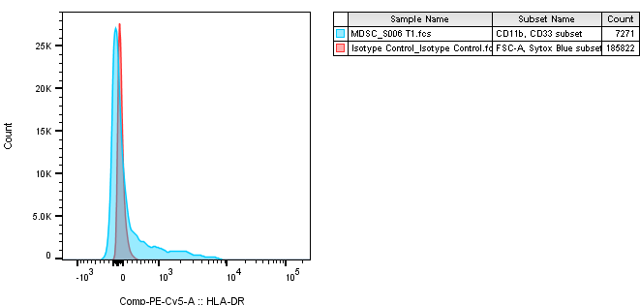
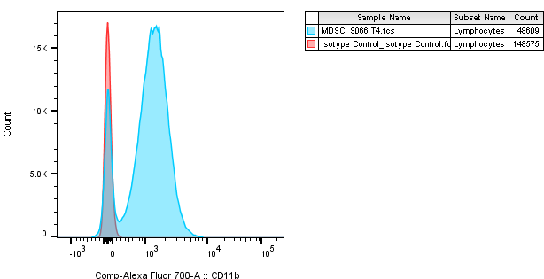
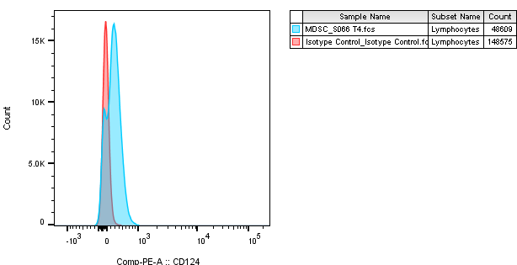

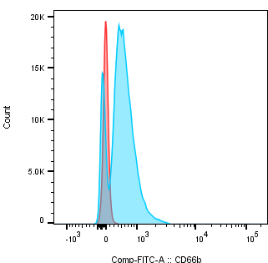
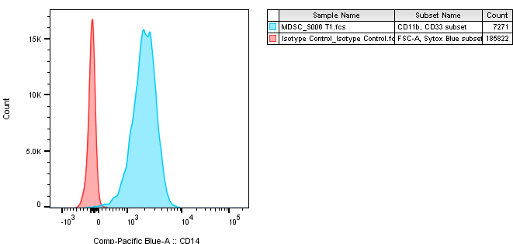
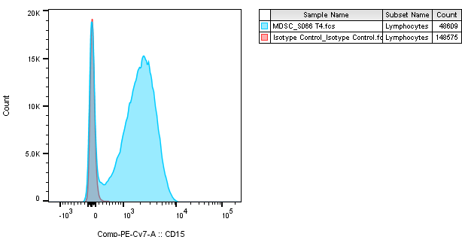
Supplemental Figure 4
HLA-DR PE-Cy5
CD11b Alex Fluor 700
CD124 PE
CD33 APC
CD66b FITC
CD14 Pacific Blue
CD15 PE-Cy7

