Slide 1
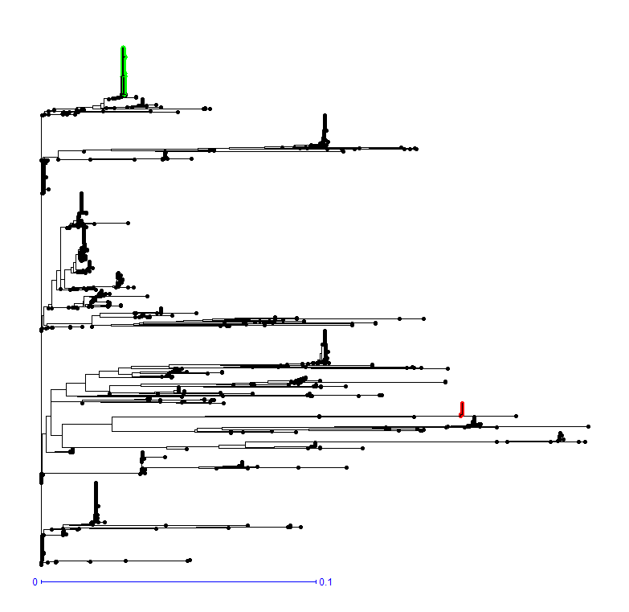
Haplotype Taichung native 1
Haplotype IR64

