Slide 1
Evaluating Digital PCR for the quantification of human genomic DNA:
Accessible amplifiable targets
Margaret C. Kline, Erica L. Romsos, David L. Duewer
Materials Measurement Laboratory
National Institute of Standards and Technology
Gaithersburg, MD 20899-8390 USA
Contact: David.Duewer@nist.gov
Supporting Information
Trevigels of enzyme-cut NIST1 and NIST2 DNAs
Flashgels of enzyme-cut NIST3 and NIST4 DNAs
Exemplar Trevigel of enzyme-cut and sham-cut NIST2 DNA

Slide 2
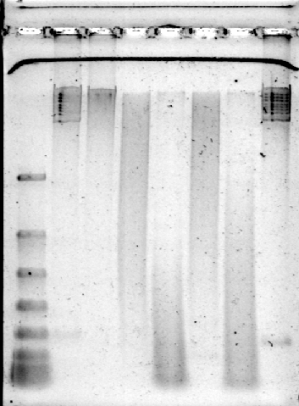
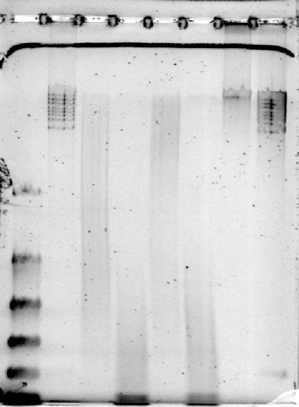
NIST1 and NIST2 Trevigels
Ladder Lo
Ladder Hi
Ladder Lo
Ladder Hi
NIST1
Ladder Hi
Ladder Hi
NIST2
EcoRI
Hae III
EcoRI
Hae III
Pst I
Alu I
Pst I
Alu I
Ladder Lo: Flash gel DNA Marker
100,200,300,500,800,1250,2000,4000 bp
Ladder Hi: GeneRuler High Range DNA Ladder
10171,12119,13825,15258,17000,20555,24508,48502 bp
TE
TE
48502
Gel Parameters
0.7 % Trevigel 5000 in 1X TAE Buffer (0.21 g)
30 mL gel matrix made
microwaved ≈ 1 m
Poured setup 20 min RT
Transfered to 4 °C for 1 h
TAE buffer also stored at 4 °C
Samples 5 µL combined with 6X Loading buffer
Stained 20 min with SybrGreen I gel stain
48502
10171
10171
4000
4000
1250
800
1250
High-resolution Trevigels were used to confirm that the uncut TE DNAs were little fragmented and that the enzyme-cut samples were thoroughly and characteristically fragmented.
500
800
300
200
500
300

Slide 3
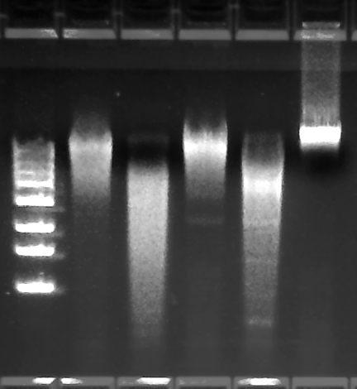
NIST3 and NIST4 FlashGels
NIST3
NIST4
Ladder PstI AluI EcoRI HaeIII TE
Ladder PstI AluI EcoRI HaeIII TE
Having confirmed that the uncut TE DNAs were little fragmented, these limited resolution Flashgels were used to confirm that the enzyme-cut samples were thoroughly and characteristically fragmented.
4000
2000
4000
1250
2000
800
1250
500
800
300
500
200
300
200
100
100

Slide 4
Exemplar Trevigel of Cut and Sham-cut Samples
Band | Sample
1 | Flash gel DNA Marker: 100,200,300,500,800,1250,2000,4000 bp
2 | GeneRuler High Range DNA Ladder: 10171,12119,13825,15258,17000,20555,24508,48502 bp
3 | NIST2 PstI Cut
4 | NIST2 Pst Sham-cut
5 | NIST2 AluI Cut
6 | NIST2 Alu Sham-cut
7 | NIST2 HaeIII Cut
8 | NIST2 Hae Sham-cut
9 | NIST2 TE
10 | GeneRuler High Range DNA Ladder
1 2 3 4 5 6 7 8 9 10
Gel Parameters
0.7 % Trevigel 5000 in 1X TAE Buffer (0.21 g)
30 mL gel matrix made
microwaved ≈ 1 m
Poured setup 20 min RT
Transfered to 4 °C for 1 h
TAE buffer also stored at 4 °C
Samples 5 µL combined with 6X Loading buffer
Run @ 45 V for 130 min
Stained 20 min with SybrGreen I gel stain
Cut samples: Enzyme-restricted NIST2 DNA
Sham-cut Samples: NIST2 DNA manipulated in identical manner, but with TE instead of enzyme-containing solution

