Slide 1
Evaluating Digital PCR for the quantification of human genomic DNA:
Accessible amplifiable targets
Margaret C. Kline, Erica L. Romsos, David L. Duewer
Materials Measurement Laboratory
National Institute of Standards and Technology
Gaithersburg, MD 20899-8390 USA
Contact: David.Duewer@nist.gov
Supporting Information
Exemplar cdPCR and ddPCR graphics of:
{Alu, Hae, and Pst}{cut, sham-cut, untreated} NIST2 DNA evaluated with {D5, ND14, and HBB1}
{Alu, Eco, Hae, and Pst}{cut, sham-cut, untreated} NIST3 DNA evaluated with {D5, ND14, and HBB1}

Slide 2
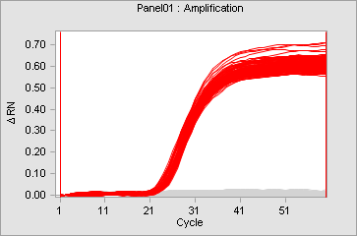
Exemplar Graphics: cdPCR
Amplification Curves
Ogive Plots
Each ogive displays the cumulative distribution of Ct values for a set of replicate panels as a function of
λ=-ln(1-i/N_{tot})*RDF, where i indexes the rank-ordered Cts and RDF is the Relative Dilution Factor. RDF is by default 1.0, but differs when non-standard DNA dilutions were used. Here, the concentration of the uncut TE solution was 1.25 times that of the enzyme cut materials, for an RDF of 1/1.25 = 0.8.
Low Resolution
High Resolution
Representative panel, copied directly
from Fluidigm’s diagnostic display
Produced from Ct values provided in Fluidigm’s “Detailed Table Results” export files. For details see: Duewer DL; Kline MC; Romsos EL. Real-time cdPCR opens a window into events occurring in the first few PCR amplification cycles. Anal Bioanal Chem 2015, 407, 9061-9069.

Slide 3
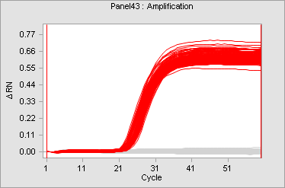
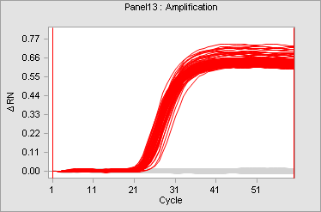
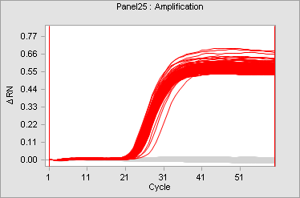
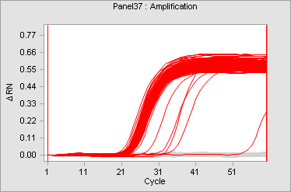

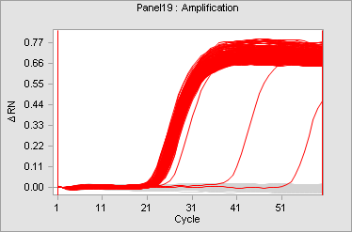
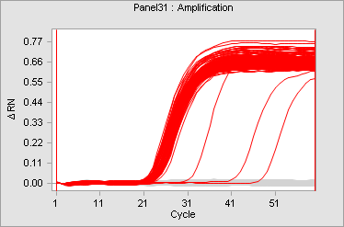
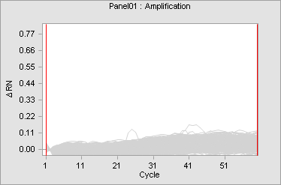
D5: Cut vs Sham-cut
NIST2_Sham_cd48_58-D5_1670088062, 58°C, 20150908
PstI
AluI
HaeIII
TE
Cut
NTC
Sham-cut

Slide 4
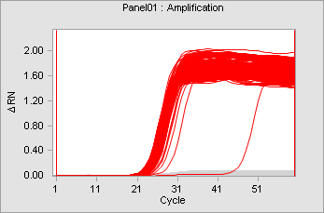
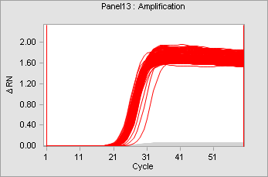
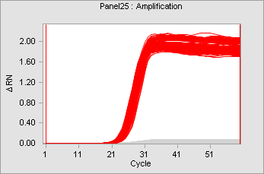
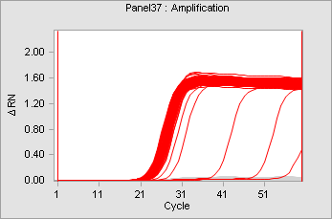
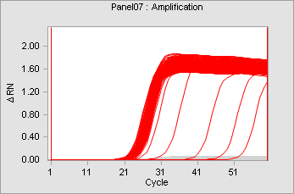
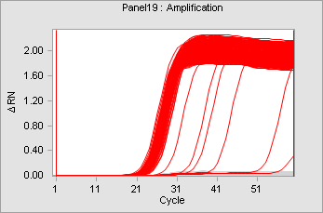
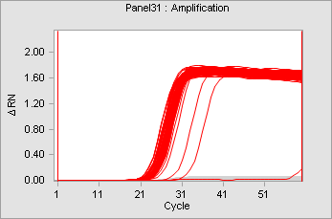
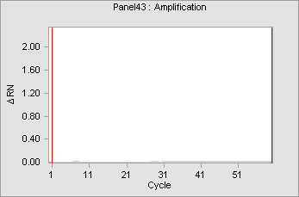
HBB1: Cut vs Sham-cut
NIST2_Sham_cd48_62-HBB1_1670088061, 62°C, 20150904
PstI
AluI
HaeIII
TE
Cut
NTC
Sham-cut

Slide 5
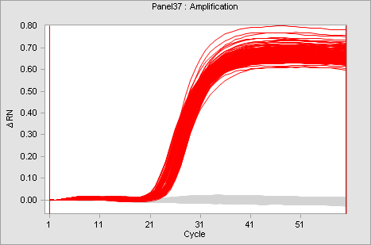
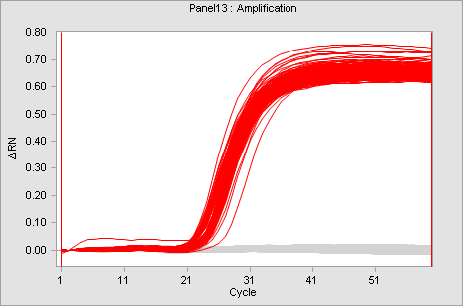
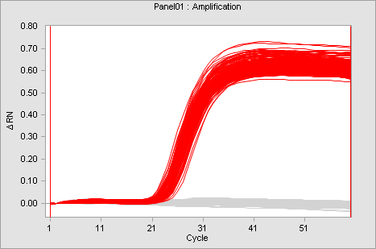
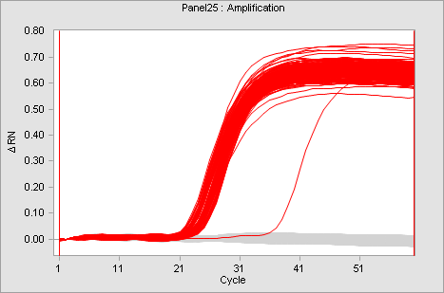
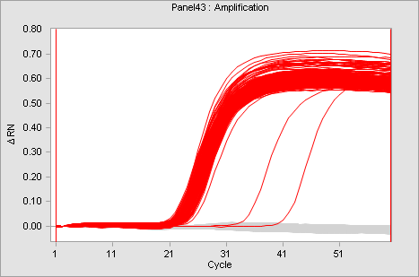
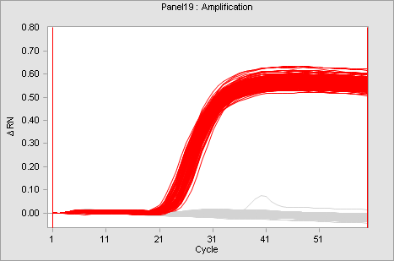
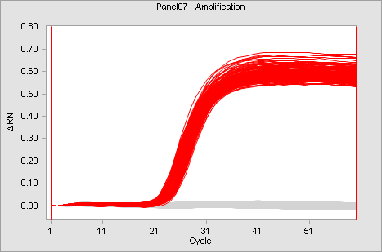
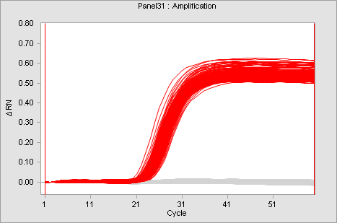
D5: Cut vs Sham-cut
NIST3_Sham_cd48_58-D5_1670088188, 58°C, 20150922
PstI
HaeIII
AluI
EcoRI
Cut
Sham-cut

Slide 6
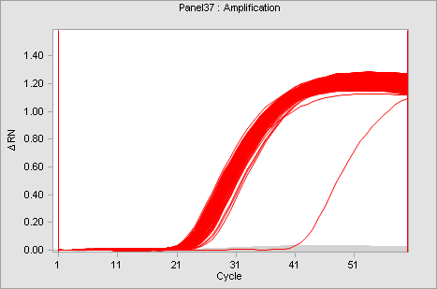
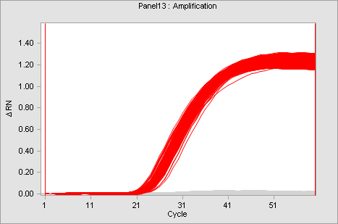
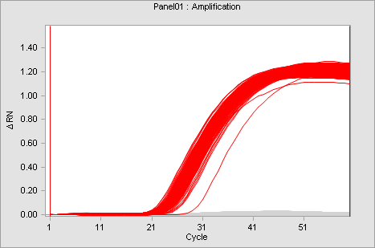
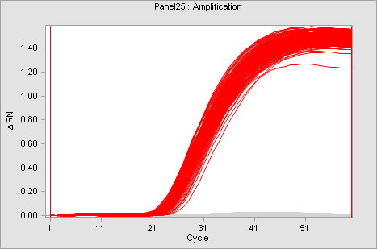
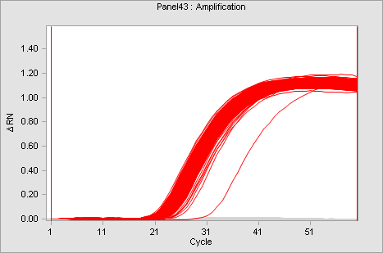
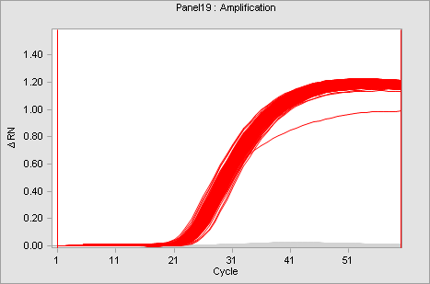
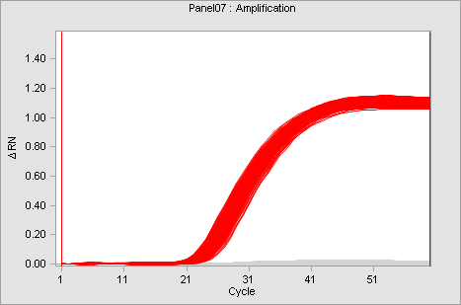
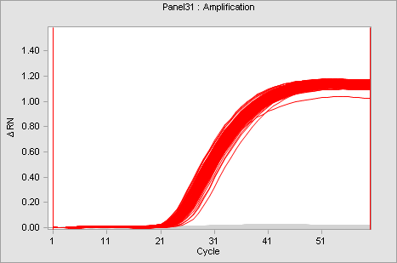
ND14: Cut vs Sham-cut
NIST3_Sham_cd48_58-ND14_1670088187, 58°C, 20150922
PstI
HaeIII
AluI
EcoRI
Cut
Sham-cut

Slide 7
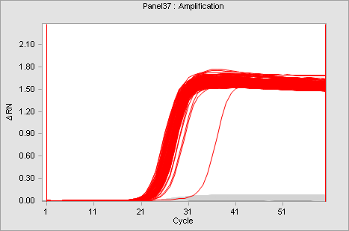
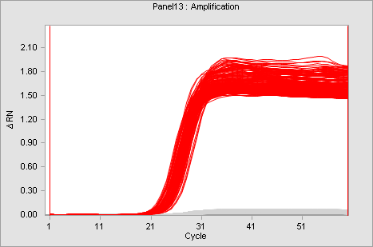
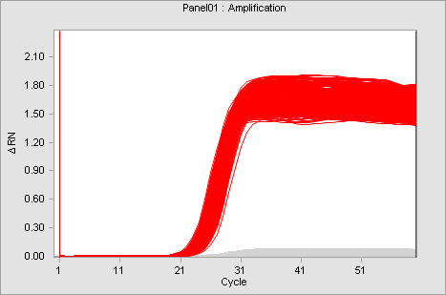
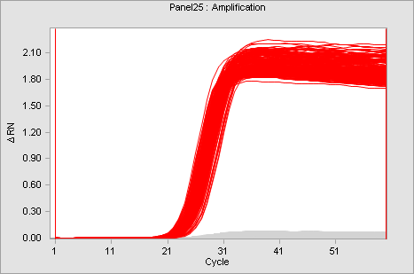
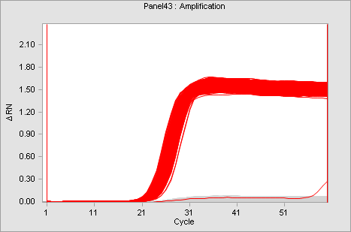
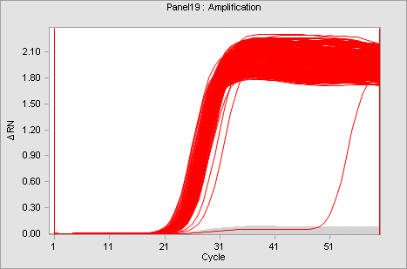
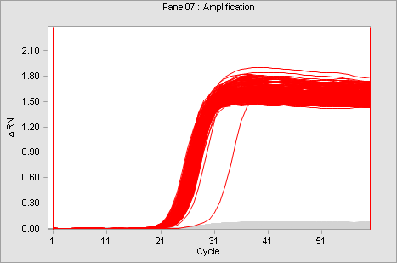
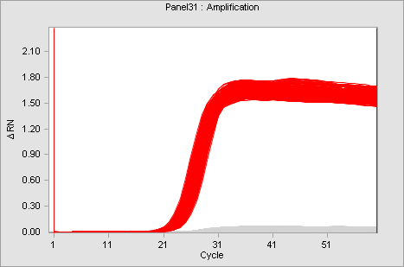
HBB1: Cut vs Sham-cut
NIST3_Sham_cd48_62-HBB1_1670088189, 62°C, 20150922
PstI
HaeIII
AluI
EcoRI
Cut
Sham-cut

Slide 8
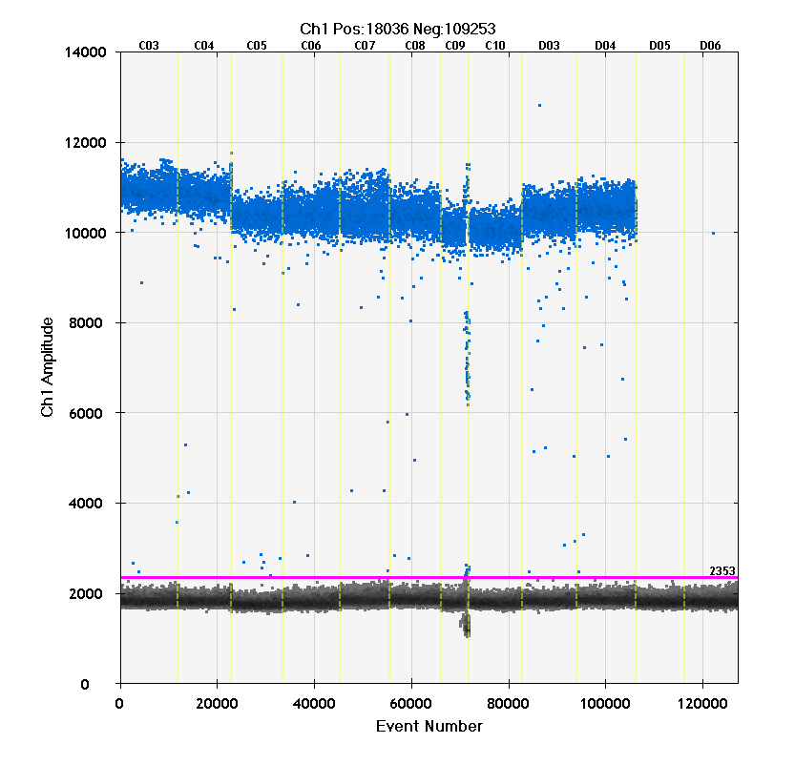
Exemplar Graphics: ddPCR
Well labels
The blue dots represent the fluorescence intensities of positive (above threshold) ddPCR droplets in a given assay. The grey dots represent the background fluorescence of the negative (below threshold) droplets. The magenta horizontal line represents the user-global intensity threshold for the assay. The horizontal axis represents the droplet counting sequence. The light yellow vertical lines mark the well-boundaries.
Pst
Alu
Eco
Hae
TE
NTC
Sample labels (added)
Potentially a failed replicate;
analyst judgement required
to evaluate whether or not to
use result
Threshold intensity
Representative panel, copied directly
from Bio-Rad’s 1-D display

Slide 9
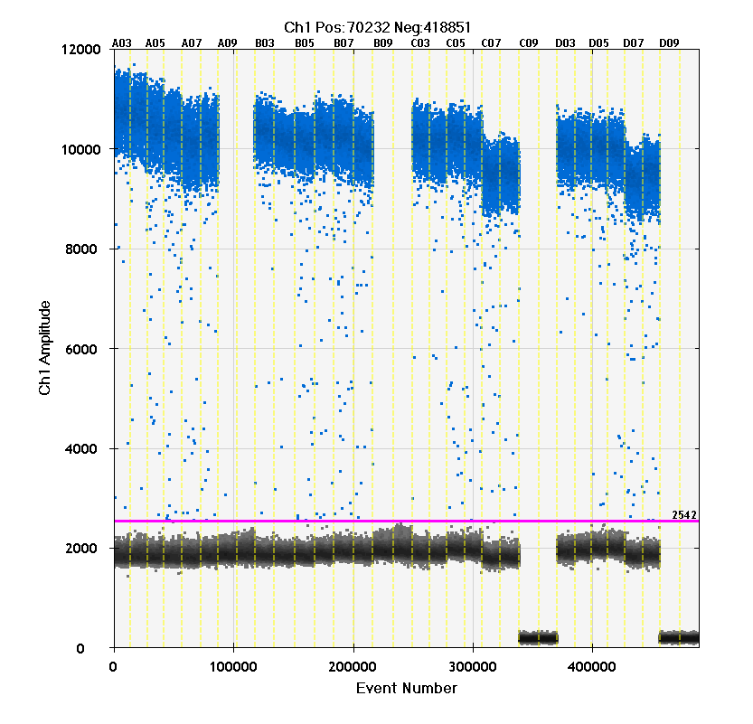
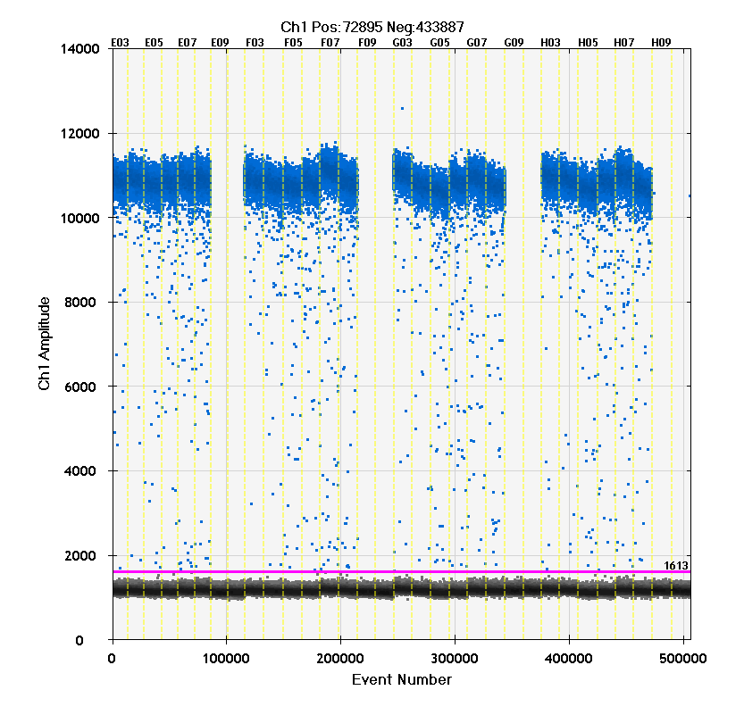
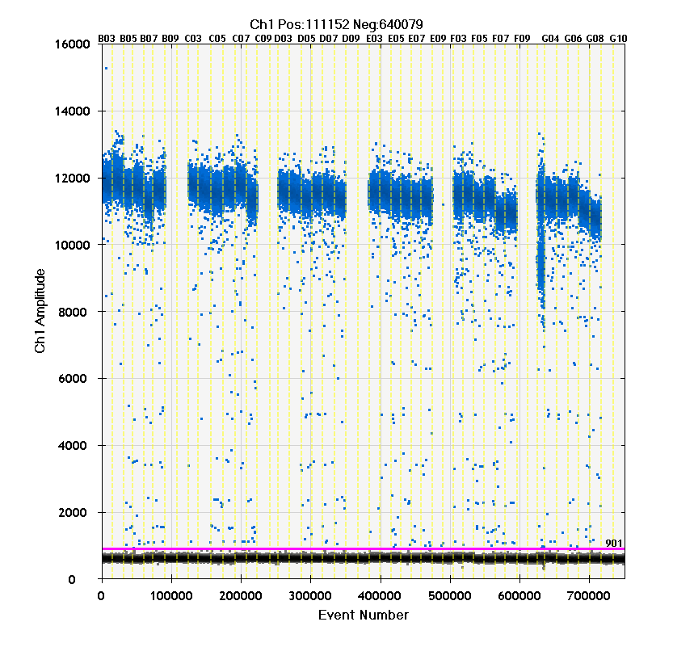
NIST2: Cut & Sham-cut
NIST2_Sham_dd_58-D5&ND14_20150807
NIST2_Sham_dd_62-HBB1_20150807
D5
ND14
HBB1

Slide 10
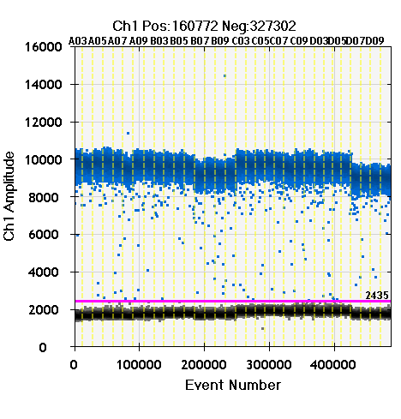
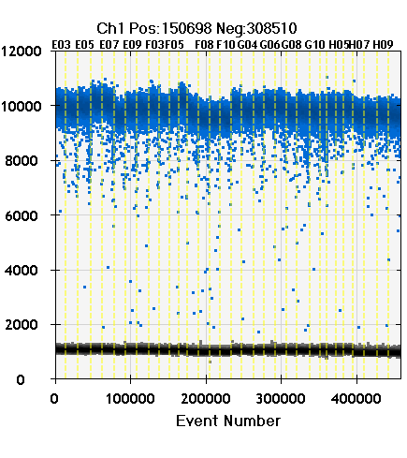
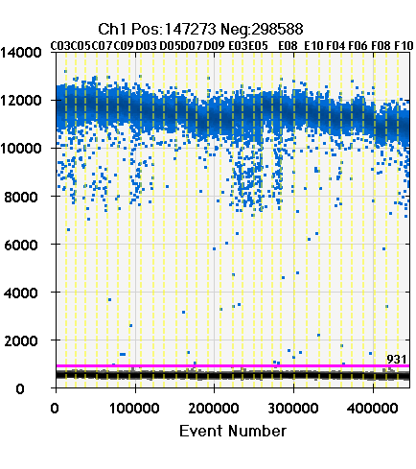
NIST3: Cut & Sham-cut
NIST3_Sham_dd_58-D5&ND14_20150921
NIST3_Sham_dd_62-HBB1_20150922
D5
ND14
HBB1

