Slide 1
Evaluating Digital PCR for the quantification of human genomic DNA:
Accessible amplifiable targets
Margaret C. Kline, Erica L. Romsos, David L. Duewer
Materials Measurement Laboratory
National Institute of Standards and Technology
Gaithersburg, MD 20899-8390 USA
Contact: David.Duewer@nist.gov
Supporting Information
Exemplar ddPCR graphics of:
{AluI, HaeIII, EcoRI, and PstI}-restricted + untreated {NIST1, NIST2, NIST3, and NIST4} DNAs evaluated with
{D5, ND14, 2PR4, NR4Q, 22C3, ND6, HBB1, NEIF} assays.

Slide 2
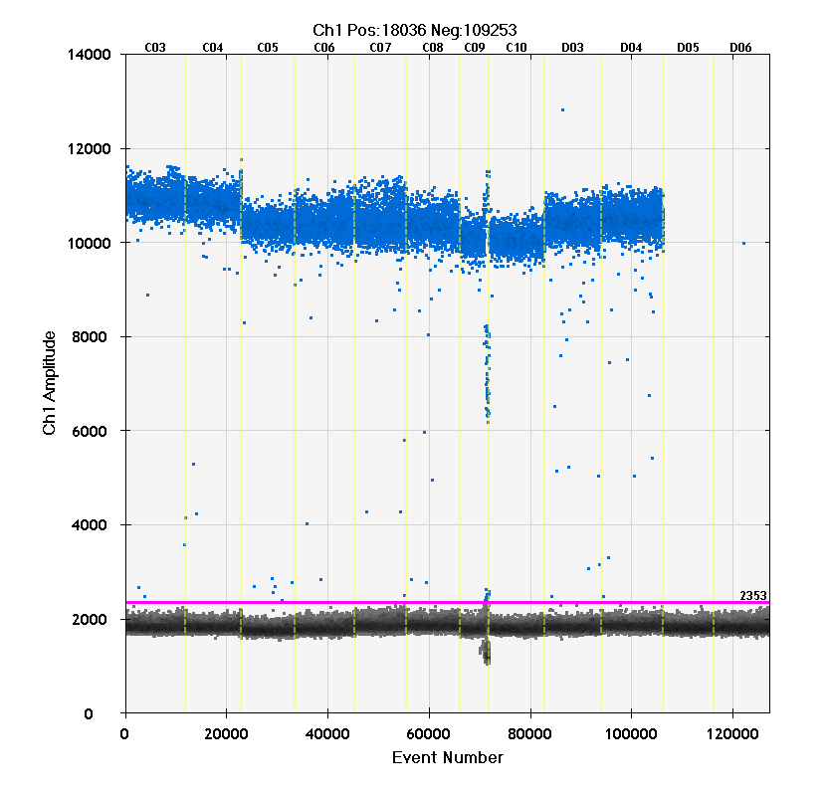
Exemplar Graphics: ddPCR
Well labels
The blue dots represent the fluorescence intensities of positive (above threshold) ddPCR droplets in a given assay. The grey dots represent the background fluorescence of the negative (below threshold) droplets. The magenta horizontal line represents the user-global intensity threshold for the assay. The horizontal axis represents the droplet counting sequence. The light yellow vertical lines mark the well-boundaries.
Pst
Alu
Eco
Hae
TE
NTC
Sample labels (added)
Potentially a failed replicate;
analyst judgement required
to evaluate whether or not to
use result
Threshold intensity
Representative panel, copied directly
from Bio-Rad’s 1-D display

Slide 3
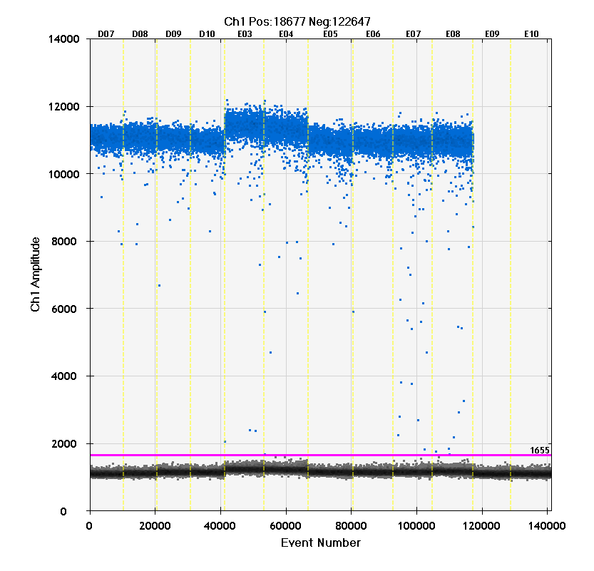
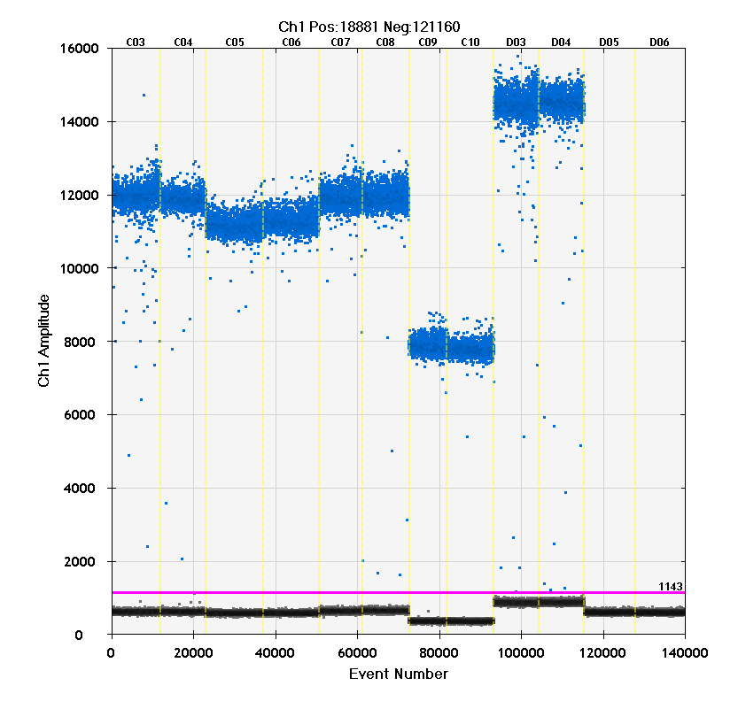
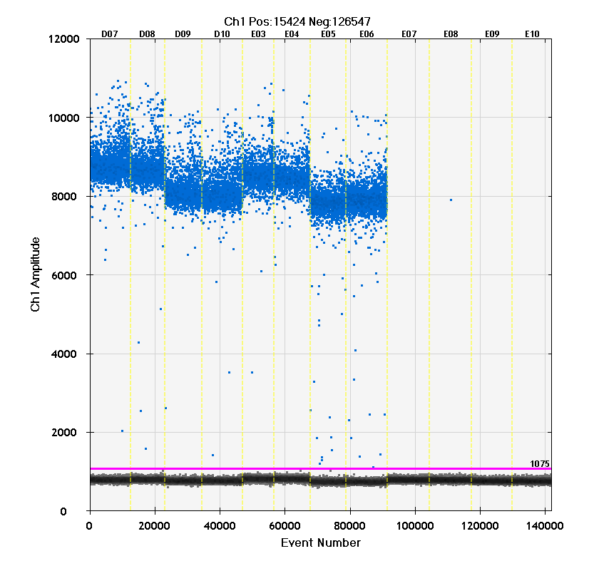
NIST1: D5, ND14, HBB1, and NEIF
Pst
Alu
Eco
Hae
TE
Pst
Alu
Eco
Hae
TE
NIST1_Enz_dd_58_20150709
58 °C
NTC
NTC
HBB1
NEIF
Pst
Alu
Eco
Pst
Eco
Hae
TE
D5
ND14
TE
Hae
NIST1_Enz_dd_62_20150710
62 °C
NTC
NTC

Slide 4
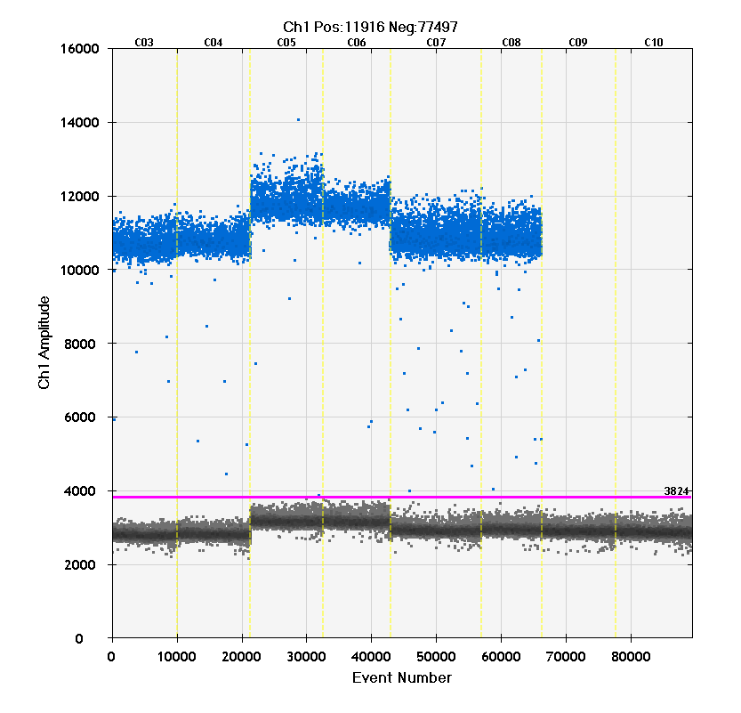
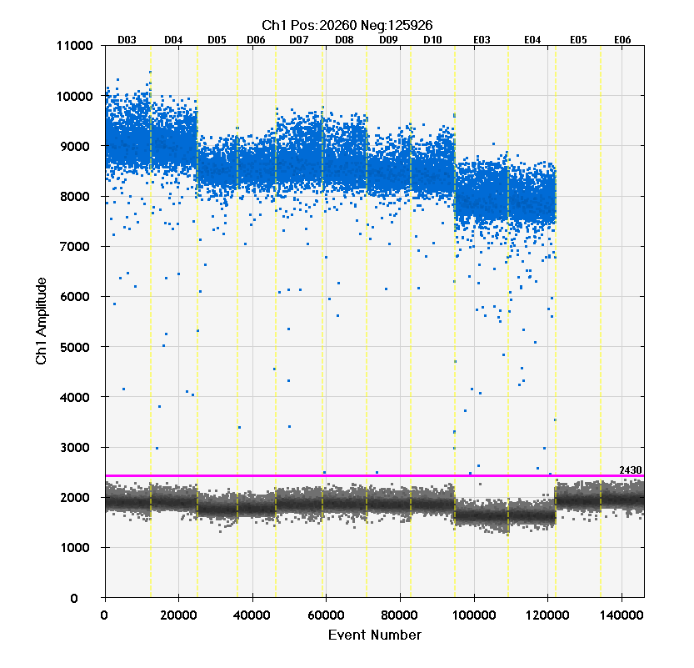
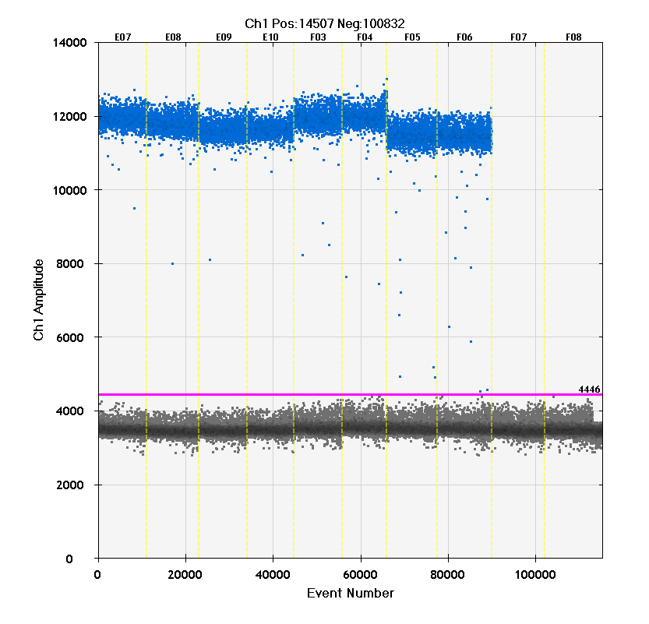
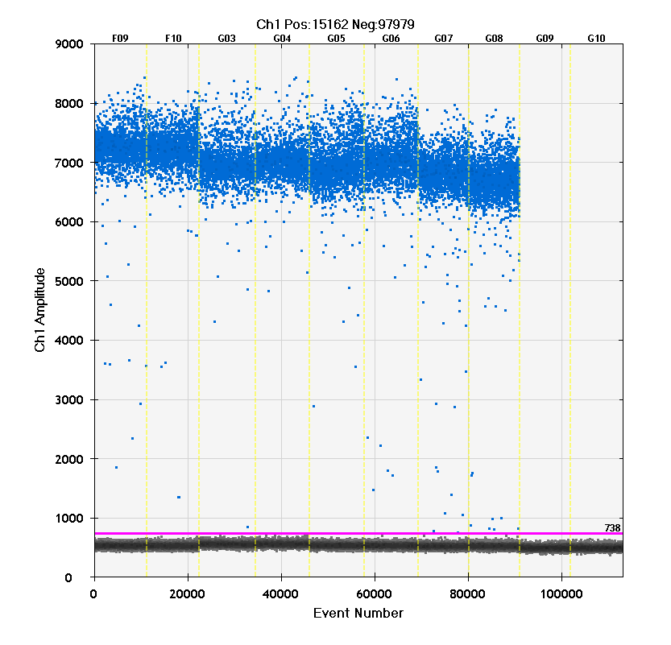
NIST1: 2PR4, NR4Q, 22C3, and ND6
NIST1_Enz_dd_58_20150709, 58 °C
Pst
Alu
Eco
Hae
TE
Pst
Alu
Eco
TE
Pst
Alu
Eco
TE
Pst
Eco
TE
NTC
NTC
NTC
NTC
2PR4
NR4Q
22C3
ND6

Slide 5
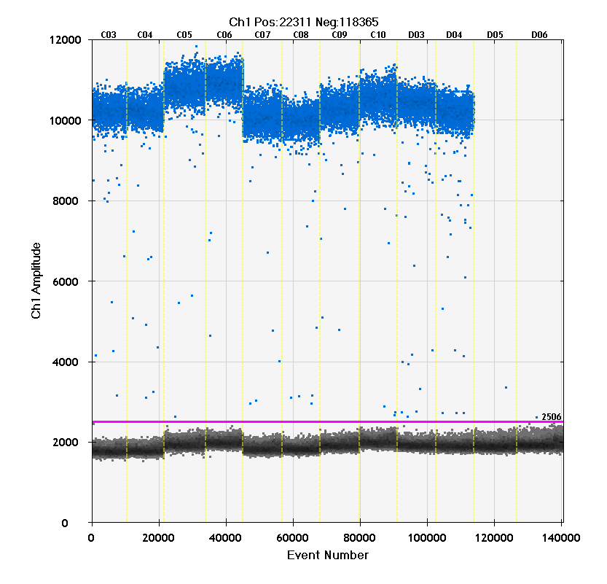
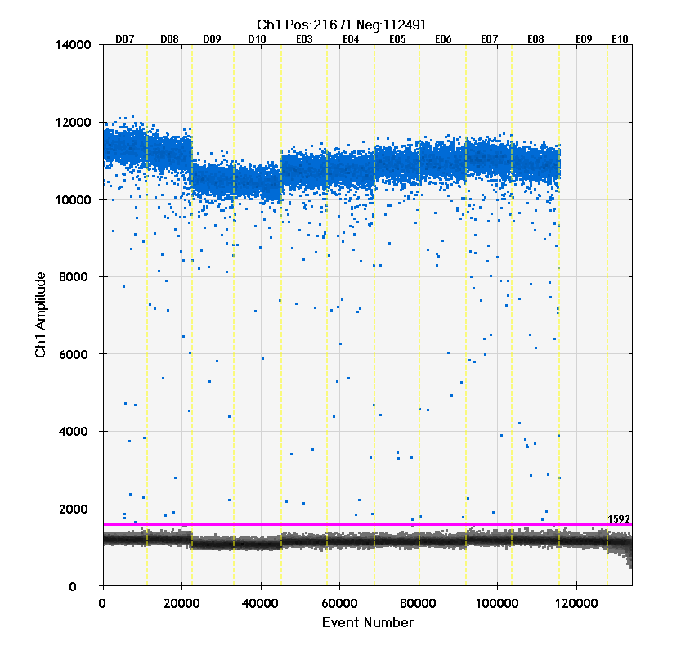
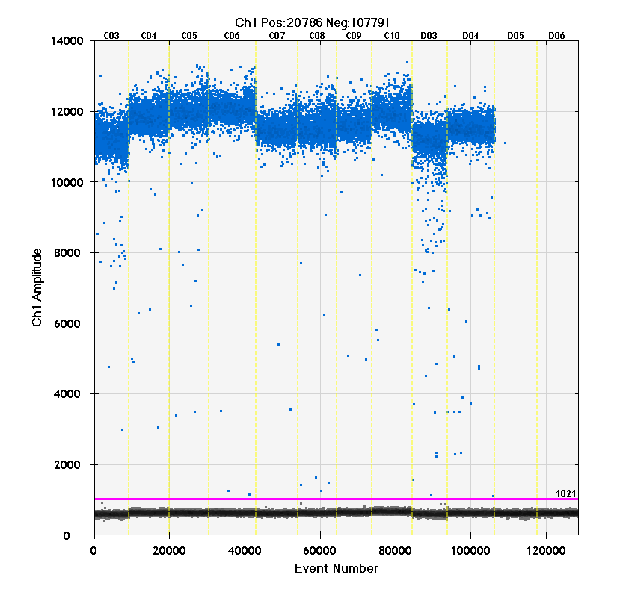
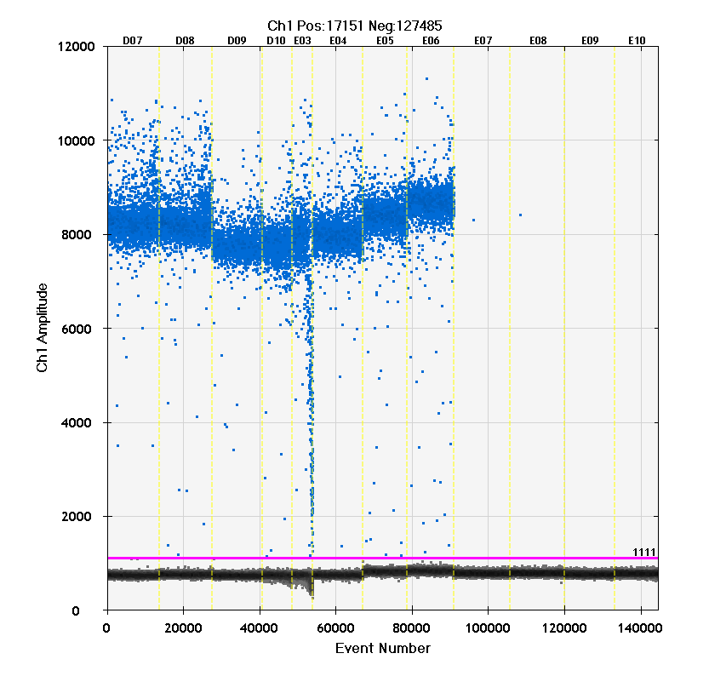
NIST2: D5, ND14, HBB1, and NEIF
Pst
Alu
Eco
Hae
TE
Pst
Alu
Eco
Hae
TE
NIST2_Enz_dd_58_20150721
58 °C
NTC
NTC
HBB1
NEIF
Pst
Alu
Eco
TE
Pst
Eco
Hae
TE
D5
ND14
Hae
NIST2_Enz_dd_62_20150721
62 °C
NTC
NTC

Slide 6
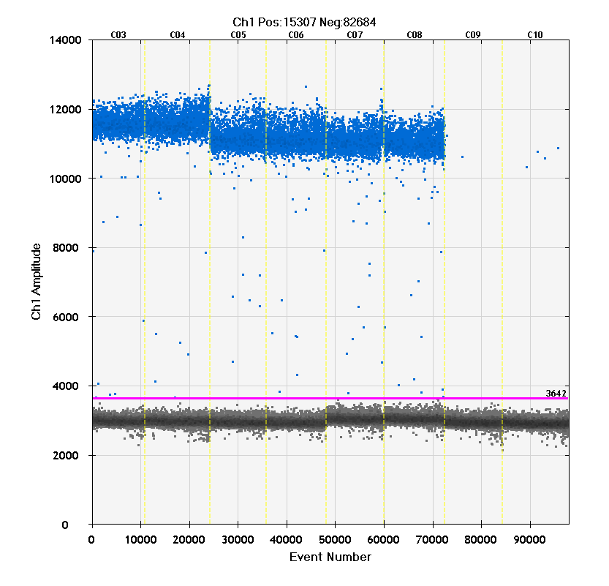
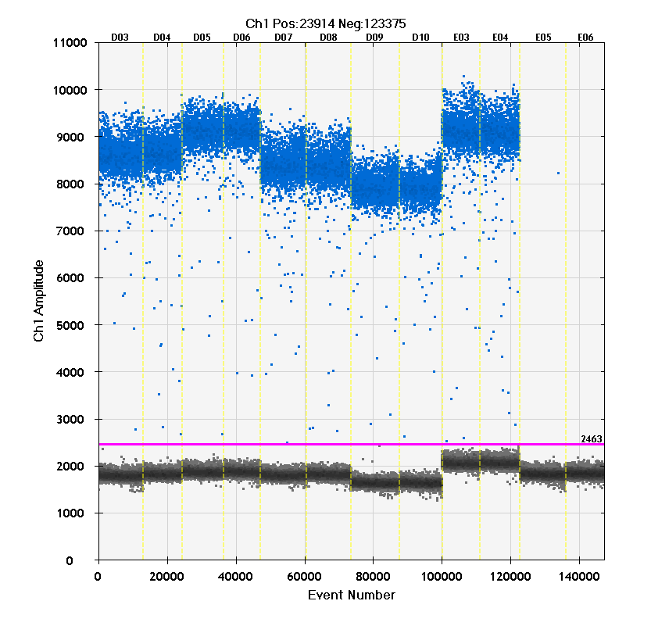
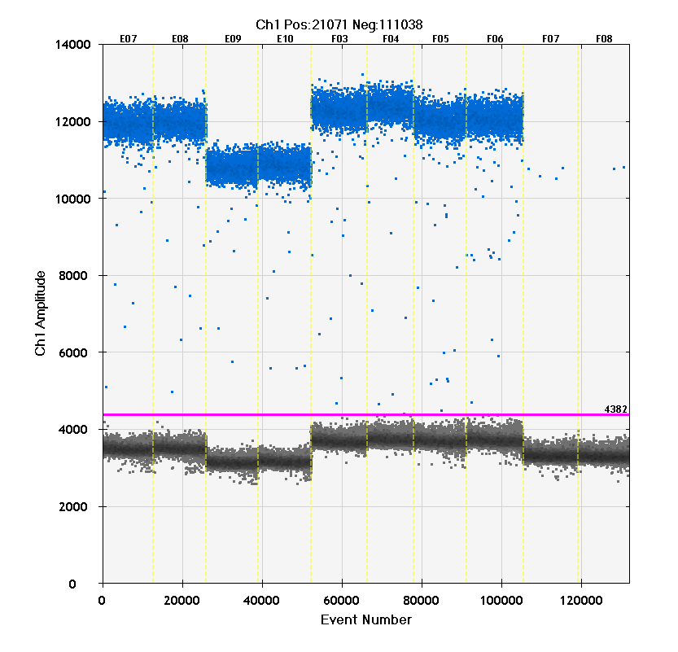
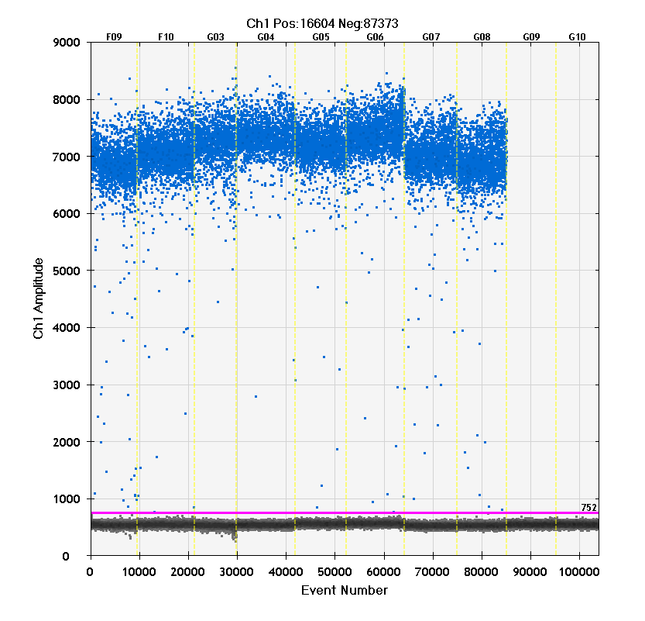
NIST2: 2PR4, NR4Q, 22C3, and ND6
NIST2_Enz_dd_60_20150722, 60 °C
Pst
Eco
TE
Pst
Alu
Eco
Hae
TE
Pst
Alu
Eco
TE
Pst
Alu
Eco
TE
NTC
NTC
NTC
NTC
2PR4
NR4Q
22C3
ND6

Slide 7
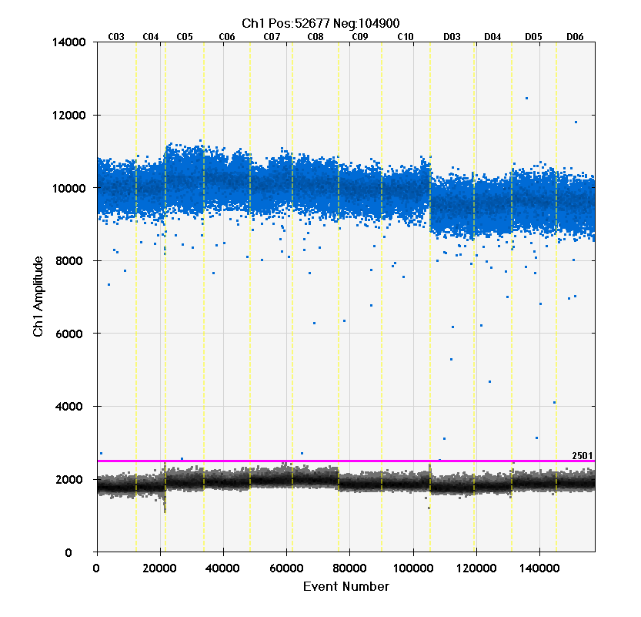
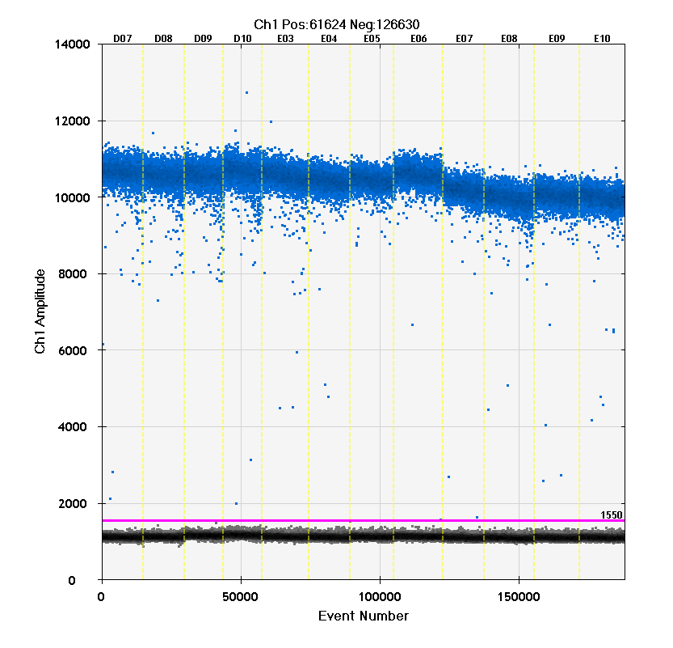
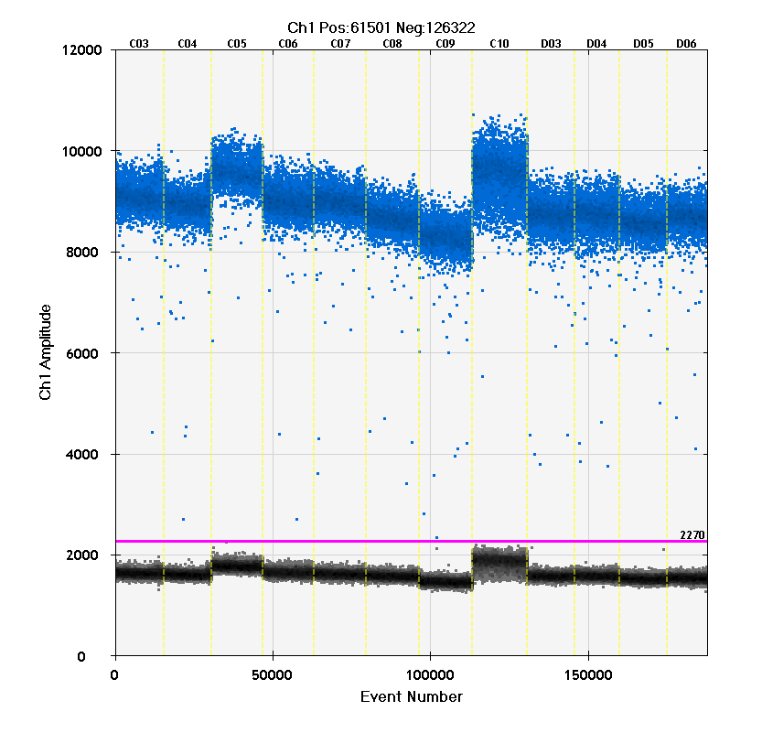
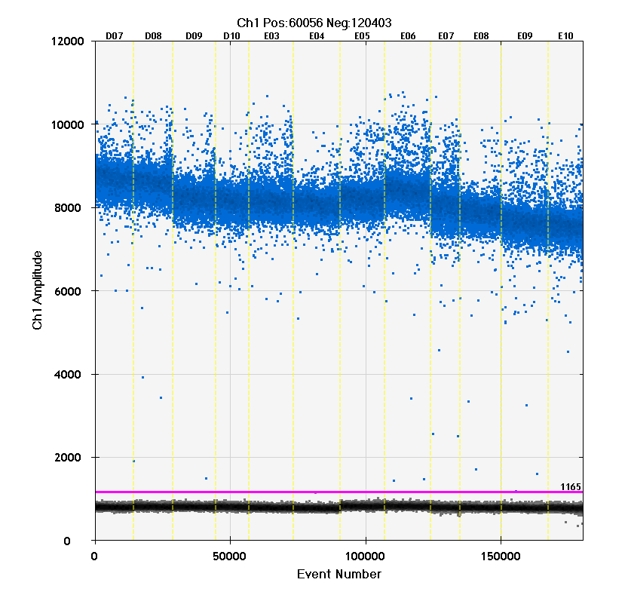
NIST3: D5, ND14, HBB1, and NEIF
Pst
Alu
Eco
Hae
TE
NIST3_Enz_dd_58_20150818
58 °C
Pst
Alu
Eco
Hae
TE
HBB1
NEIF
Pst
Alu
Eco
Hae
Pst
Eco
Hae
TE
TE
D5
ND14
NIST3_Enz_dd_62_2015081862 °C

Slide 8
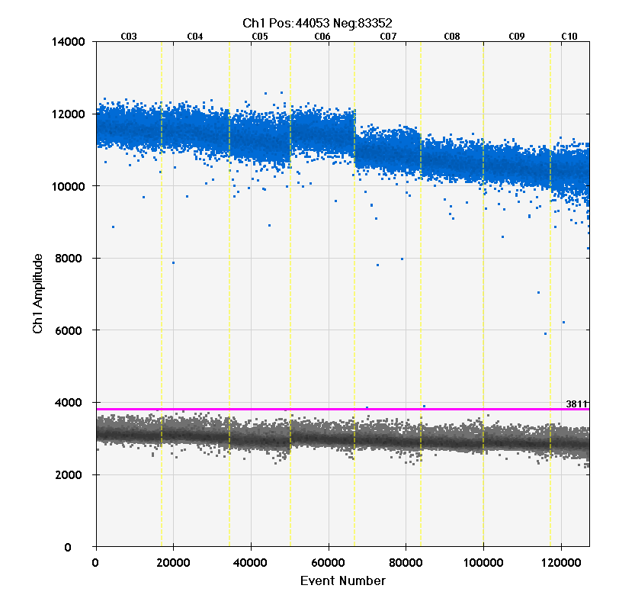
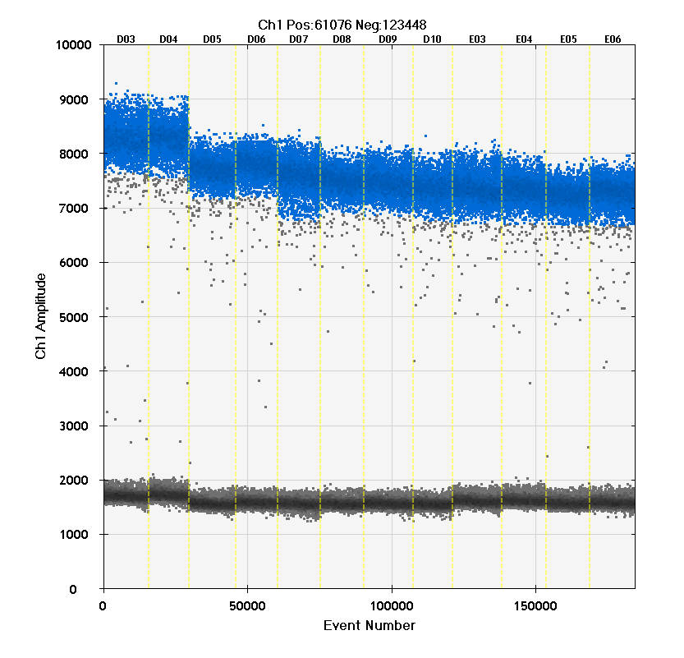
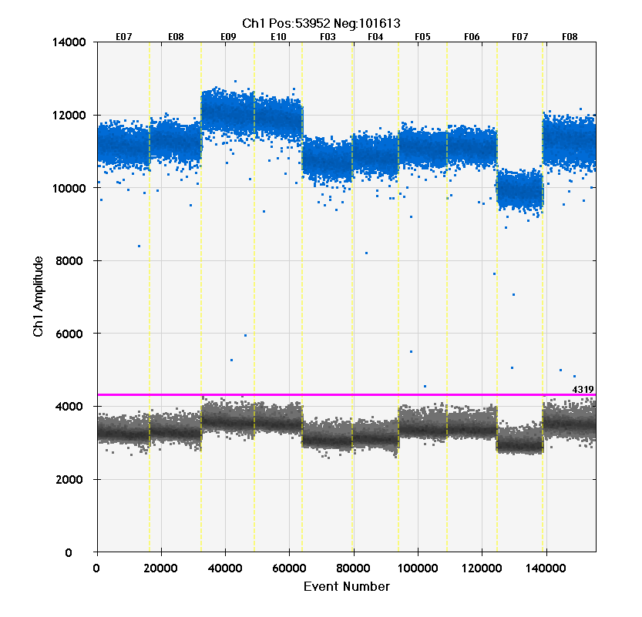
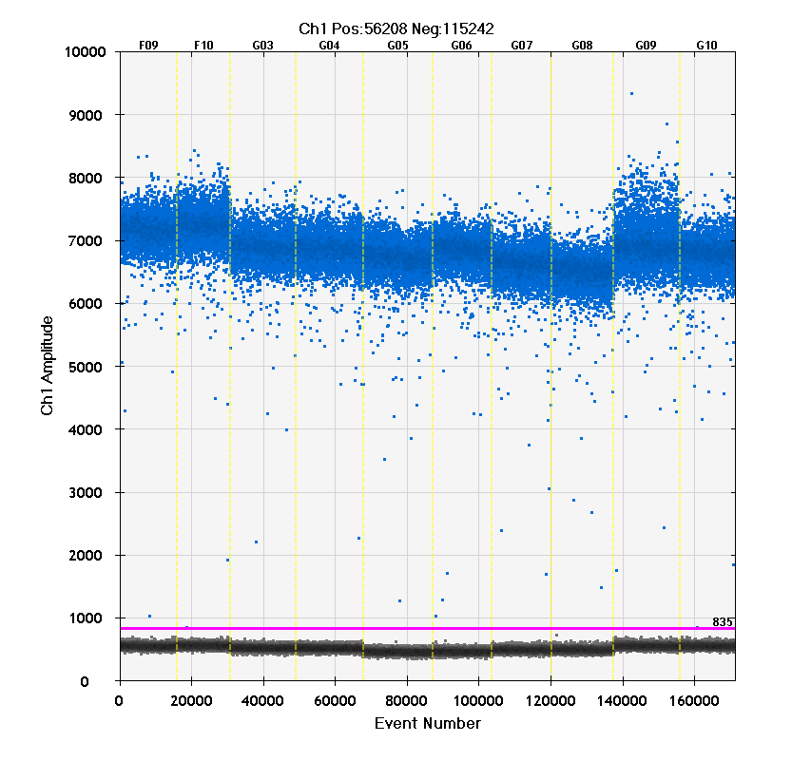
NIST3: 2PR4, NR4Q, 22C3, and ND6
NIST3_Enz_dd_60_20150818 60°C
Pst
Eco
TE
Pst
Alu
Eco
Hae
TE
Pst
Alu
Eco
TE
Pst
Alu
Eco
TE
2PR4
NR4Q
22C3
ND6

Slide 9
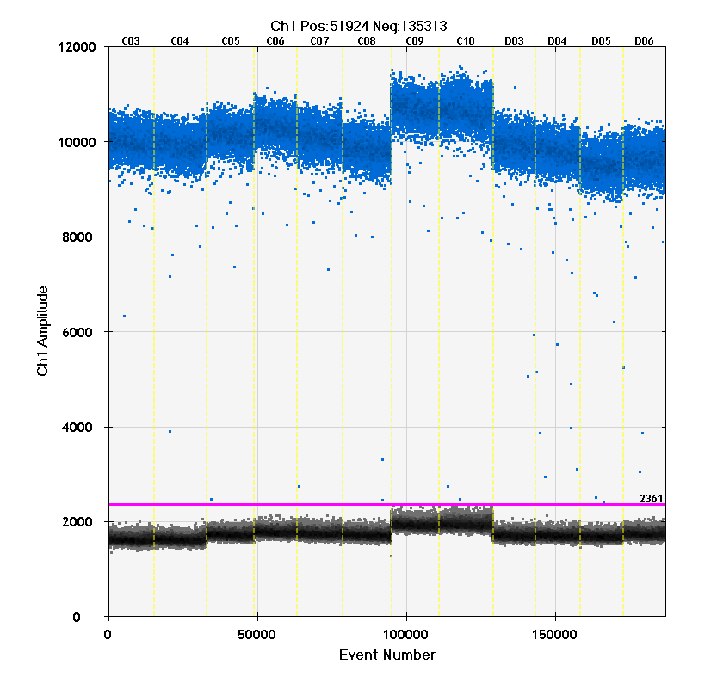
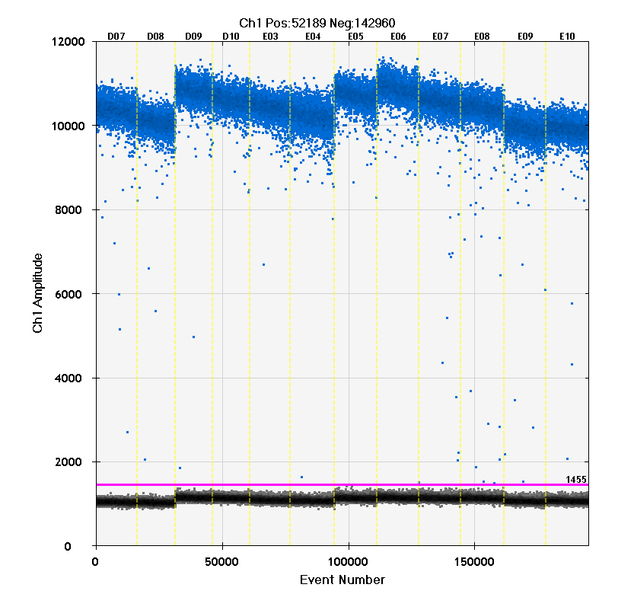
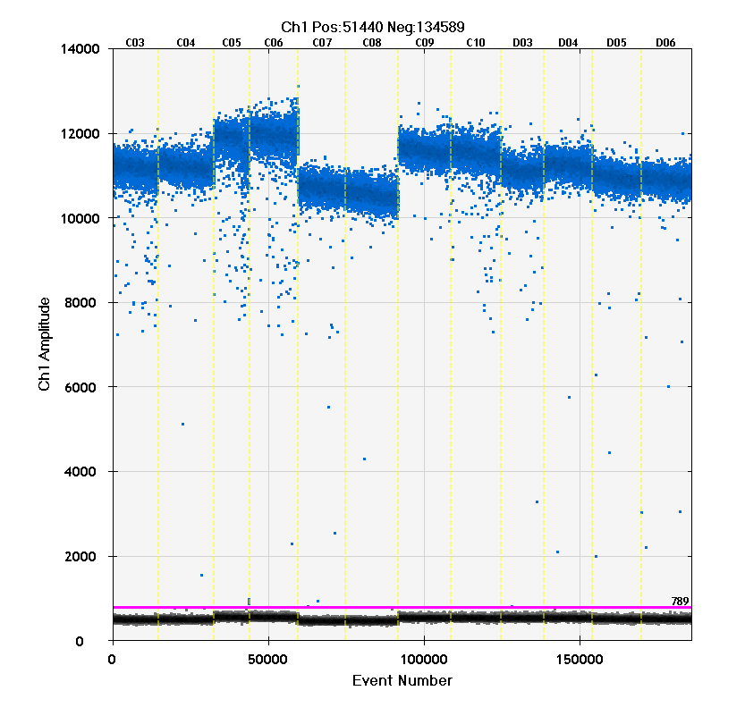
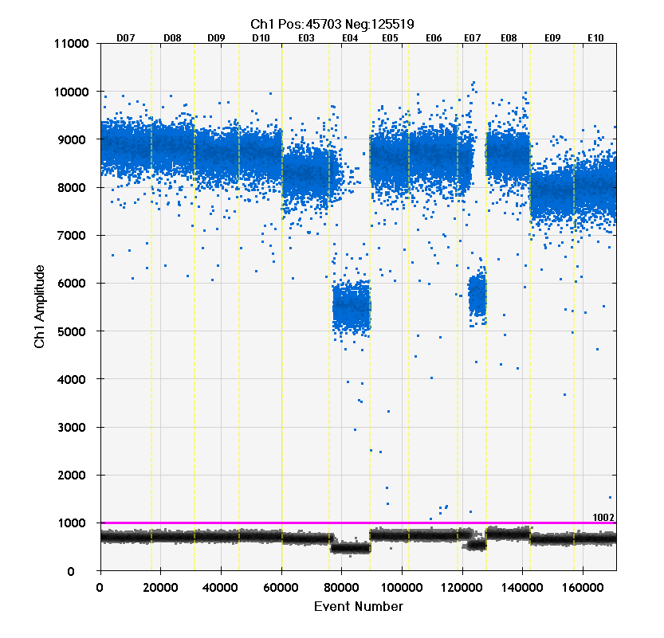
NIST4: D5, ND14, HBB1, and NEIF
Pst
Alu
Eco
Hae
TE
NIST4_Enz_dd_58_20150831
58 °C
Pst
Alu
Eco
Hae
TE
HBB1
NEIF
D5
ND14
Pst
Alu
Eco
Hae
TE
Pst
Eco
Hae
TE
ND14
NIST4_Enz_dd_62_20150901
62 °C
Failed

Slide 10
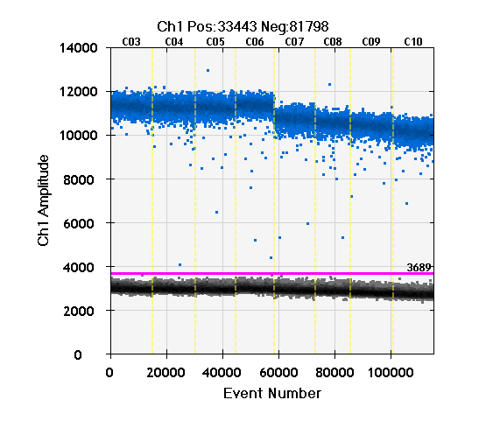
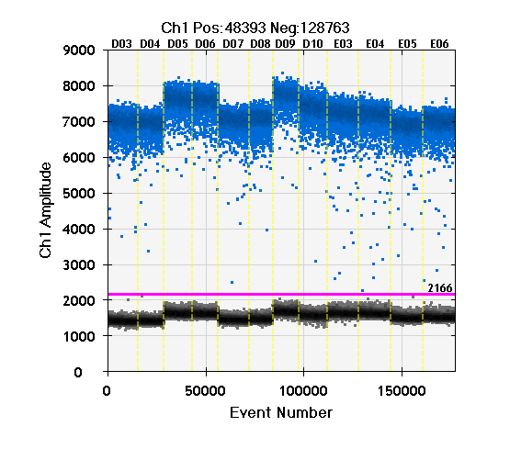
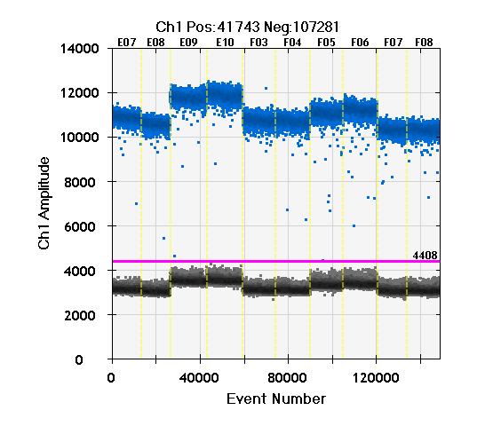
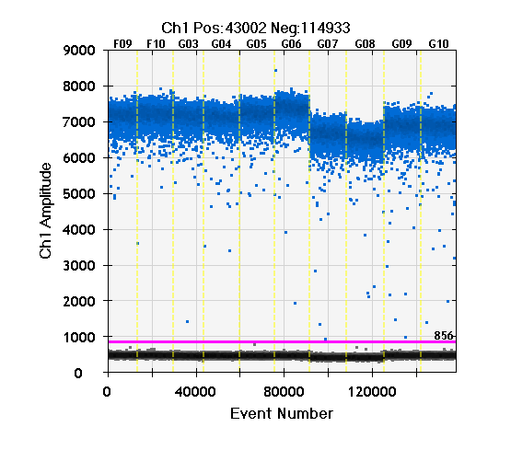
NIST4: 2PR4, NR4Q5, 22C3, and ND6
NIST4_Enz_dd_60_20150901 60 °C
Pst
Eco
TE
Pst
Alu
Eco
Hae
TE
Pst
Alu
Eco
TE
Pst
Alu
Eco
TE
2PR4
NR4Q5
22C3
ND6

