Slide 1
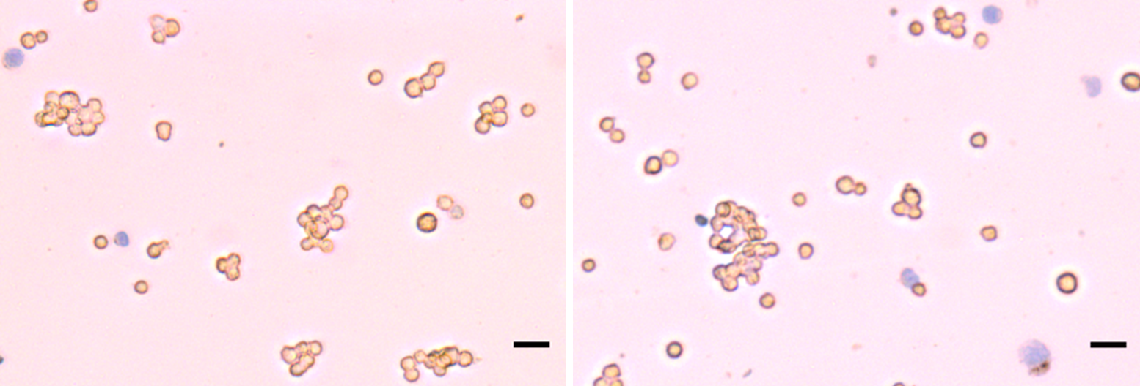
0
PP242
Supplemental Figure S1. The mTOR inhibitor PP242 (50μM) does not alter cell viability in LβT2 cells. LβT2 cells (2 X 10⁶) were treated with either vehicle (0) or PP242 (50μM) for 30 min. Cells were then suspended in a 1:1 dilution of 0.4% trypan blue solution (Thermo-Fisher Scientific). Cell density was calculated using a hemocytometer and cell viability was assayed by the trypan blue exclusion test. Percent cell viability was calculated by the following equation: (1.0 - (number of blue cells / number of total cells) x 100). Scale bar = 30 μm.
Figure S1

