Slide 1
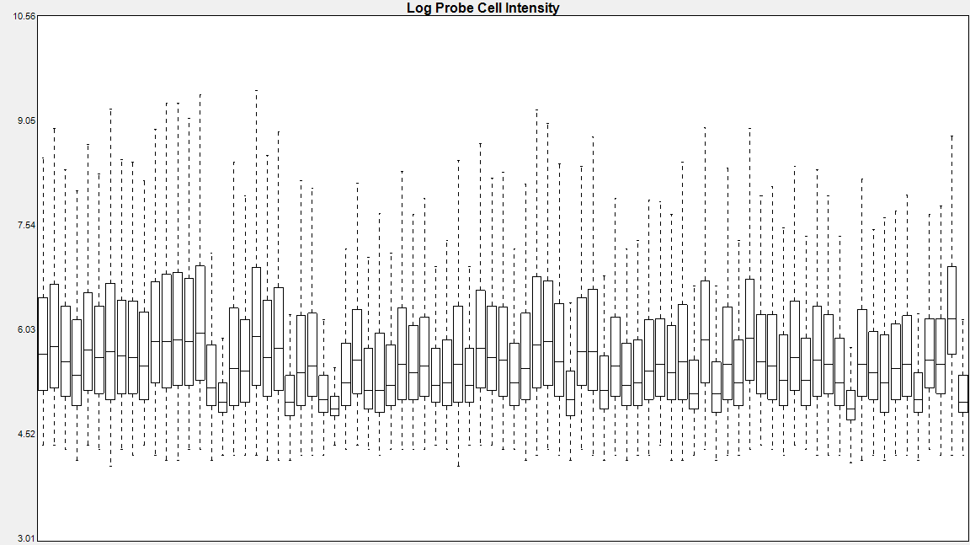
A
Supplemental figure 1.
Array samples
Patients
in the CONFIRM study
B
C
134 primary tumor
samples collected
117 primary tumors
with sufficient cellularity and RNA
112 primary tumors
passed microarray QC

