Slide 1
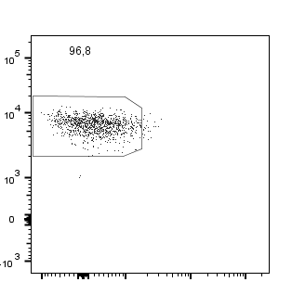
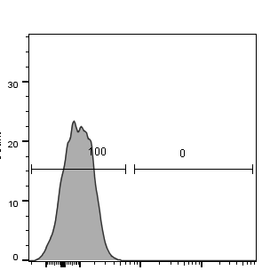
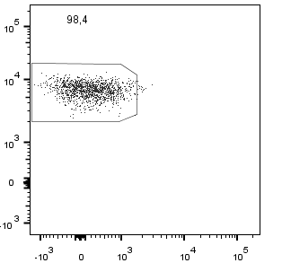
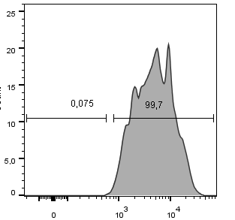


A
Memory CCR6-
CD4
Count
Memory CCR6+
CD45RA
CCR6
B
ID | ART#04 |  |  |  | ART#05 |  |  |  | ART#06 |  |  |  | ART#07 |  |  |  | ART#08
Subset | CCR6+ |  | CCR6- |  | CCR6+ |  | CCR6- |  | CCR6+ |  | CCR6- |  | CCR6+ |  | CCR6- |  | CCR6+ |  | CCR6-
RT | - | + | - | + | - | + | - | + | - | + | - | + | - | + | - | + | - | + | - | +
CCR6 cDNA
Gosselin/Wiche Salinas et al., Supplemental Figure 2

